Slide 1
LCOE/S Tool User Guide
April, 2024

Slide 2
Topics Covered
Levelised Cost Methodology
Main Assumptions and Operational Principles
Key Sheets of the Tool

Slide 3
Levelised Cost Methodology (LCOx)
LCOx is a measure of costs which attempts to compare different methods of energy generation on a comparable basis. LCOx can be regarded as the minimum constant price at which energy must be sold in order for a plant to break even over the lifetime of a project. In other words, LCOx is a method for comparing the plant-level unit costs ($/MWh) of different energy producing technologies over their lifetimes, while accounting for all types of costs related to each unit, such as capital expenditure towards equipment, operational and maintenance costs, fuel costs and others. The upsides of the LCOE metric is the provision of a comparison basis amongst entities of different characteristics, e.g. of different capacities, lifetime, cost of capital.
2 of the most commonly used calculation methodologies for LCOxs are the “Discounting” and the “Annuitising”^{1,2}.
$${LCOE}_{Discounting}^{ }=\frac{PV_{Costs}}{PV_{Outputs}} =\frac{\sum_{y=0}^{n}{\frac{C_{y}}{{\left(1+r\right)}^{y}}}}{\sum_{y=0}^{n}{\frac{E_{y}}{{\left(1+r\right)}^{y}}}}$$
$${LCOE}_{Annuitising}^{ }=\frac{{Ann}_{Costs}}{{Ave}_{Outputs}} =\frac{Capex ·\frac{r ·{\left(1+r\right)}^{n}}{{\left(1+r\right)}^{n}−1}+fO\&M+O_{c}}{\frac{\sum_{y=1}^{n}{E_{y}}}{n}}+vO\&M+F_{c}$$
Where: Present Value (PV), Total costs in year y (C_{y}), Energy Production in year y (E_{y}), Number of Investigated Years (n), Discount Rate (r), Annuitised (Ann), Average (Ave), Fixed O&M (fO&M), Other annual costs (O_{c}), variable O&M (vO&M), Fuel cost per MWh output (F_{c}). The factor multiplied to the Capex is the Capital Recovery Factor which is a ratio of a constant annuity to the present value of receiving that annuity for a given length of time. Note that in the annuitising formula, more costs can be added
The “annuitising” methodology has also been previously used for hybrid applications where storage technologies are combined with power sources³. On the whole, the two methods give the same levelised costs when the utilised discount rate is the same and the annual energy output remains constant over the lifetime of the plant. With both assumptions holding true across the present tool, the “Annuitising” methodology will be used and produce the presented results.

Slide 4
Main Assumptions and Operational Principles
The most recent version of the tool has been developed for the Indonesian TC.
The user can choose the tool’s price year. Currently, outputs reflect a 2022 price level.
A flat inflation rate of 2% is applied to bring all input data at the tool’s price level.
In an attempt to preserve a level playing field between different types of investments and maintain the undertaken comparison on a technological cost basis, a uniform Weighted Average Cost of Capital (WACC) has been utilised, rising to 10% in real terms.
The capital expenditure of each invested unit is uniformly distributed across years based on the calculated capital recovery factor (annuity).
The annual production of all units is assumed flat within their lifetime.
A color coding is present across the tool, navigating the users. For optimal use, please complete the tool on a top-down sequential manner.

Slide 5
Key Tool Sheets
Background (from TC)* (technology info) | Sheet “Costs” (fuel costs) | Sheet “LCOE-S Template” (calculation sheet)
Capex | A:AK columns: Fuel costs at selected units | Current range: C15:Z92 columns
Fixed O&M | AO:BX columns: Fuel costs at $/GJ | Color coding navigates the natural progression of inputs, starting top->down
Variable O&M |  | Generic and user specified inputs are available for the following fields: WACC, FLHs and fuel cost
Start up Costs |  | A generic figure is generated within the range B105:I129
Input Fuel Type & Cost |  | The sheet “Hybrid LCOE Tool” operates in a similar fashion, inserting the storage technology in column C, while its power source in the adjacent columns on the right
Representative Year of the Technology
Lifetime
Input to Output Efficiency
* User specified technologies can be listed at the bottom of the page with all necessary information, and the technology will be listed in the tool automatically.

Slide 6
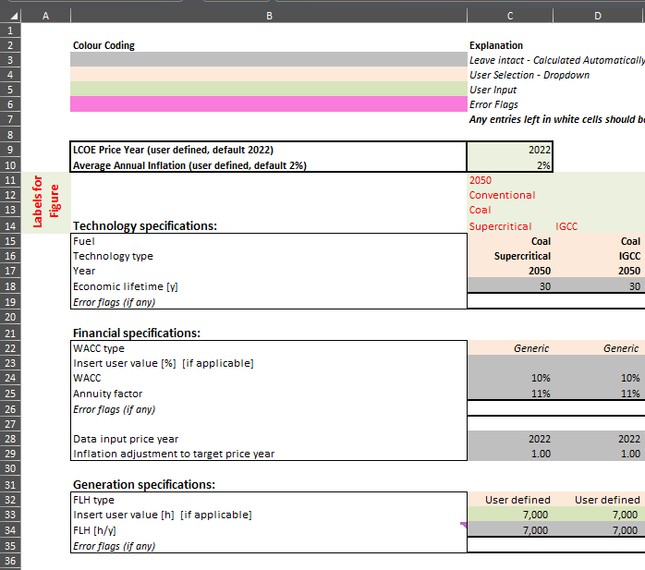
Tool Instructions (1/3)
1: User defined legend entries for the generated figure. At least 1 of the 4 rows should be populated (bottom-up priority). If the value on the adjacent left column also represents the new column, then leave blank.
2: Select from the 3 dropdown menus the fuel output, technology type and representative year.
3: Select a generic or user defined WACC value. The generic option represents the default value presented in the assumptions.
4: Select a generic or user defined Full Load Hours level. The generic option represents the default value presented in the assumptions.
1
2
3
4
* Error flags will be raised in case of combinations that do not work for the tool, e.g. if selecting a fuel and a technology that are not compatible

Slide 7
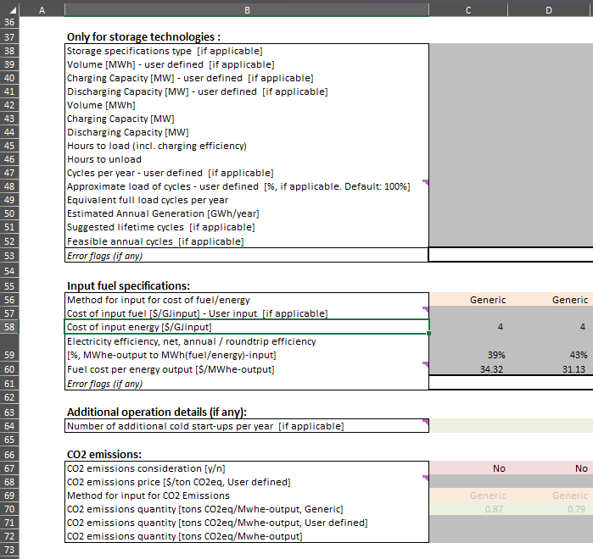
Tool Instructions (2/3)
5: Selecting storage technology properties (if applicable).
6: Select a generic or user defined fuel cost. The generic option represents the cost of the tool’s library within the sheet “Costs”.
7: Field turns green for technologies that reflect explicit start-up costs.
8: Incorporation of a CO2 emission penalty in the levelised cost calculation.
5
6
7
8

Slide 8
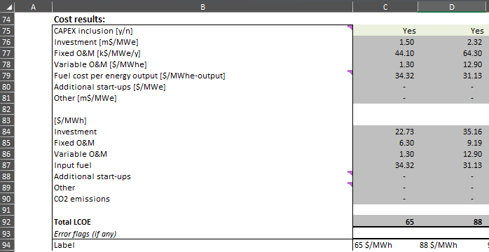
Tool Instructions (3/3)
9: Allowing for the exclusion of Capex for existing technologies, under the scope of comparing existing operational costs to new investments.
10: Automatically generated entries.
11: Final label call-out for the generated figure.
9
10
11

Slide 9
Generated figures
The tool can handle up to 24 parallel comparisons.
The automatically generated figures can include entries up to column Z. Filtering the correct entries can take place via selecting or deselecting entries from the following list:

Slide 10
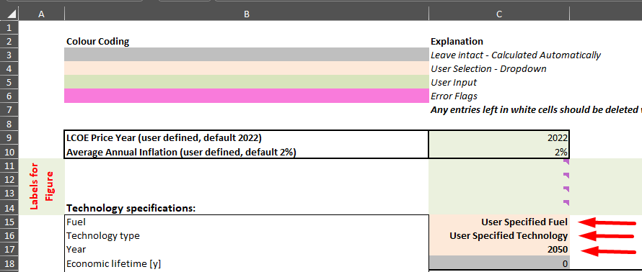
User Defined Technologies
For the inclusion of new technologies (e.g. for Capex sensitivity testing of a specific technology), the users can create their own technology at the bottom of the sheet “Background (from TC)”. Whatever fuel/technology is added at the bottom of the list will automatically show up in the tool:
Define the fuel and technology names in columns D & E.
Then populate all applicable columns from F to G and column AF. Columns T to AD are redundant for non storage technologies.
Note: Generic and user specified inputs are available for the fields: WACC, FLHs and fuel cost within the tool’s interface, without the need of a new technology addition.
Overwriting the tool’s grey cells is also an option for a quick back of the envelope evaluation, but not advised ☺

Slide 12
For any inquiry, contact:
info@eaea.dk
Check out our website or find us on LinkedIn

