Slide 1
Socio-economic analysis of a Voluntary Agreement (VA) scheme for energy efficiency in industry in Ukraine
Draft final CBA model, 24 March 2021

Slide 2
Introduction and key results
The socio-economic analysis of a Voluntary Agreement (VA) scheme for energy efficiency in industry in Ukraine includes an excel-based Cost Benefit Assessment (CBA) model of the scheme.
A preliminary version of the model was established in October 2017 during the initial analysis of a possible VA scheme for Ukraine. The model was updated in March 2021 to reflect the expected final structure of the scheme in accordance with recent political decision and take into account changes in energy prices, energy consumption and CO2 emissions.
The results show a socio-economic surplus from incentivizing enterprises to implement energy efficiency improvements under the VA-scheme. The surplus accrues to both enterprises (through energy savings) and broader society (through reductions in CO2 emissions).
Furthermore, a number of additional benefits (not quantified in the model) accrue to society, enterprises and the financial sector in Ukraine from implementation of the VA scheme.

Slide 3

Methodology
GHG Inventory and Energy Balances
Danish and EU experience data
Energy prices, energy consumption and CO2 emissions in industry
EE savings potentials, payback times and unit costs
VA scheme design parameters
Cost Benefit Analysis (CBA) model

Slide 4
Key parameters in CBA model
The model inputs describe the energy consumption and CO2 emissions, the design of the VA scheme and the socio-economic factors. To facilitate usability default values based on publicly available Ukrainian or international reference data are provided.
VA design parameters
Other assumptions
Share of industrial energy use included in VA scheme
Number of enterprises included
Number of years payback within which the VA scheme will require implementation of all identified EE measures
CO2 tax before VA scheme
Percentage reduction in CO2 tax under VA scheme
Expected energy saving under VA scheme
Average EE investment
Baseline energy consumption in industry (from GHG inventory and Energy Balance)
Industry emission factors (from GHG inventory)
Energy price in industry (weighted average price for Ukraine)
Discount rate
Exchange rate
SAEE administrative resource need
Enterprise EMS resource need
External consultants/specialists
Cost of energy audit and certification (if required)

Slide 5
Key outputs of the CBA model
Based on user selected parameters and assumptions, the model calculates:
the annual socio-economic costs and benefits for the VA scheme
the Net Present Value (NPV) for enterprises included under the VA-scheme, government and society as a whole
the required disbursements from the Decarbonization Fund
The results indicate a significant socio-economic surplus of almost 100 Mill. EUR that will result from the scheme benefitting from low administrative costs combined with energy efficiency projects with short payback periods and significant reductions in CO2 emissions.
However, the scheme will incur administrative and investment costs during the first years. The accumulated costs will be more than offset by the benefits in 2027 when the energy savings are fully phased in and the resulting CO2 reductions are realized.

Slide 6
Key outputs of the CBA model

Slide 7
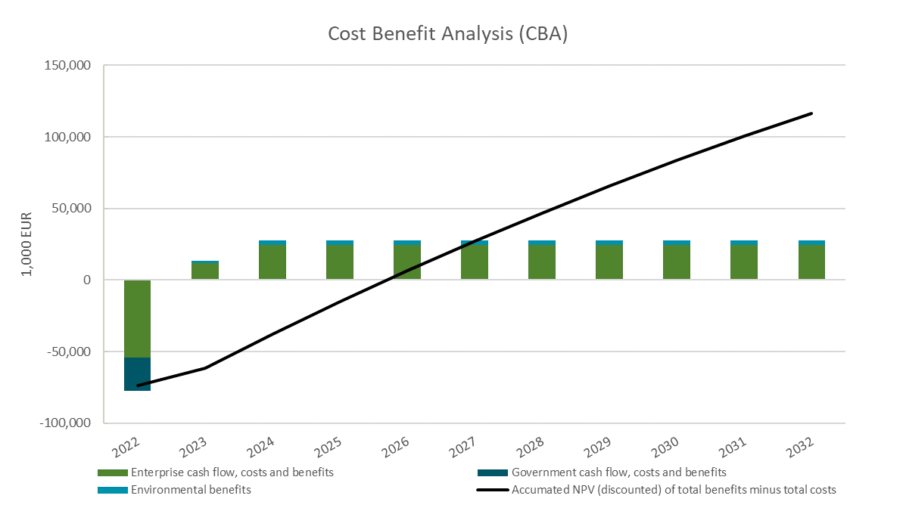
Key outputs of the CBA model

Slide 8
Additional benefits
It should be noted that the calculated NPV only includes monetized costs and benefits (i.e. costs and benefits for which a monetary value has been assigned).
A number of additional (non-monetized) benefits accrue to the stakeholders:
Enterprises - Co-benefits resulting from energy efficiency investments (reduced maintenance costs, improved process productivity, more efficient raw material use)
Financial sector - Business creation through participation in VA scheme
Society - Environmental benefits (reductions in NOx and SO2 levels and particulate emissions)
Society - Increased supply security
Society - Reduced foreign exchange spent on fuels import
Society - Job creation in enterprise EMS, energy consulting and ISO certification, as well as government administration
These additional benefits should be remembered when interpreting NPVs calculated by the model.

Slide 9
Data background and assumptions
Overview of inputs and assumptions applied in the model sheet “Cost Benefit Analysis”

Slide 10
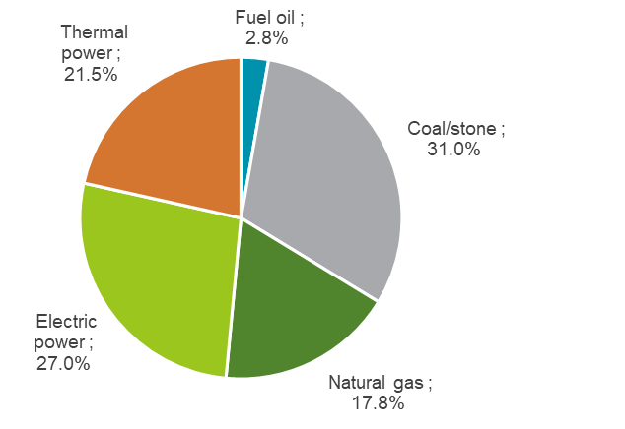
Data background and assumptions
Energy consumption by industry
Energy prices
Year | Prices (EUR/MWh equivalent)
Fuel oil | 37.2
Coal/stone | 12.7
Natural gas | 24.8
Electric power | 109.2
Thermal power | 56.9

