Slide 1
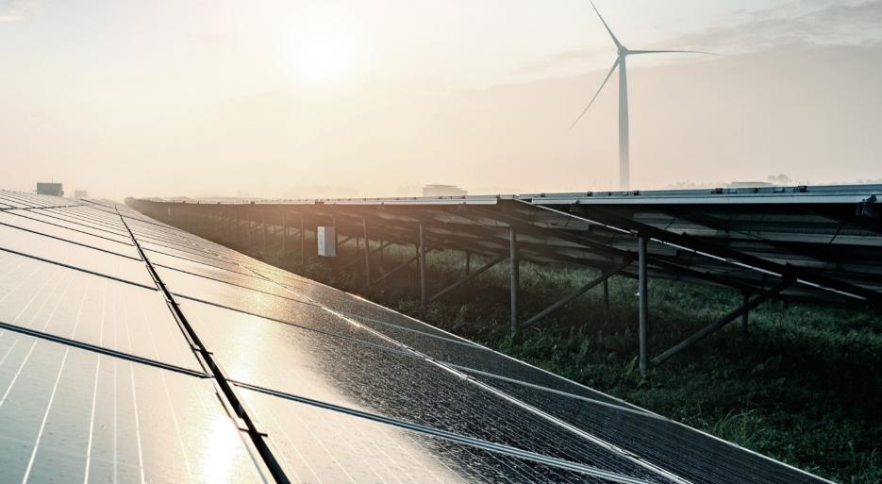

Partnering with Denmark
Ole Emmik Sørensen,
Danish Energy Agency

Slide 2
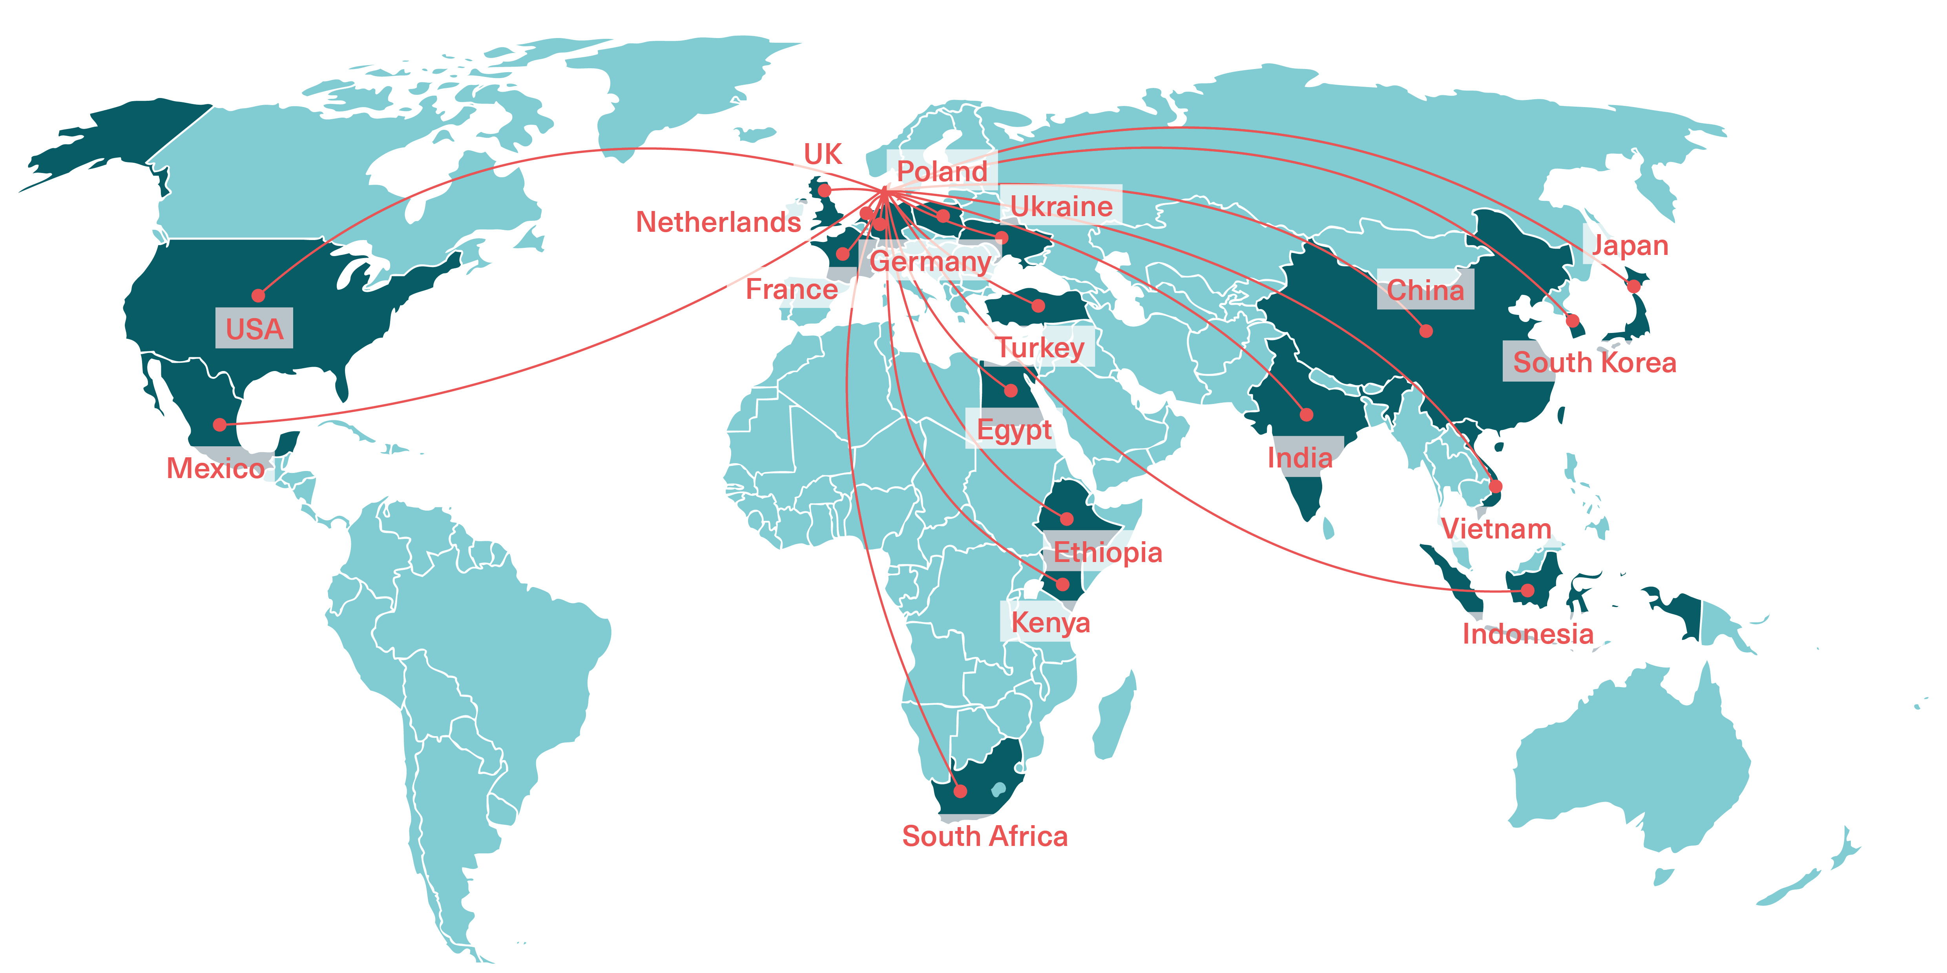
Cooperation's around the world

Slide 3
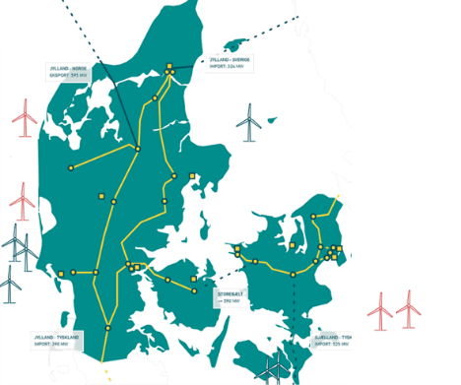
Why Denmark?
50%
Wind and solar share
in the electricity
production
70%
CO₂ reduction
in 2030
compared to 1990
99.996%
Security of supply
100%
Green electricity
by 2030
100%
Independence
from fossil fuels
by 2050

Slide 4
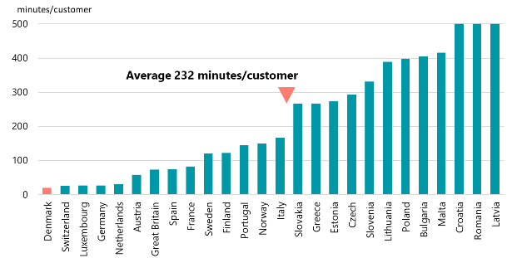
Why Denmark?
Minutes of annual outage in Europe, 2010-2016 average
Security of Supply
The highest level of security of supply in Europe
Notes: This is unplanned and planned system average interruption duration index (SAIDI) including exceptional events. Source: Council of European Energy Regulation (CEER), July 2018
Notes:
… At the same time we maintain the higheste level of security of supply in Europe and probably in the world.
So VRE does NOT jeopardize security of supply
DK: 20 mins
SWZ: 25 mins
LX: 27 mins

Slide 5
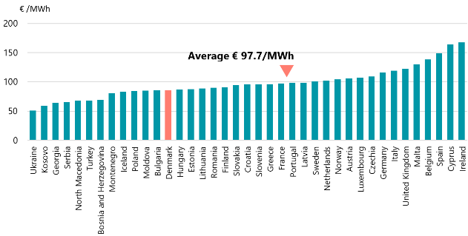
Why Denmark?
Electricity prices excluding VAT and taxes in EU, 2019 H1
Costs
Consumer prices of electricity are below average in Denmark incl. grid tariffs
Notes: This is the average price of household (annual consumption 500 kWh < consumption < 5 000 kWh) and non-household (500 < consumption < 2 000 MWh). Source: Eurostat, November 2019
Notes:
… And we still have consumer prices below average in Europe incl. system costs represented in the grid tariffs.
So Denmark is the best proof you will find that you can integrate large shares of VRE without jeopardizing security of supply and without having high consumer prices.
Baggrundsviden! Til hvis der bliver spurgt. Noget af PSOen er lagt over på finansloven så vi har desværre ikke hele VE støtten med her. Men det har de andre lande måske heller ikke.

Slide 6
Levelised cost of Electricity (LCOE), 2018
Notes:
The cheapest way to produce new powerproducing units today is wind or solar PV
But they are only cheao if they are integrated into the system

Slide 7
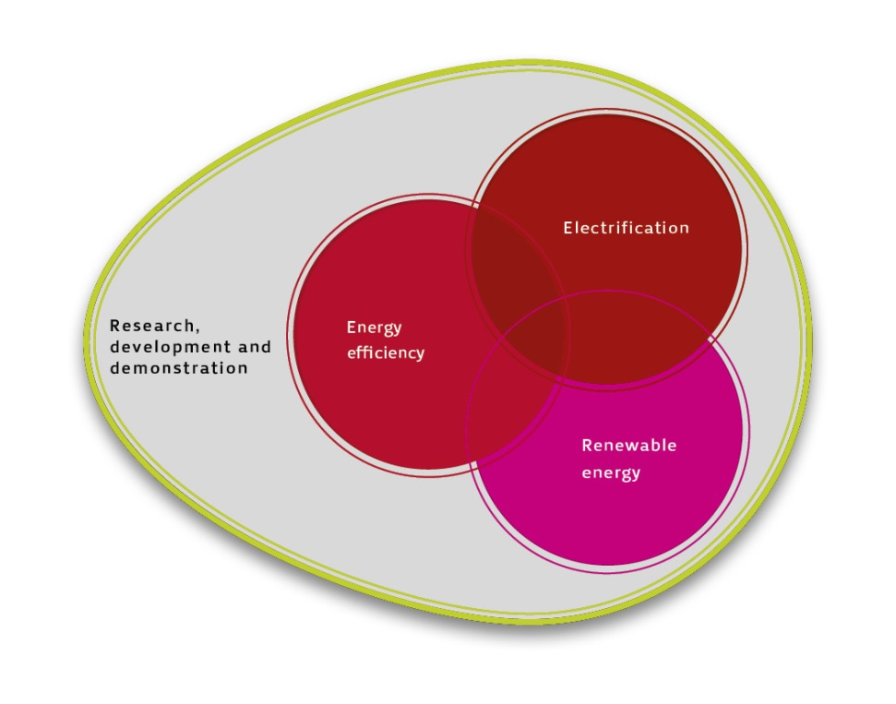
Partnering with Denmark
Power sector models
Energy scenarios and long-term planning
Technology catalogues
Integration and balancing of VRE
Power system flexibility / Power markets
District Heating – use of waste heat
Regulation of and targeted investments in energy efficiency
Offshore development

Slide 8

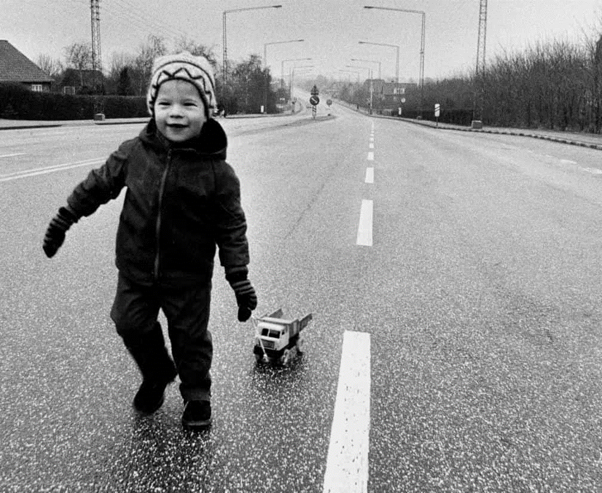

In the 1970s, the oil crisis forced us to take a long, hard look at ourselves…
OUR OWN ENERGY
CRISIS IS WHAT GOT
US STARTED
Due to the oil crisis, Denmark had car-free Sundays from 25 November 1973 to 10 February 1974
Notes:
Denmark’s energy policy took shape after the oil crises of the 1970s.
When oil prices accelerated in 1973, Denmark was among the OECD countries most dependent on oil in its energy supply.
More than 99% of all energy supply was imported oil.
The oil crisis caused a severe economic crisis, rising unemployment - and no non-commercial driving on Sundays!
As a consequence, Denmark launched an active energy policy to ensure the security of supply and enable Denmark to reduce its dependency on imported oil.

Slide 9
?

