Slide 1
Thermal Power Plants Flexibility in a Danish and International context
Dr. Mattia Baldini,
Advisor - Global Cooperation, Danish Energy Agency

Slide 2
About myself
Sharing knowledge from the Danish experience
Dr. Mattia Baldini
Advisor @ Danish Energy Agency
Background:
BsC Energy Engineering
MsC Sustainable Energy
PhD Energy System Analysis
Postdoc Feasibility of Smart Renewable Hubs
Involved in India and South Africa on integration of variable renewable energy in the system (ancillary services, thermal flexibility, trans. planning,…)

Slide 3
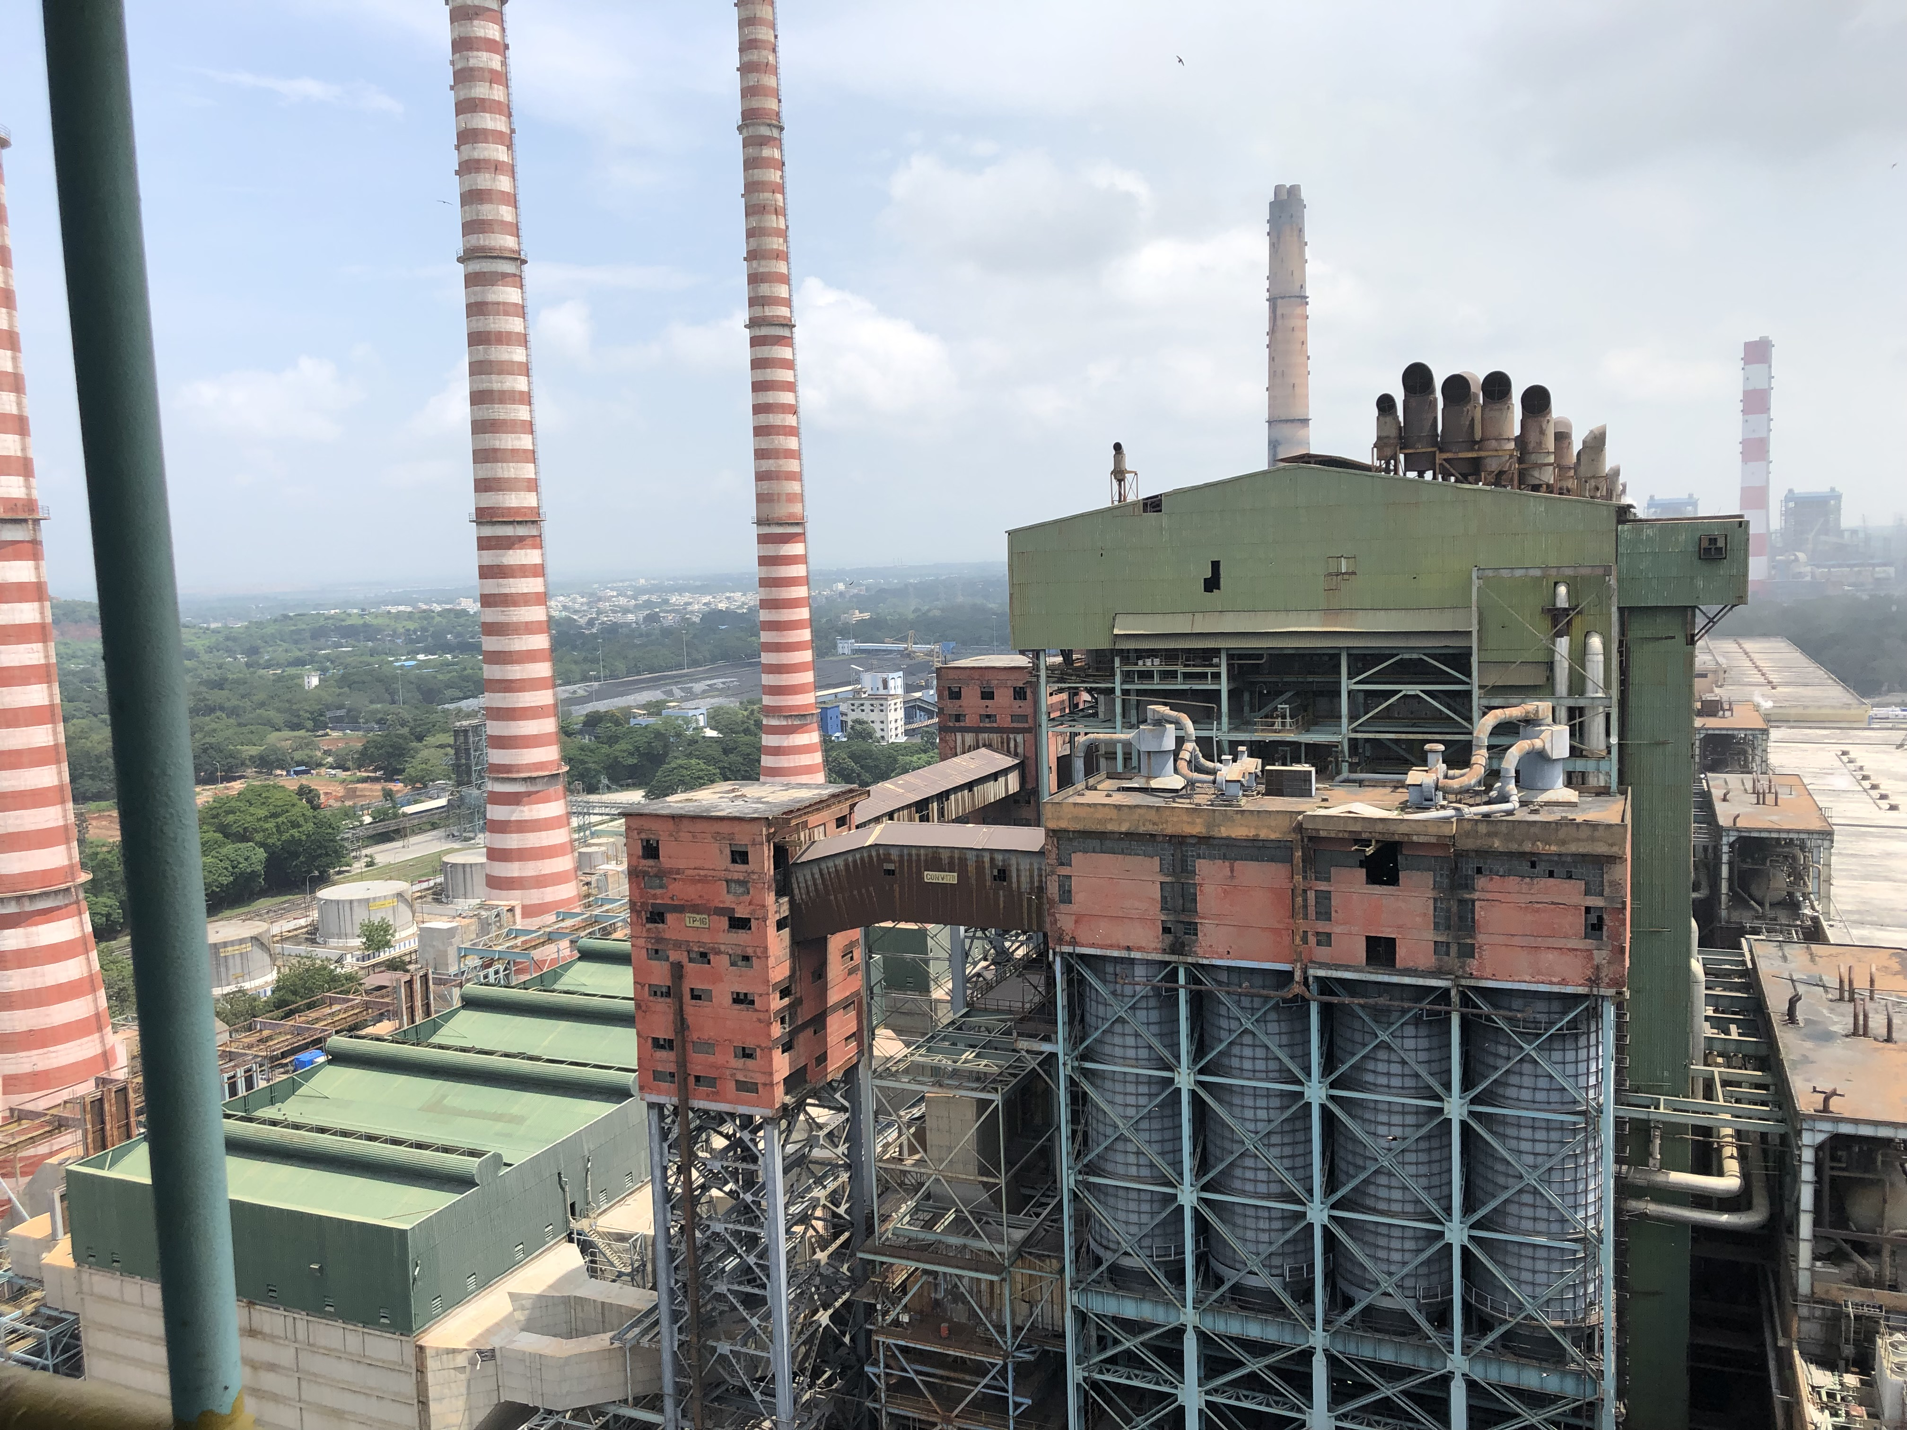
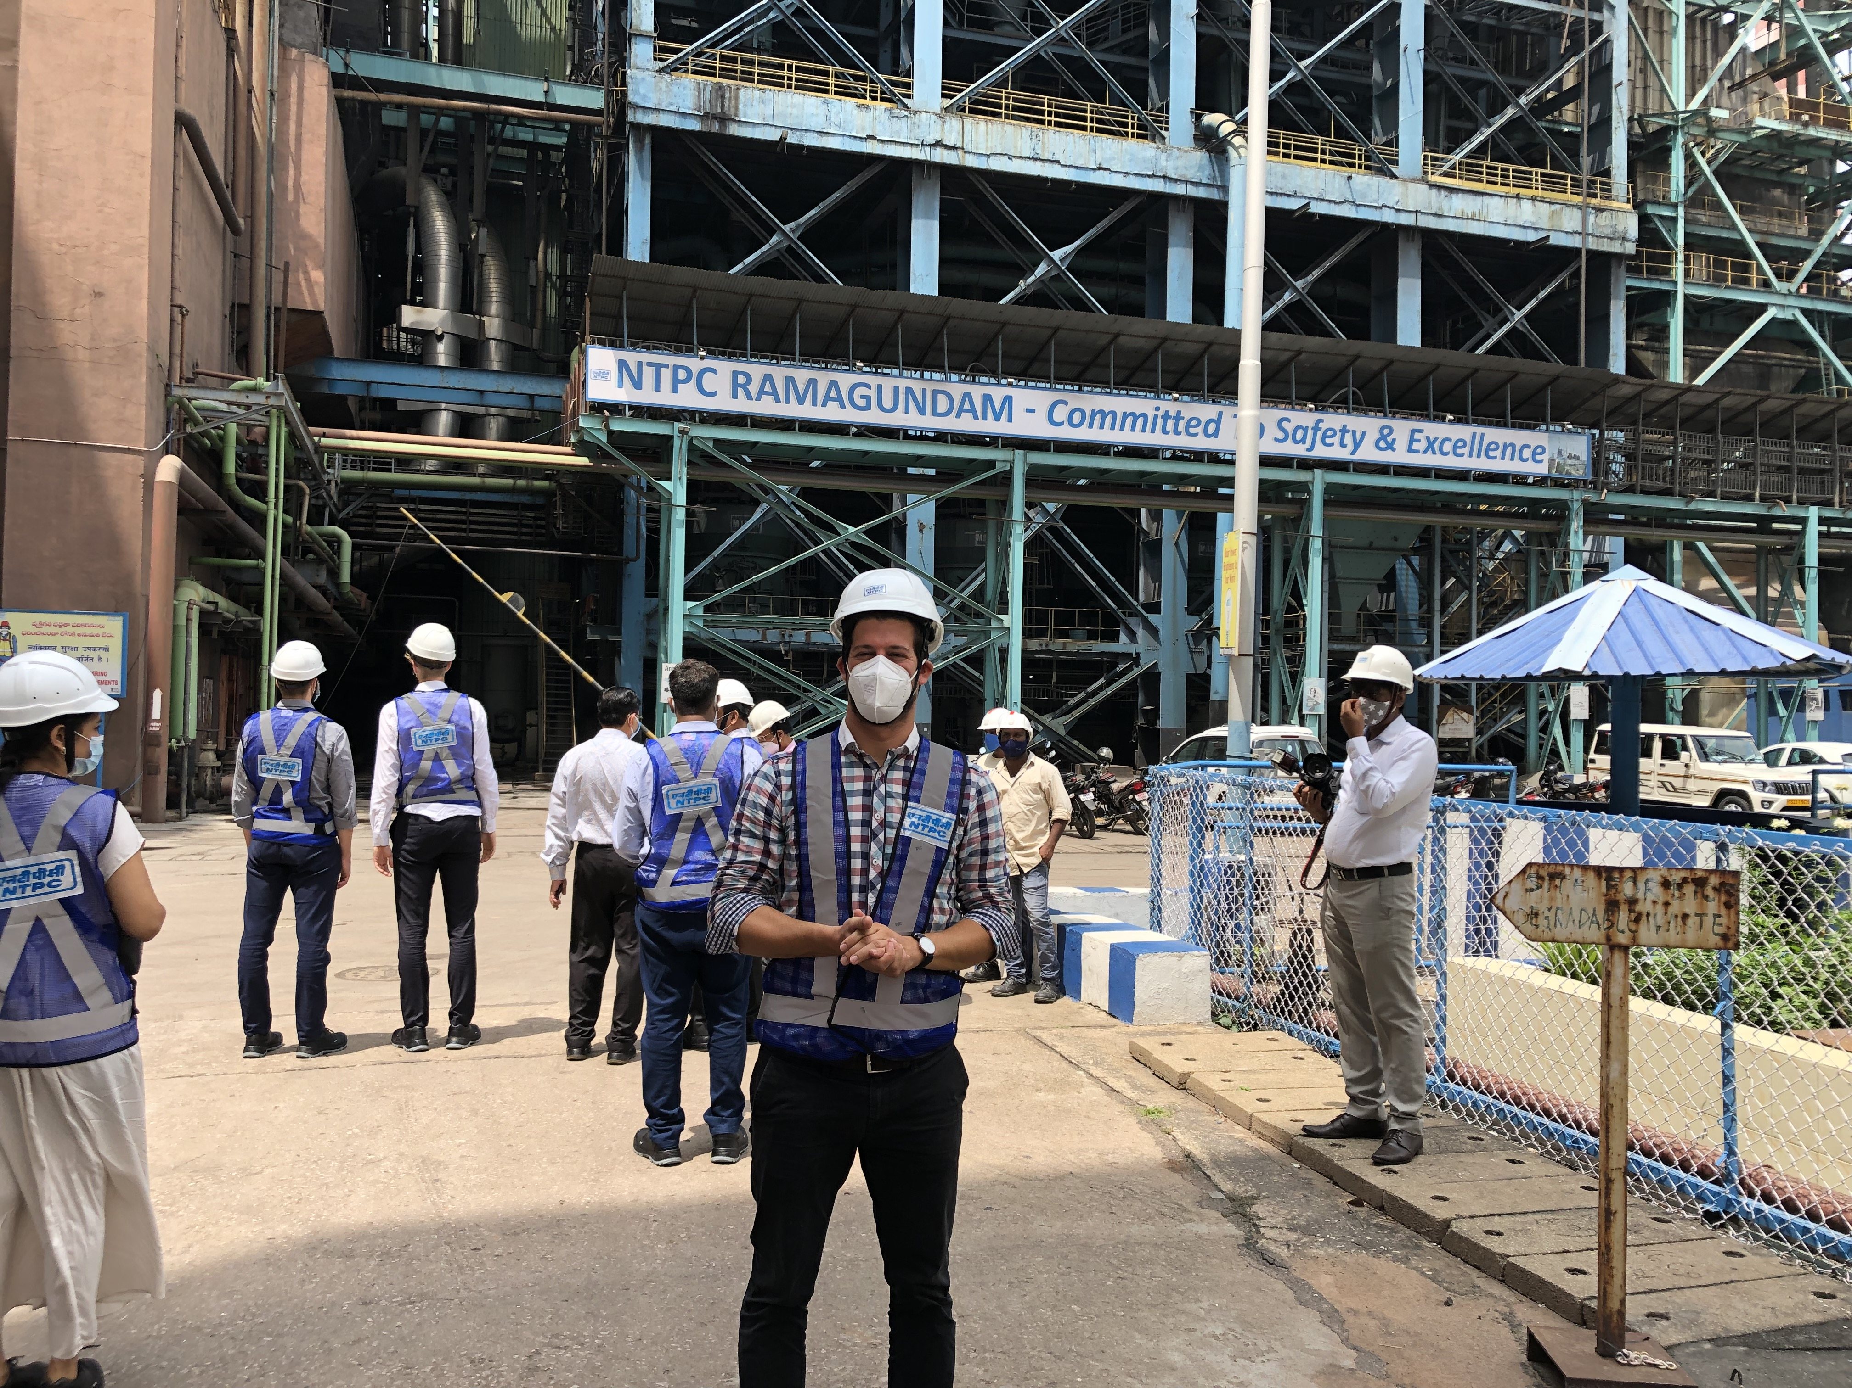
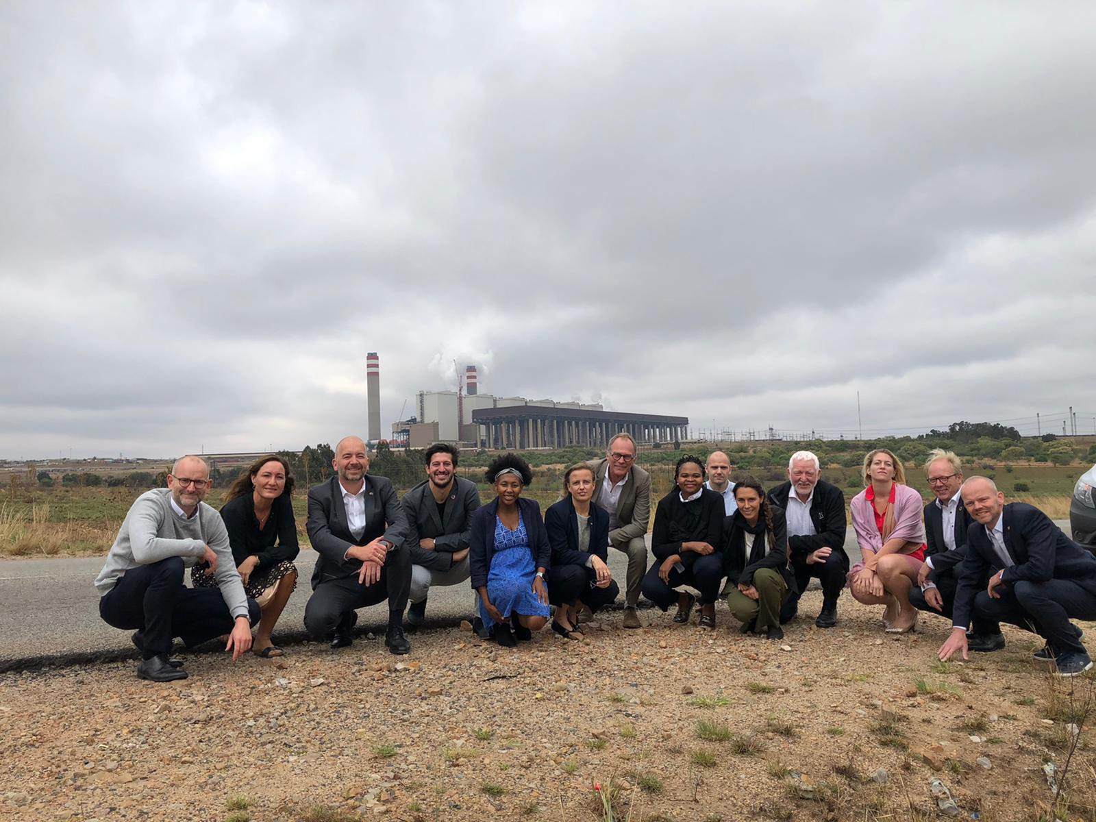
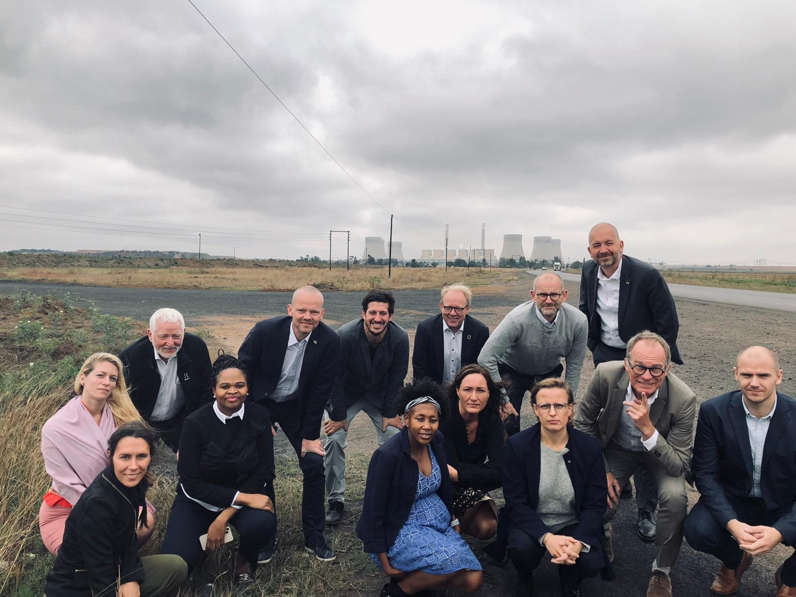
About myself
Sharing knowledge from the Danish experience

Slide 4
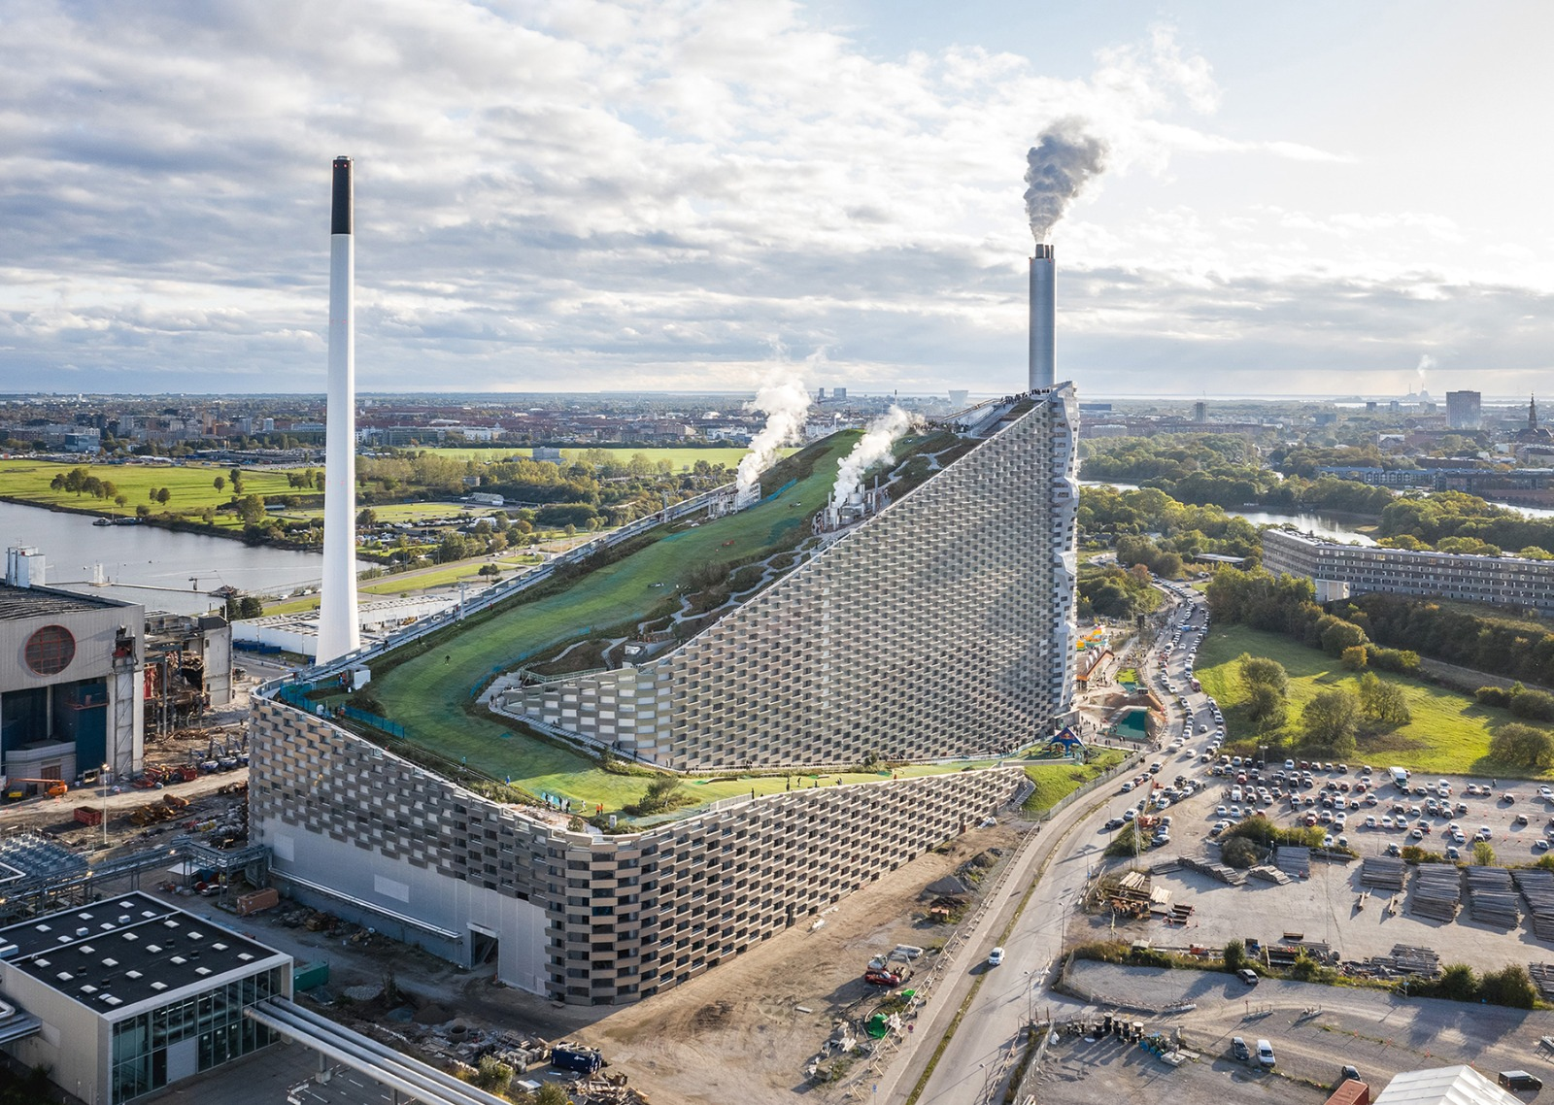
Agenda for the day
Sharing knowledge from the Danish experience
Thermal plants flexibility: conceptual definition
Thermal flexibility in the Danish energy system
International experiences:
replicating thermal flexibility in South Africa to facilitate integration of RES
Key learnings and takeaways

Slide 5
Agenda for the day
Sharing knowledge from the Danish experience
Thermal plants flexibility: conceptual definition
Thermal flexibility in the Danish energy system
International experiences:
replicating thermal flexibility in South Africa to facilitate integration of RES
Key learnings and takeaways

Slide 6
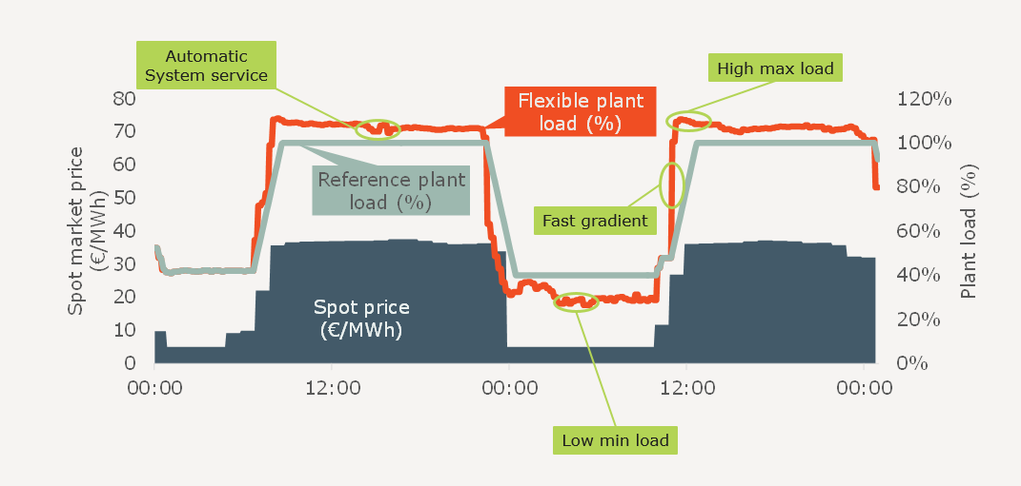
Thermal plants flexibility: conceptual definition
Notes:
Furthermore, the example highlights how the largest share of production occurred during hours of high electricity prices
(see e.g. between September the 19th and 20th),
thus exploiting the occasion to operate at higher capacity and gain revenues.

Slide 7
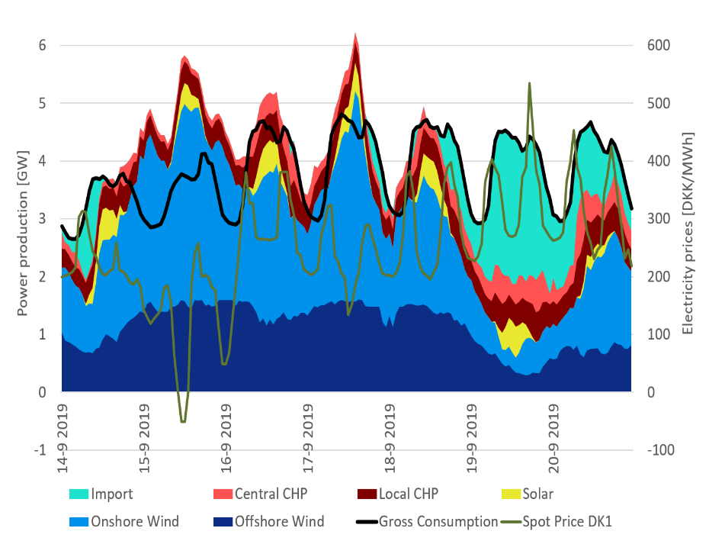
Thermal plants flexibility: conceptual definition
Conceptual definition of thermal plant flexibility:
The ability of a thermal power plants to follow the load, changing the operational constrains (e.g. ramp rates, start-ups, shut down, …) according to external inputs (e.g. fluctuating production from RES, price signals, …).
Notes:
The example week in Figure 1 clearly shows the resilient operation of the thermal power plants,
which are designed to quickly adapt their load according to the fluctuating production from VRE,
maintaining stability in the system.
Furthermore, the example highlights how the largest share of production occurred during hours of high electricity prices
(see e.g. between September the 19th and 20th),
thus exploiting the occasion to operate at higher capacity and gain revenues.

Slide 8
Agenda for the day
Sharing knowledge from the Danish experience
Thermal plants flexibility: conceptual definition
Thermal flexibility in the Danish energy system
International experiences:
replicating thermal flexibility in South Africa to facilitate integration of RES
Key learnings and takeaways

Slide 9
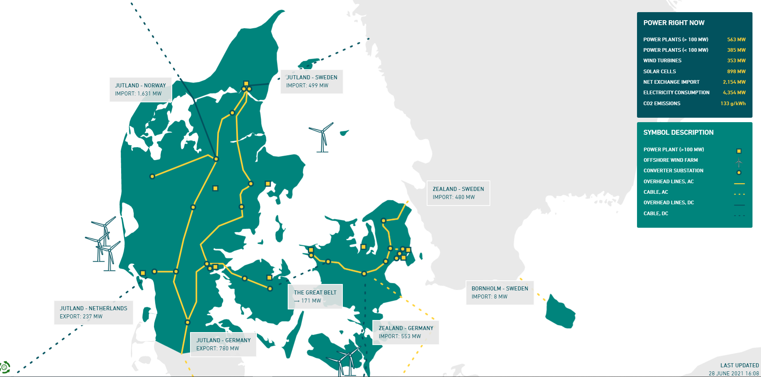
Thermal flexibility in the Danish system
Integration of RES
The Danish power systems is characterized by large flexibility and manages to integrate increasing levels of RES in the power system through:
market design,
grid codes
forecast and dispatch
thermal power plant flexibility
interconnectors and transmission planning
Download Report

Slide 10
Thermal flexibility in the Danish system
Technical characteristics of Danish Power Plants:
Min load 20-35%
Rampings 4-8% nom load/min
Notes:
The example week in Figure 1 clearly shows the resilient operation of the thermal power plants,
which are designed to quickly adapt their load according to the fluctuating production from VRE,
maintaining stability in the system.
Furthermore, the example highlights how the largest share of production occurred during hours of high electricity prices
(see e.g. between September the 19th and 20th),
thus exploiting the occasion to operate at higher capacity and gain revenues.

Slide 11
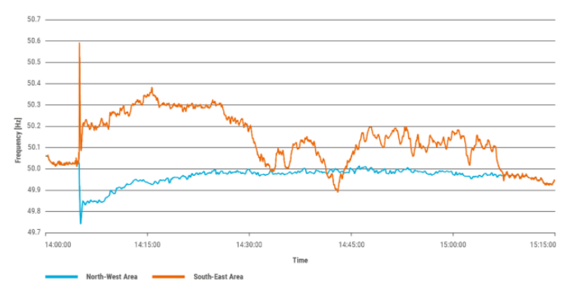
Strenghts of the Danish power sector
Toolbox for efficient RES integration
Strong transmission grids and interconnectors
International electricity markets
Flexible thermal power plant fleet
Stability through grid codes and dynamic resources
Specialised forecasting, operational planning and dispatch

Slide 12
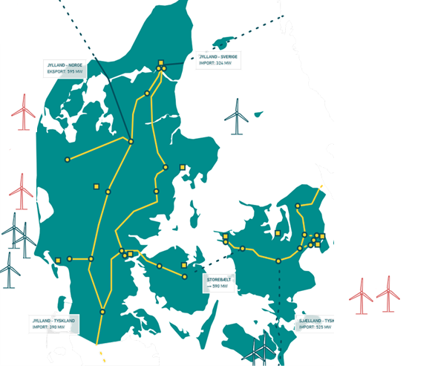
Why Denmark?
The Green Energy Transition
>50%
Variable renewable
electricity
production
(2020)
99.997%
Security of
supply
Flexible Power Plants
35%
Minimum load
capability
4%/min
Ramp rates
(grid codes)
100%
Green electricity
by 2030
70%
CO2 reduction
by 2030
Source: Dansk Energi

Slide 13
Agenda for the day
Sharing knowledge from the Danish experience
Thermal plants flexibility: conceptual definition
Thermal flexibility in the Danish energy system
International experiences:
replicating thermal flexibility in South Africa to facilitate integration of RES
Key learnings and takeaways

Slide 14
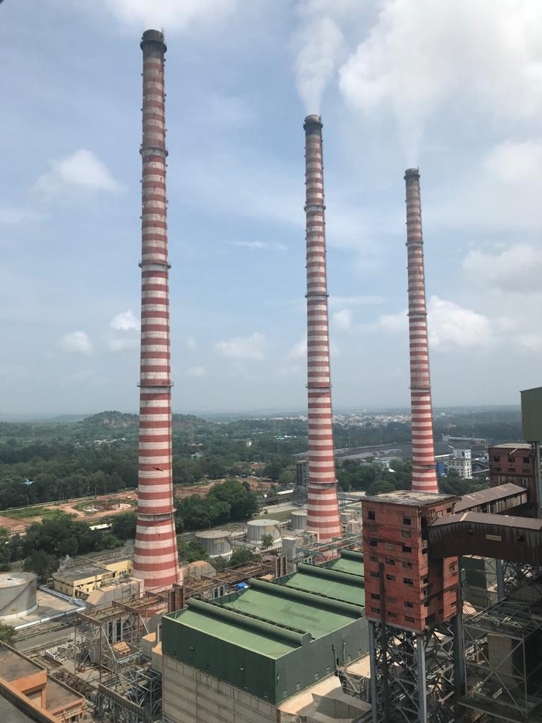
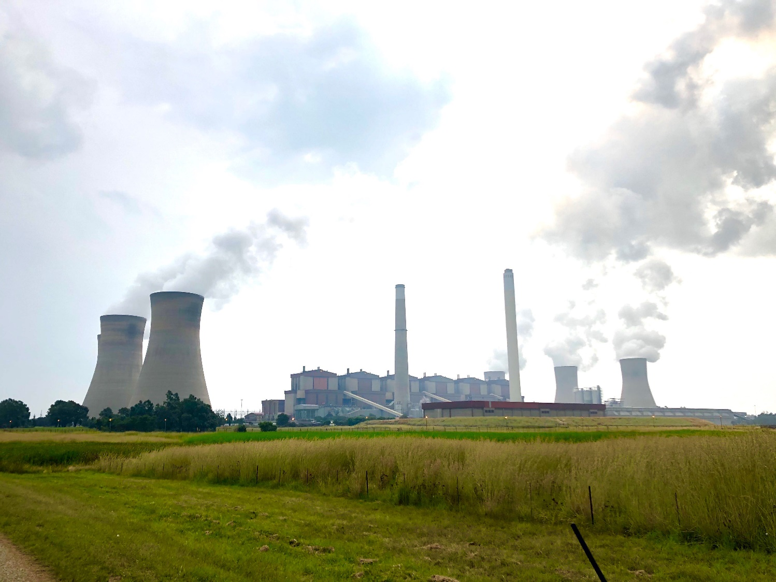
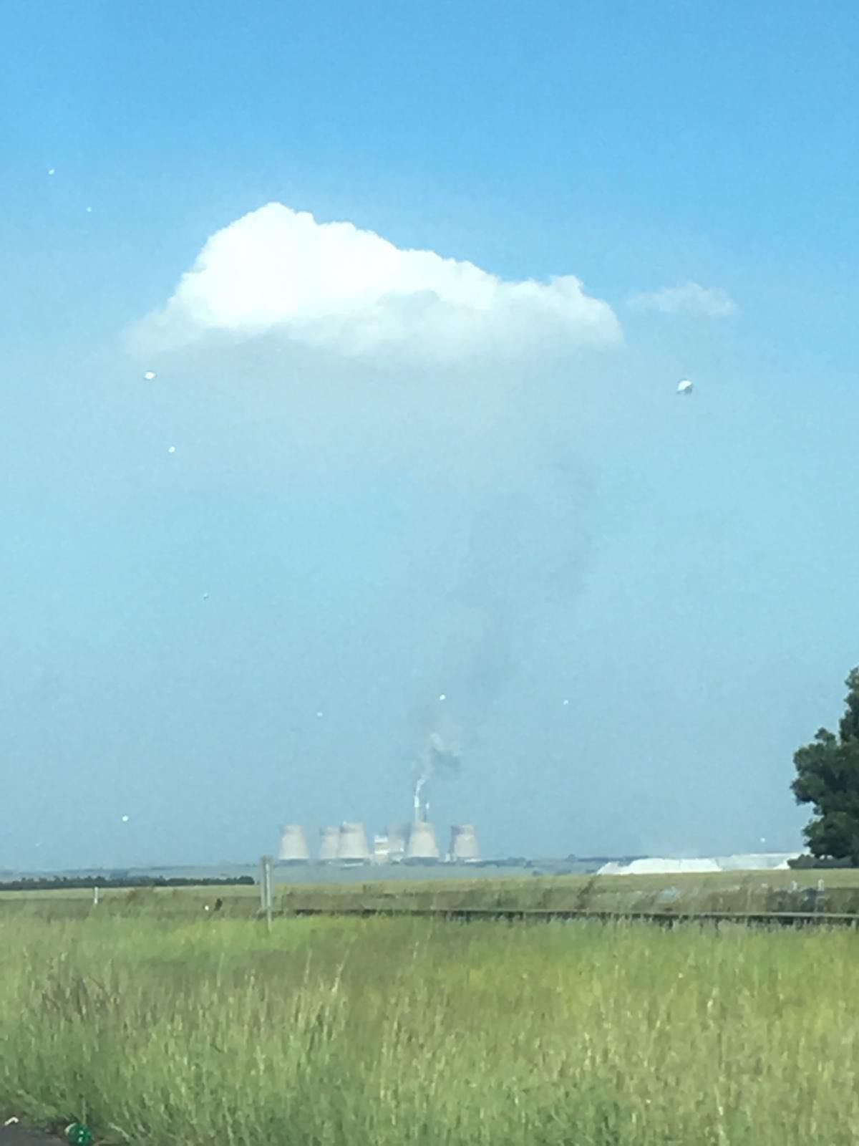
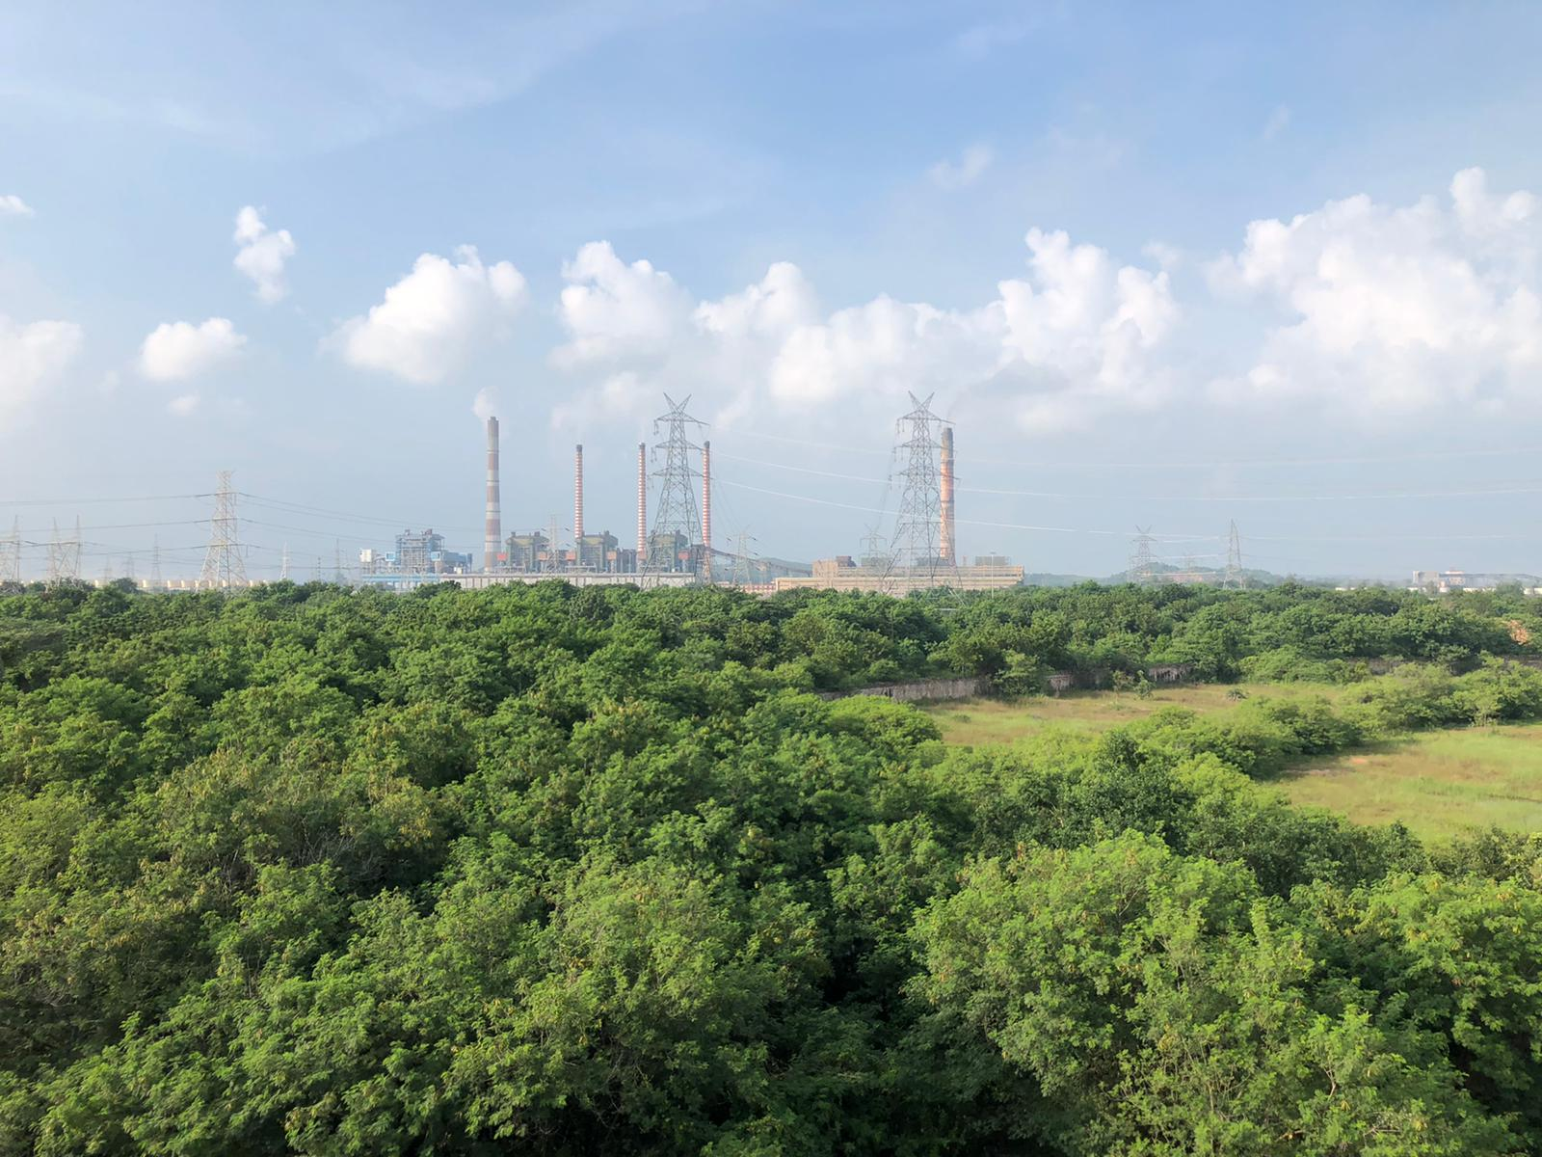
Thermal flexibility in South Africa
International knowledge sharing experiences
Knowledge sharing experiences in South Africa (Danish Energy Agency and Danish Experts)
Large potential for enhance flexibility of the thermal fleet

Slide 15
Thermal flexibility in South Africa
International knowledge sharing experiences
What drove the need for thermal flexibility in the SA context?
Status of the energy system
Motivation for South Africa: ambitious target for the energy sector
Challenges
Approaches to develop thermal flexibility

Slide 16
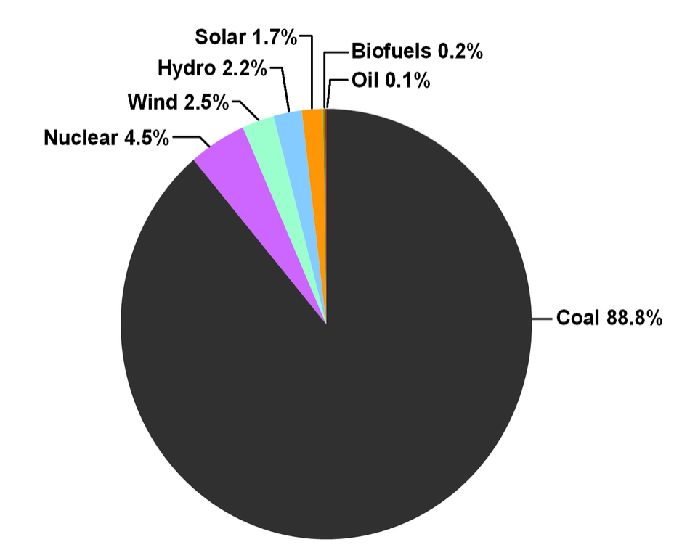
Thermal flexibility in South Africa
International knowledge sharing experiences
What drove the need for thermal flexibility in the SA context?
Status of the energy system
227 TWh of electricity in 2018
88.8% from coal-fired thermal plants
Low share of RES (~4%)
Low use of interconnectors for electricity supply
Electricity production in South Africa in 2018 by sources (Source: IEA)

Slide 17
Thermal flexibility in South Africa
International knowledge sharing experiences
What drove the need for thermal flexibility in the SA context?
Motivation for South Africa: ambitious target for the energy sector
REIPPP-> 7GW of RES by 2050
Integrated resource plan (IRP) and National Development Plan (NDP)
diversification of the power mix
decommission of coal (35GW by 2050)
reduce GHG emissions while addressing poverty and inequality
RES emerging quite fast -> large needs for flexibility

Slide 18
Thermal flexibility in South Africa
International knowledge sharing experiences
What drove the need for thermal flexibility in the SA context?
Challenges (hindering power plant flexibility potential)
Delicate power system (load-shedding) -> plants are needed (not available for tests)
No short term/ancillary service market -> missing incentives
Current maintenance level and operation approach of the plants
Existing direct regulation might dissuade development of flexibility
Limited experience on operating the power plants at lower minimum loads with enhanced flexibility and out of the current boundary conditions

Slide 19
Thermal flexibility in South Africa
International knowledge sharing experiences
What drove the need for thermal flexibility in the SA context?
Approaches to develop thermal flexibility
Regulation:
Incentives and measures for enhancing flexibility through grid codes based on the Danish experience
Technical:
Modelling studies
Minimum load generation tests at Power Plant Units

Slide 20
Thermal flexibility in South Africa
International knowledge sharing experiences
Technical/Modelling studies:
Main findings:
Short window for coal plant flexibility in South Africa (pay back time) in short term
More opportunities for medium-long term (decommissioning?)
Other technologies are competing for flexibility (e.g. gas)
Refurbishment came in as a precondition for retrofits (low min load/ramp rates), but yields interesting results
Substitute for expensive gas and close gaps supply-demand (less load shedding)
Annual savings from refurbishments 351-842 million USD/year in short- to medium-term
5 GW economic potential for retrofitting coal power plants for flexibility
Can give annual savings between 4-21 million USD/year

Slide 21
Thermal flexibility in South Africa
International knowledge sharing experiences
Technical/Minimum load tests:
Focus on power station (6x 600 MW units)
Creation of a core team supported by Danish experts via trainings
Systematic and comprehensive test procedures for units
Night/weekend min load tests (Stable reduction and operation at min.load)
Lowering min-load for thermal fleet (50% load reduction)

Slide 22
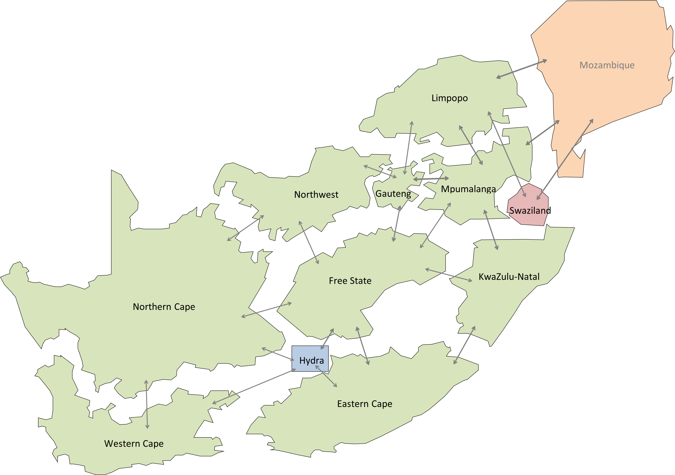
Thermal flexibility in South Africa
International knowledge sharing experiences
Technical/Minimum load tests:
Key conclusions:
Projected savings: 225.000 t CO2/year
Test procedures can be replicated in other coal plants
Autonomous tests on min. load in daily operation (unplanned “tests”, forced by operational constraints)
“Tests" demonstrated the learnings from the tests, as well as the ability and willingness to replicate autonomously low load in other units
Core team educate/instruct other engineers and thermal power plant operators to increase skills and confidence in operating plants flexibly.
Regulation needs to be improved (incentives/grid codes)

Slide 23
Agenda for the day
Sharing knowledge from the Danish experience
Thermal plants flexibility: conceptual definition
Thermal flexibility in the Danish energy system
International experiences:
replicating thermal flexibility in South Africa to facilitate integration of RES
Key learnings and takeaways

Slide 24
Take-home messages
International knowledge sharing experiences
What are the steps for realising thermal flexibility in the power system?
Realize the (current/future) needs for flexibility -> the sooner the better
Investigate the potential from existing options
Test the limits: how low is low?
Look at the long term need/impact of interventions
Establish the framework conditions for fostering flexibility:
Regulatory (grid codes)
Technical
Economical (incentives)

Slide 25
Take-home messages
Sharing knowledge from the Danish experience
Thermal plants flexibility is essential for the transition to energy systems largely based on RES
The existing asset has an un-explored potential
Technical challenges can be tackled with the proper trainings.
The valuable learnings can then be replicated in the rest of the fleet
A mix of regulatory and technical interventions are required to foster flexibility of thermal power plants

Slide 26
Take-home messages
Sharing knowledge from the Danish experience
How to incentive thermal plants flexibility?
(lower minimum load, higher ramp rates, …)
National technical regulations (e.g. grid codes)
Market influence
Self-adaptation from plant owners (in DK limit of 35%min load and 4% ramp removed in 2017 -> facility owners had learned)

Slide 27
Thank you
Tak for i dag.

