Slide 1
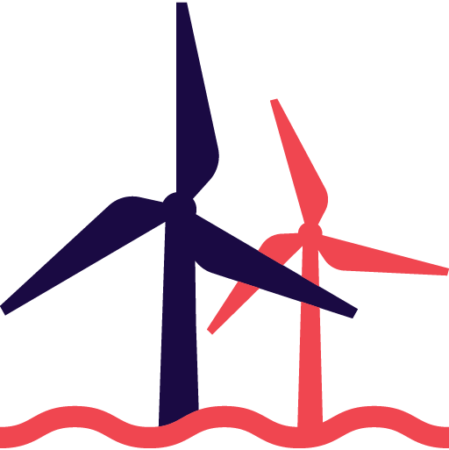
EKF Denmark’s Export Credit Agency: Financing offshore wind
Colombia
/Patrick R. Jakobsen
Copenhagen October 2021
Offshore and Project Finance
Notes:
Forside rødt logo (billede)

Slide 2
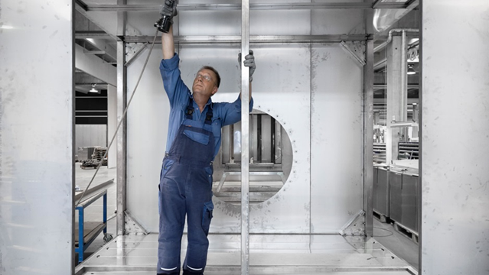
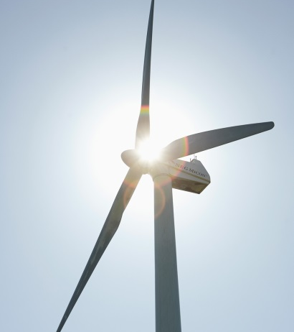
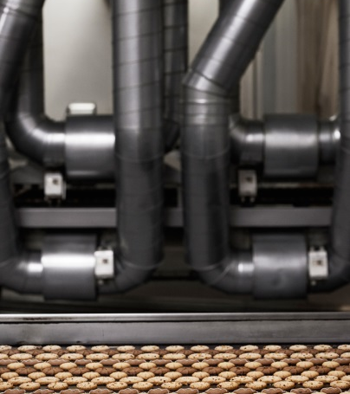
About EKF
Denmark´s official export credit company
Nearly 100 years of experience
Owned and guaranteed by the Danish state
Operates on commercial terms

Slide 3
EKF leads the world in wind financing
EKF Denmark’s Export Credit Agency is one of the world’s most experienced financial partners in wind financing and the world’s leading export credit agency in the field
Since our first transaction in 1998, we have helped finance more than 150 wind farms in more than 35 countries all over the world
So far, we secured finance for +25 GW of installed capacity (12.8 GW onshore and 12.4 GW offshore)
1 – 6 GW
251-999 MW
1-250 MW
0 MW
Onshore: 12.8 GW
Offshore: 12.4 GW
Project finance: 18.9 GW
Buyer credit: 6.3 GW
As of March 2021

Slide 4
EKF & The Offshore Market

Slide 5
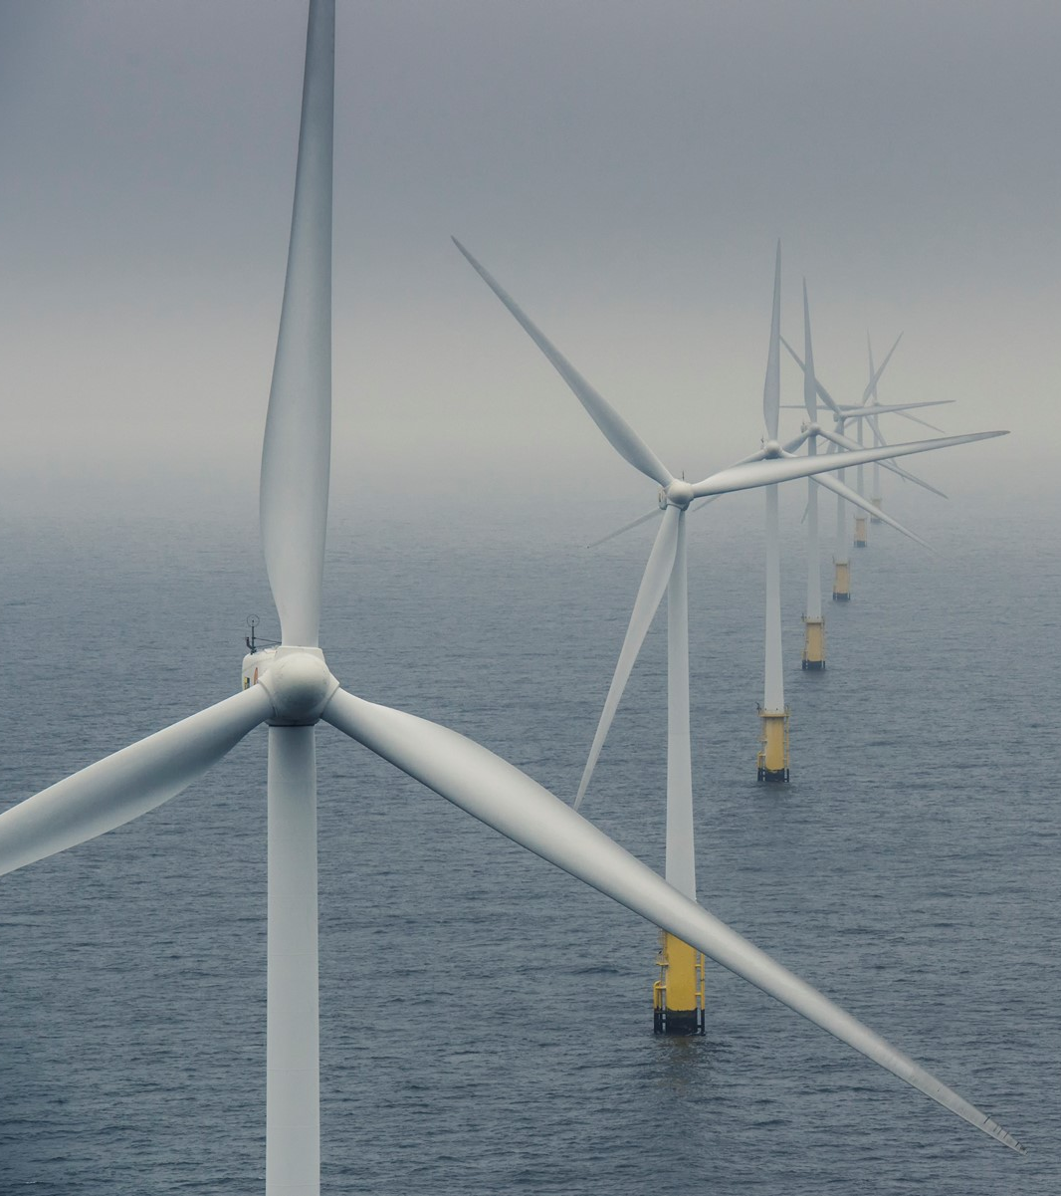
EKF has been involved in financing what equals to almost 30% of total offshore wind capacity!
Offshore wind co-financed by EKF
Installed Projects co-financed by EKF:
7.3 GW**
Total Globally installed capacity, excl. China:
25.4 GW*
Projects under construction co-financed by EKF:
4.8 GW
*Source: GWEC YE2020.
**Incl. Corporate Credit Guarantee – London Array 630MW and PF Nearshore - Westermeerwind 144MW
© MHI Vestas Offshore Wind
Notes:
Almost 1/3 of offshore capacity excluding China. China has no or only limited international financing. If you add the projects under construction where EKF has been involved it gets close to half of the installed GW in the world.

Slide 6
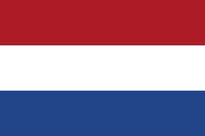
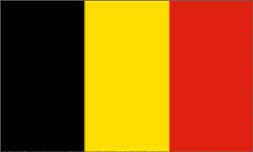



Size of offshore wind projects has increased (EKF post-COD projects)
Q7
2006
ENECO
130 MW
Vestas WTG´s
€ 380m
Belwind
2009
Parkwind
165 MW
Vestas WTG´s
€ 610m
EIB/Rabo
C-power
2010
EDF + oth´s
295 MW
Repower WTG´s
€ 1300m
EIB
Meerwind
2011
3 Gorges + oth´s
288 MW
Siemens WTG´s
€ 1270m
KfW IPEX
Northwind
2012
Parkwind + oth´s
216 MW
Vestas WTG´s
€ 850m
EIB + oth´s
Butendiek
2013
WPD
288 MW
Siemens WTG´s
€ 1300m
EIB
Gemini
2014
Northland + oth´s
600 MW
Siemens WTG´s
€ 2800m
Santander +oth´s
Veja Mate
2015
CIP + oth´s
402 MW
Siemens WTG´s
€ 1900m
Santander/KfW
Nobelwind
2015
Parkw+ oth´s
165 MW
MVOW WTG´s
€ 620m
EIB
Beatrice
2016
SSE + oth´s
588 MW
Siemens WTG´s
€ 2550m
EIB
Rentel
2016
Otary
309 MW
Siemens WTG´s
€ 1100m
EIB
Norther
2016
ENECO + oth´s
370 MW
MVOW WTG´s
€ 1150m
EIB
Walney Ext
2017
Ørsted
659 MW
MVOW/SGRE
€ -m
Macquaire
Formosa 1
2018
JERA + oth´s
128 MW
SGRE WTG´s
€ 705m
BNP
Hornsea
2018
Ørsted
1218 MW
SGRE WTG´s
€ -m
CITI Bank
Northwester2
2018
Parkwind/Sumitomo
219 MW
MVOW WTG´s
€ 650m
EIB
Seamade
2018
Otary, OW, Eneco
487 MW
SGRE WTG´s
€ 1300m
KfW IPEX

Slide 7
Future projects are even bigger
(EKF projects under construction)
Moray East
2018
Ocean Winds + oth´s
950 MW
MVOW WTG´s
€ 2540m
Norinchukin + oth´s
Yunlin
2019
WPD
640 MW
SGRE WTG´s
€ 2790m
Mizuho + oth´s
Formosa 2
2019
Macquarie, JERA + oth´s
376 MW
SGRE WTG´s
€ 2260m
Taiwan Life, MUFG + oth´s
NNG
2019
EDF/ESB
448 MW
SGRE WTG´s
€ 1790m
Santander + oth´s
CFXD
2020
CIP + oth´s
600 MW
MVOW WTG´s
€ 3200m
SMBC + oth´s
Seagreen
2020
SSE/Total
1140 MW
MVOW WTG´s
€ 2750m
SMBC + oth´s
Greater Changhua
2021
Ørsted
605 MW
SGRE WTG´s
€ -m
Taiwan Life, Cathay+ oth´s

Slide 8
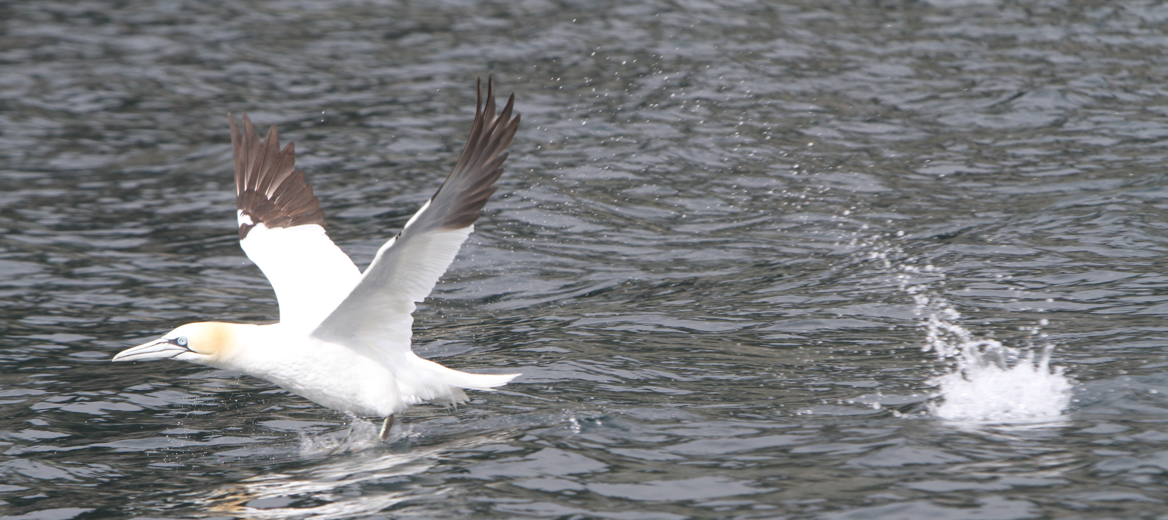
Case:
Neart na Gaoithe
NnG
Structure
Chart at
EDF
EDF
New Sponsor
Financial Close
Energy
Renouvables
TBC
EKF
      Location
Scotland, UK
      Owners
EDF (50%), ESB (50%)
      Lenders
24 international commercial banks
      Financial close
Nov, 2019
      Project Tenor
3 + 15.5years
      Total investment
GBP 2.14bn
      EKF share
GBP 250m
(14.6% of senior debt), of which 40% reinsured.
      Size
54 * 8.4 MW > 448 MW
      Turbines
Siemens Gamesa (SGRE) (SG-8.0-167)
      Offtake Type, Strike Price, Tenor
Contract for Difference (CfD), GBP 130/MWh (2019 prices), 15 years
49%
51%
100%
EDF R UK
3 Banks,
covered
24 Banks,
50%
tranche
commercial
tranche
NnG
Holding Company
50%
Ltd
14.6%
85.4%
Equity og
shareholder
loan
Senior
debt
20%
80%
TSA agreement with
NnG
Offshore Wind Ltd
Offtaker
Siemens
Gamesa
(SPV)
Agreement with
EDF Energy
CfD
Agreement
Management
with LCCC
EPCI
O&M
Services
Saipem
SGRE
EDF R UK

Slide 9
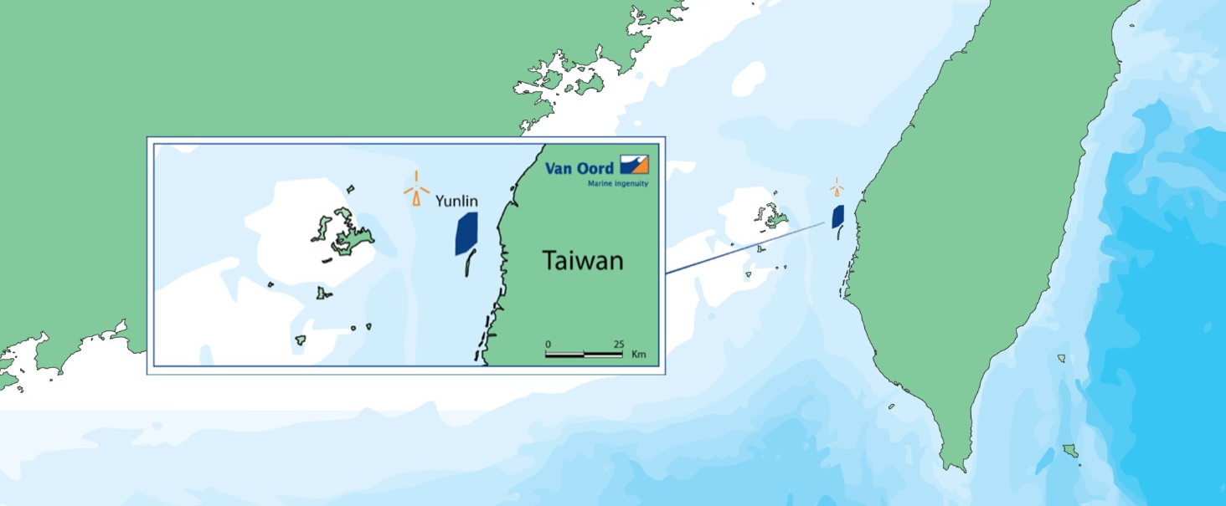
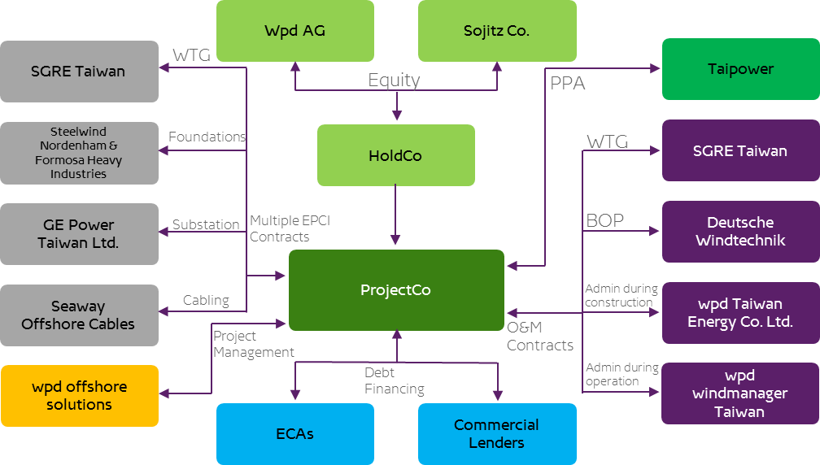
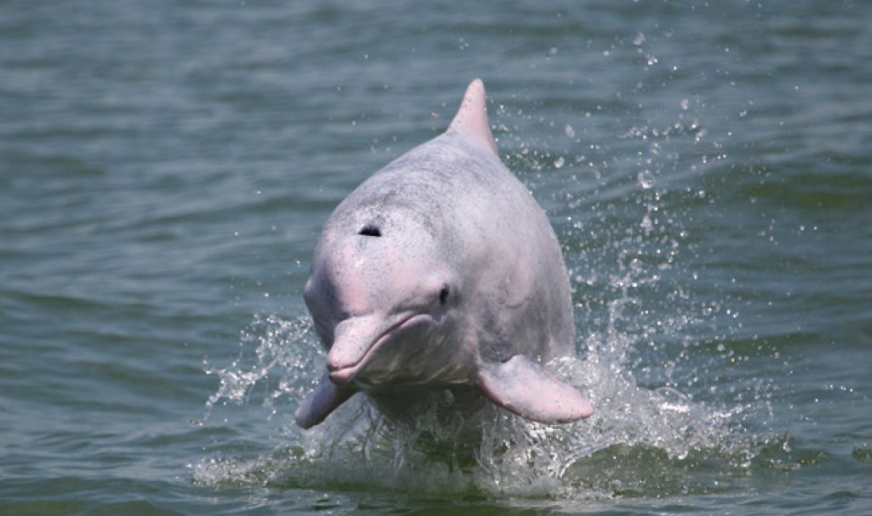
Case: Yunlin
      Location
Taiwan
      Owners
Wpd (73%)
Sojitz Corp. (27%)
      Lenders
18 various International and local banks
3 ECA’s
      Financial close
June 2019
      Project Tenor
2.5Y + 15.5Y
      Total investment
NTD 97,073m (USD 3,190m)
      EKF share
USD 500m (25% of senior debt), of which 75% is reinsured
      Size
640MW
      Turbines
8.0-167 SGRE
      Offtake Type, Strike Price, Tenor
Taipower,
NTD/MWh 7,117.7/3,568.5 (10Y/10Y)
20Y

Slide 10
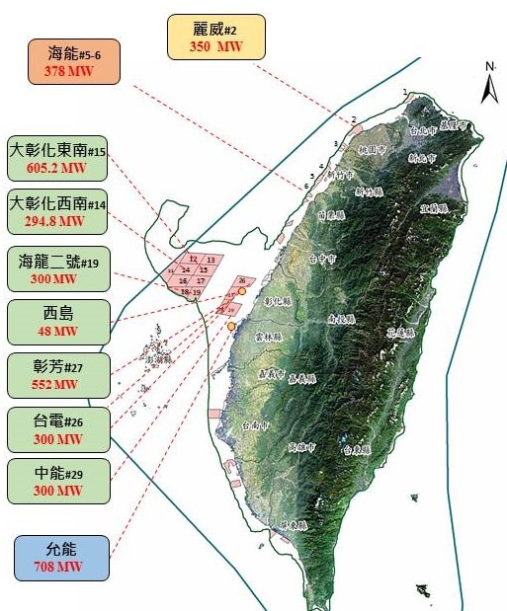
Offshore: From Europe to the whole world
Current market
Future market

Slide 11
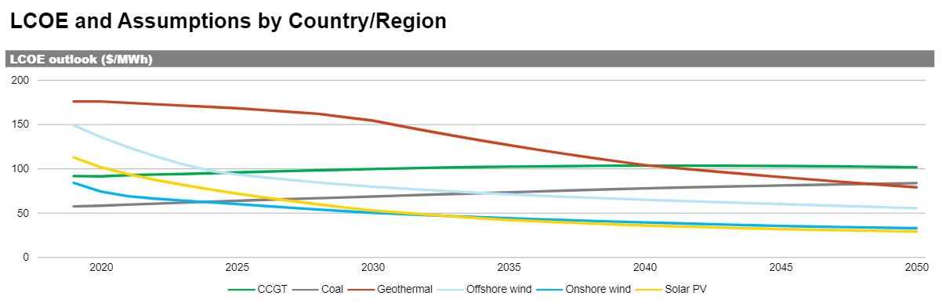
Levelized cost of electricity, Taiwan
Levelized cost of electricity, offshore wind, Taiwan, 2020-2050. Source, IHS Markit, 2021

Slide 12
Risk &
Due diligence

Slide 13
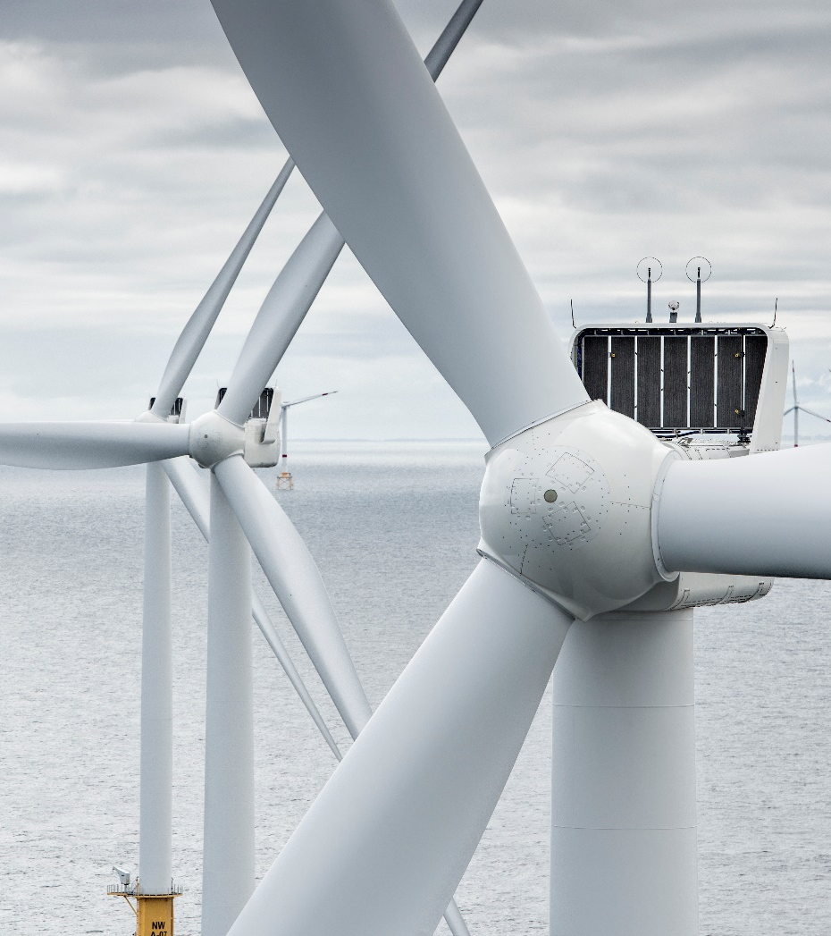
Due diligence
& Risk
Off take study One or two independent
Legal Security, offtake, permit/licence, law, loan documentation etc.
Technical O&M, turnkey, site, contract etc.
Insurance Market standards etc.
Environment Compliance – EQ/IFC PS
© MHI Vestas Offshore Wind

Slide 14
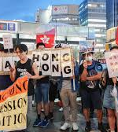
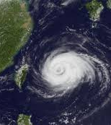
Taiwan Risk - new
Earthquake
Typhoon
Pink Chinese dolphin
Country risk
PPA risk – Direct Agreements/Bankability
Mitigation: Sponsor, Technology, Design, Banks, General law, Risk country I and ECAs.

Slide 15
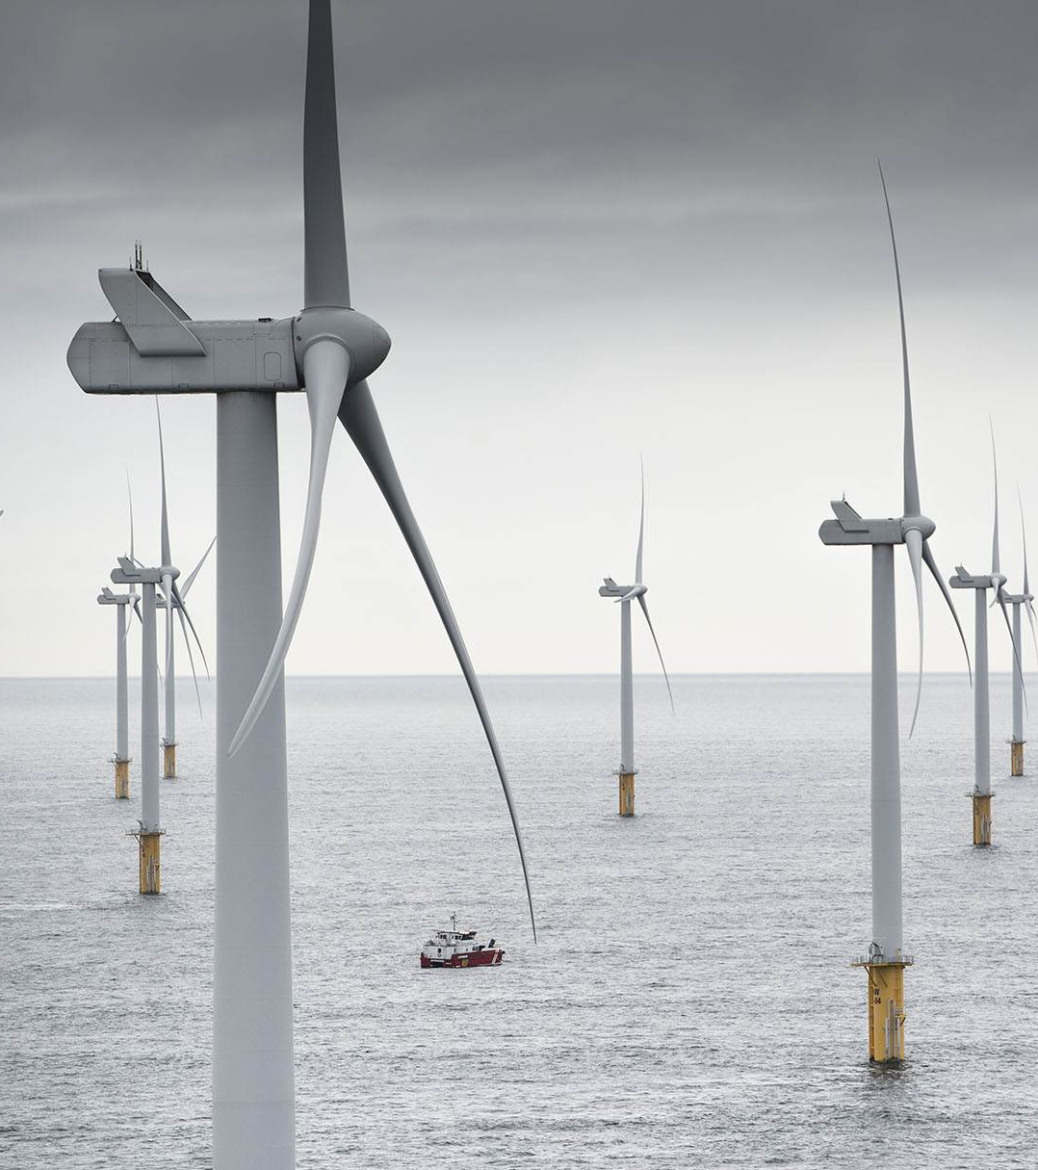
What we bring
Great experience in offshore project finance: Flexible, reliable and well connected
Up to 80% of senior debt – in offshore typically:
25-50% of senior debt
Max. exposure per transaction:
USD 800 million
Local currency:
EKF can look into guaranteeing loans in non-hard currencies
Market pricing
Full Due Diligence including documentation risk
© MHI Vestas Offshore Wind

Slide 16
Investment guarantee
Notes:
Investment guarantee

Slide 17
Investment Guarantee
What does Investment Guarantee cover?
Advantages of Investment Guarantee
Application
Investments abroad
An Investment Guarantee enables you to invest in subsidiaries and expand in countries with political instability.
It will be easier for you to gain access to bank financing because EKF assumes the main part of the political risk.
EKF will pay compensation if political problems resulting in loss to your company should arise in the country.
In the event of loss and claims are to be recovered, the demand for payment is backed by the Danish government.
Cover
Loss caused by political unrest
Guarantee percentage (of the bank´s loss) up to
95%
Amount
Unlimited
Credit period up to
15 years
Notes:
INVESTMENT GUARANTEE

Slide 18
Questions?

