Slide 1
From black to green – a Danish sustainable energy growth story
A case study of how an energy utility can transition from fossil fuels to renewable energy, and the enabling regulatory framework that made it possible
Danish Energy Transition Initiative
Colombia - Denmark
11th October 2021
Dr. Mattia Baldini
Danish Energy Agency
Connect. Inspire. Share. Think Denmark
Notes:
Thank you chair and thanks to all participants for the introduction.
Today I would like to share some experience from the Danish green transition, and specifically how one state-owned energy company transitioned from black to green energy while remaining profitable. I would like to share lessons learned relating to the regulatory framework that made it possible.

Slide 2
From both the policy- and energy company-side:
Agenda
Timeline of events
Learnings
Recommendations
Report can be found here: https://ens.dk/sites/ens.dk/files/Globalcooperation/sog_fromblacktogreenreport_210x297_v08_web_spreads.pdf
Connect. Inspire. Share. Think Denmark
Notes:
I will present findings from a report published on the 28th of May, which was done by the Danish Energy Agency and State of Green. There are three sections to the report, namely, timeline, to take you through a historical journey of the Danish energy sector, learnings from that journey, and finally recommendations for countries willing to make a green transition of the energy sector, which I know South Africa is one. For each of these three sections, i will present from both the policy-side and the company-side. This format has been chosen to show the concrete business decisions as they relate to policy development, as obviously energy companies do not operate in a bubble separate from policy developments.

Slide 3
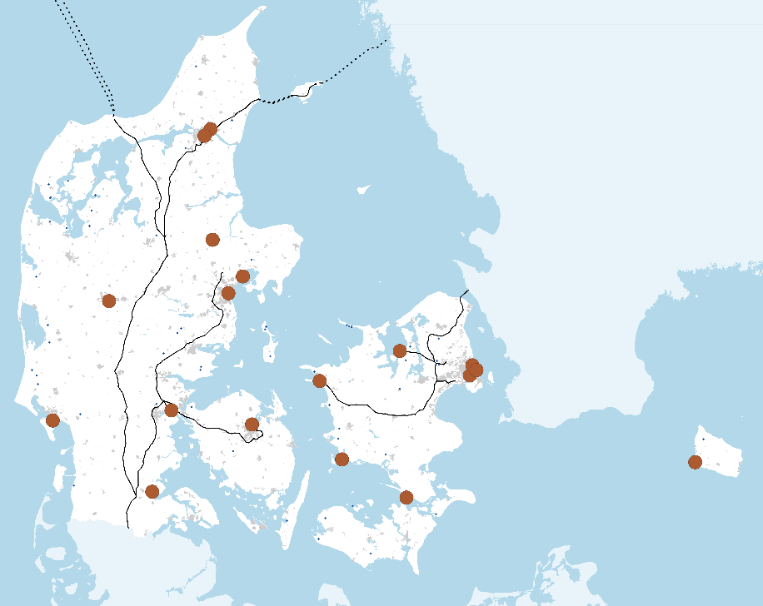
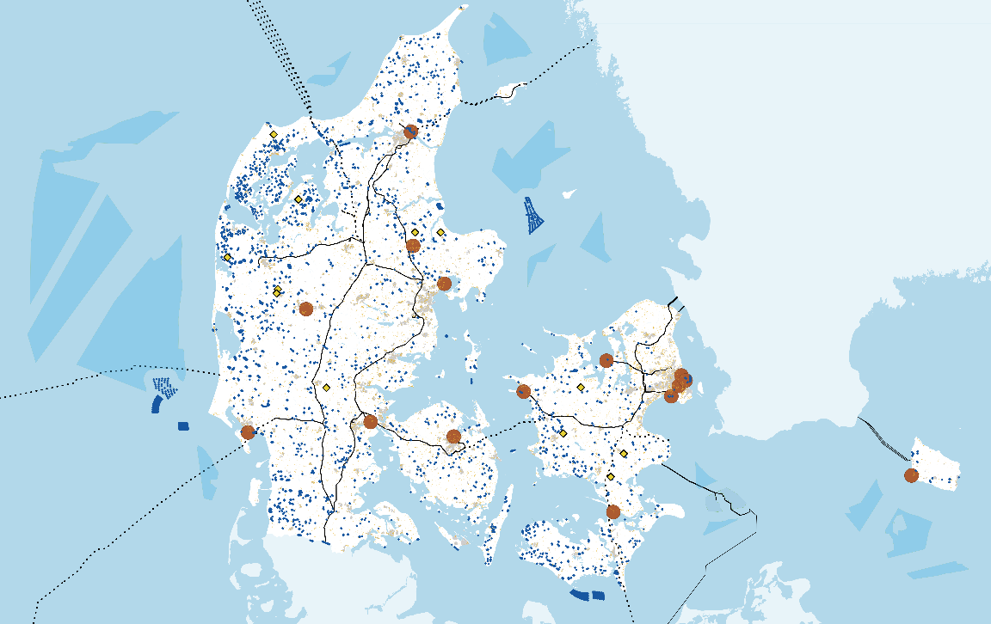
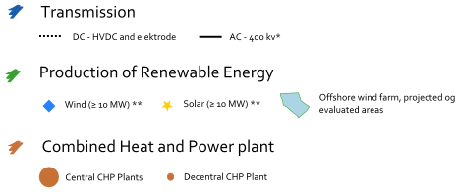
The Danish renewable energy journey
From centralized… …to decentralized system
Notes:
If i start with a timeline of some notable event – there are many events that have shaped the Danish energy sector as it is today, which is known to be the power system with the highest share of wind and solar in the world, while having relatively low electricity prices and high security of supply. In this timeline, this is obviously not everything that happened but some major highlights, and as you can see there are policy-related events and energy-company events.

Slide 4
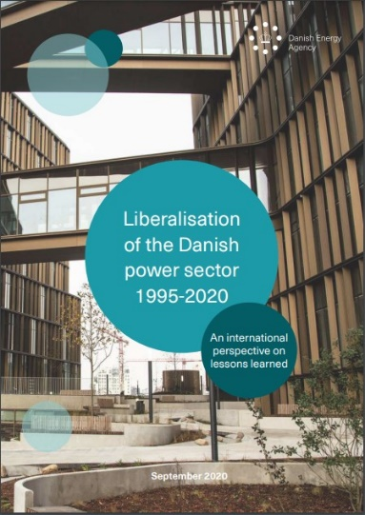
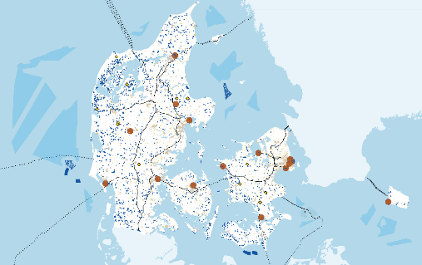
The Danish renewable energy journey
1980… …2021
1995
Generation
Transmission
Distribution
Generation
Retail
Unbundling
Transmission System Operator
Distribution
Notes:
If i start with a timeline of some notable event – there are many events that have shaped the Danish energy sector as it is today, which is known to be the power system with the highest share of wind and solar in the world, while having relatively low electricity prices and high security of supply. In this timeline, this is obviously not everything that happened but some major highlights, and as you can see there are policy-related events and energy-company events.

Slide 5
Emissions in Denmark on the way down
Notes:
Progress towards 70% reduction in CO2e in all sectors by 2030 compared to 1990 levels
This graph is only showing power and district heating emissions as that is mostly relevant from today
1970-1990 basically constant emissions
As you can see in especially the previous 25 years a great progress has been made. This has built upon experience and learnings from even all way back to the 1970s.

Slide 6
The Danish renewable energy journey
TIMELINE
The Danish renewable energy journey
Key milestones in Denmark and Ørsted's transition to green energy
Notes:
If i start with a timeline of some notable event – there are many events that have shaped the Danish energy sector as it is today, which is known to be the power system with the highest share of wind and solar in the world, while having relatively low electricity prices and high security of supply. In this timeline, this is obviously not everything that happened but some major highlights, and as you can see there are policy-related events and energy-company events.

Slide 7
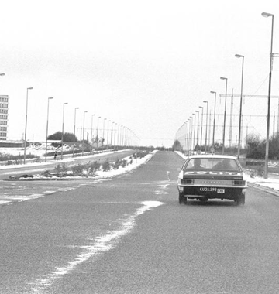
TIMELINE
1970s and 1980s
The oil crises call for new energy policies and technologies
Car-free Sundays in Denmark as a result of the oil crisis in 1973
Notes:
Zooming in to the 1970s and 1980s period – In 1972, oil accounted for 92 per cent of gross energy consumption in Denmark. Thus, when the OPEC oil crisis quadrupled the price of oil in 1973, Denmark’s economy and energy supplies were severely affected. While some short-term measures such as the introduction of car-free Sundays in Denmark during the 1973/74 winter were launched, the event was the catalyst for long-term energy planning.
This culminated in the establishment of the Danish Energy Agency and the government’s “Danish Energy Policy 1976” with the front cover shown here in the image. Short-term aims ranged from reducing the country’s dependence on oil, diversifying security of supply, reducing energy consumption, and increasing energy-related research and development. The long-term aims of the agreement were to slow the depletion of natural resources and develop stable, long-term solutions to energy demand by utilising renewable energy sources. However, the initial result enacted as part of the policy was the rapid conversion of power stations from oil to coal. Locally extracted natural gas was initially seen as a solution to the country’s energy woes and the Danish state-owned natural gas company, Dansk Naturgas, was merged with the Danish state-owned oil company in the early 1970s to create Danish Oil and Natural Gas A/S (DONG A/S)
Denmark said “nej tak” to nuclear energy in a parliamentary decision on energy planning in 1985, which was due to large public opposition.
A series of energy agreements, mandated the build out of wind energy and decentralized CHPs in the coming years.
__-----------
This was 1 year before the Chernobyl disaster. So, the quest for local sources of environmentally friendly energy continued, and was supported by 2 energy agreements – one agreeing on 100 MW of wind from 1986 to 1990, and one for 450 MW of decentralized CHPs based on bioenergy, gas, waste.
Another energy agreement was made 9 months later, where it was agreed that the energy companies would construct 100 MW of wind energy between 1986 and 1990 continuing the momentum.

Slide 8
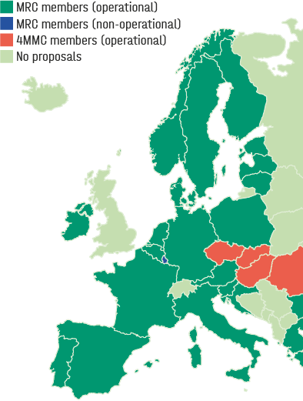
The integration of day-ahead markets started with the liberalisation in 1999 and by 2021, 25 countries have fully integrated day-ahead markets, and an electricity demand of around 3,000 TWh/year (ENTSO-E). More information can be found at (ENTSO-E, 2021)
TIMELINE
2001 to 2006
A new era for the supply of electricity
Notes:
New millenium, new era
After the liberalisation at the turn of the milenium, transition to market happened, and market coupling. A map of market coupling in the day-ahead market as of 2021 is presented, however this has been a gradual progression, which started back in 2000.
Offshore wind on the other hand saw the build out of the first two major demonstration projects, followed by the first tenders in the world for offshore wind. These first two tenders gave signficant learnings especially on aspects relating to environmental impact assessment, penalties, timelines and so on.
On the energy company side, most notably a merger of 6 power companies in 2006 meant the creation of Dong Energy A/S – an energy behemoth in Denmark, including oil&gas, more than half of the national capacity of power and heat production of aroudn 5.7 GW mostly coal, gas wholesale business, retail, and a small RE business which included the first offshore wind farms. The reason for the merger was to take control of the energy production in Denmark, as it was very close to falling into Vattenfalls hands, the swedish owned energy company FINISH
-------
to the point where Vattenfall was on their way to a press conference to announce it, before they were told that no, it would actually still be Danish. Vattenfall does still however own assets in Denmark and competes for tenders for example for offshore wind farms in Denmark.

Slide 9
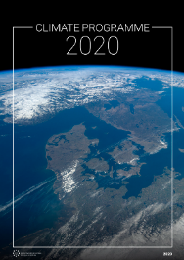
TIMELINE
2017 to 2021
Heightened ambitions for Denmark’s green transition
Notes:
DONG Energy increased its ambitions for green energy overseas, in markets such as Germany, incuding projects without subsidy. In 2017 it changes its name to Ørsted, after Danish scientist Hans Christian Ørsted, who discovered electromagnetism in 1820, and divested the oil and gas business.
It invested more into the US market, acquiring Deepwater Wind and Lincoln Clean Energy in the US in 2018.
In 2019, the distribution company part of the business was sold as it did not align with the company strategy.
From a policy-perspective, in 2020 a new energy agreement announced by the Climate and Energy ministry in Denmark presented a target of 70% reduction of CO2 by 2030. This also included two new large offshore wind tenders of 800-1000 MW called Thor and Hesselø. And plans for the worlds first energy islands.

Slide 10
Policy-side learnings
Planning – setting ambitious and reliable targets | Long-term, stable, inclusive and transparent energy planning procedures, supported by legislation, concrete reforms, and dialogue with the industry and with the public, are an essential part of the green transition
Demonstration projects | Demonstration projects provide invaluable regulatory, technical and engineering learning and boost investors' confidence, proving the scalability of the technology.
Permitting and de-risking | Appropriate allocation of risk and the streamlining of permitting procedures reduce regulatory risk and potential delays
Competition | An electricity sector built on the fundamental concept of competition creates incentives to innovate and lowers prices
Economic incentives | Subsidies, taxes and CO₂ prices have proved instrumental, when designed in a transparent manner to reduce regulatory risk
Notes:
So, that was a whirlwind tour through 50 years of policy and energy company developments in Denmark and a green transition.
In the next section I would like to present some of the learnings from this journey which may be interesting for an international audience. I will start from the policy-side learnings, which we have grouped into 5 categories. A lot of these are focused on reducing regulatory risk or policy risk – as developers or investors may perceive a market to be risky and therefore price it as such, leading to higher prices than necessary and a slower build out of renewables.
The first learning is the importance of energy planning – it is essential but it should have several characteristics to be effective. These are mainly again to reduce that policy risk or regulatory risk and to achieve cliamte and energy targets
Energy planning needs to be long term in order for industry to make long term commitments
It needs to reflect transparency and stability. If political decisions are reversed or retroactively changed, it can severely damage the government’s credibility with developers and investors, leading to greater perceived risk, higher prices and slower uptake of renewable energy.
Include dialogue with future players at the early stages – this can help design the rules to avoid delays at a later stage. A concrete example of this in Denmark is the market dialogues in offshore wind tenders where industry is invited in to discuss tender rules, or technology catalogues, where industry is invited to give feedback to technology data used for energy planning. All of this information is published online in a transparent manner
Be supported by the legislation through concrete reforms. This ensures the energy plans are achieved.
DEMONSTRATION PROJECTS are often thought of as a way to prove teh technology, but actually in Denmark they have proven to provide a comprehensive experience in planning and regulation.
PERMITTING AND DE-RISKING
The way the permitting process is designed is crucial to ensure appropriate allocation of risk. This is important to avoid costly delays and competitive costs.
COMPETITION:
Competition creates incentives to innovate and lower prices. Lower prices are passed down to consumers.
As the generators compete on costs, new markets overseas can open up as has been seen with Ørsted.
This has created a vibrant offshore wind industry in Denmark.
Power plant package: While not all countries may have the financial
capacity for such a buyout, capital can be raised in addition
to any available funds, and cost benefit analyses can reveal
where buyouts can make the most impact.
ECONOMIC incentives: on next slide

Slide 11
POLICY-SIDE LEARNINGS
Demonstration projects
The first projects in any technology are more expensive than subsequent projects when the technology is more mature.
Demonstration projects were a key policy tool to kickstart the industry and gave the following key learnings:
Myriad of technical and engineering learnings to develop the supply chain and reduce costs
Environmental impact assessments – learnings from the offshore projects have helped shape the regulations around environmental impact assessments
Investor confidence, as the projects showed that the technology was possible at scale
Has underpinned the Danish wind industry as a first mover on offshore wind
Notes:
Demonstration projects are essential to prove a technology and encourage cost reductions
They have given technical and operational learnings but also regulatory learnings, e.g. environmental impact assessments.

Slide 12
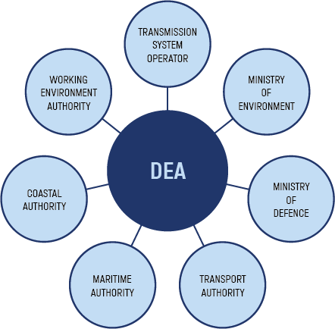
POLICY-SIDE LEARNINGS
Permitting and de-risking
The regulatory framework for offshore wind (for example) should be designed in a way so as to properly allocate risk, with the goal of attracting competition in projects to achieve the best price.
DEA acts as one-stop-shop – streamlining the consenting process, an important regulatory step to facilitate large offshore wind projects.
More information can be found on DEA’s website on the one-stop-shop concept. https://ens.dk/sites/ens.dk/files/Globalcooperation/one-stop_shop_oct2020.pdf
Notes:
And permitting and de-risking is an important area to de-risk and streamline projects.
DEA acts as a one stop shop to streamline the consenting process, which is important to avoid costly delays.

Slide 13
POLICY-SIDE LEARNINGS
Economic incentives
Anholt
Lessons through time in auction design process for offshore wind
More information can be found here:
https://ens.dk/sites/ens.dk/files/Globalcooperation/the_danish_offshore_wind_tender_model_final.pdf
Horns Rev III
Rødsand II
Horns Rev II
Vesterhav Nord & Syd
Kriegers Flak
Source: Danish Energy Agency
Notes:
We know typically that costs of RE are decreasing year by year, so what happened to Anholt here?
It was the largest offshore wind farm in the world at the time, the 400 MW Anholt project, the tender was launched in 2009. Lessons from the previous tender dictated that penalties were applied in the tender process so that the winning bidder would have to pay penalties if they withdrew their bid. Furthermore, the tender specified that if the winning bidder withdrew within the first half year, the second placed bidder would have to take over the project. Additionally, it was decided that Anholt had to be established in a recordbreaking four years, the same time as the previous projects despite being double the size. At the time, the wind turbine market was overheated due to the many projects being developed as a result of the UK ‘s first round of tenders, meaning wind turbines and components came at a higher cost than the previous tenders. A combination of these factors, alongside the context of the GFC, meant that in the end, only one company submitted a bid. DONG Energy won the tender, with a higher price than had been seen at the previous two tenders. The Danish government decided nonetheless to accept the offer to remain on schedule with targets.
One of the most important overriding lessons from this tender was to systematically de-risk the process. A method to achieve this was to include industry in a market dialogue prior to the tender. This allowed industry and government to discuss all matters relating to the tender, which resulted in an adjustment to penalties and greater flexibility in the
different milestones in the timeline for the next tender, and ultimately, a lower price. More information on the Danish
offshore wind tender model can be found in the Danish Offshore Wind Tender Model (Danish Energy Agency, 2020d).
It could be argued that a similar sort of industry dialogue could have mitigated the slowdown in the onshore industry in the early 2000s also.

Slide 14
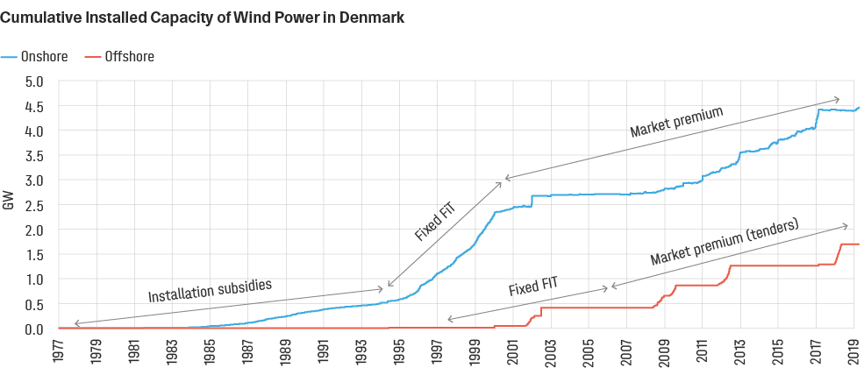
POLICY-SIDE LEARNINGS
Economic incentives
Changes through time, but importantly no retroactive changes to incentive schemes
Onshore wind grew rapidly in the 1990s in Denmark until the year 2000 saw market liberalisation, combined with reduced subsidies and low electricity prices.
Since then, the growth has resumed mainly due to replacing older turbines with newer, larger turbines.
Offshore wind turbines installed since 2004 have been through a competitive tendering procedure, whereas projects before this were demonstration projects through public-private partnerships with a Fixed FiT.
Note: the data does not include recently connected 600 MW offshore wind farm Kriegers Flak.
Notes:
Economic incentives have proved instrumental but must be designed carefully and transparently to reduce regulatory risk as seen by energy companies or investors.
Onshore wind slowed down in the early 2000s in denmark due to:
Revised support and low electricity prices, as well as uncertainty in electricity prices
Sellers market for wind turbines and more attractive market in Germany and the UK
RECs considered but scrapped due to added uncertainties

Slide 15
Learnings from the energy company's business transformation
2008
2019
Creating a sustainable vision
Exit strategy for fossil fuels
Entry strategy for renewable energy
Notes:
If we move to learnings from the energy company side,
For DONG Energy, who became Ørsted,
Three areas – oil&gas, coal-fired thermal and DSO – were divested or reduced to focus on RE especially offshore wind.
Danish state has maintained majority ownership
Lessons are to create a sustianable vision
Follow up on that vision to create an exit strategy for tech that doesnt comply,
And entry strategy for RE tech that fits

Slide 16
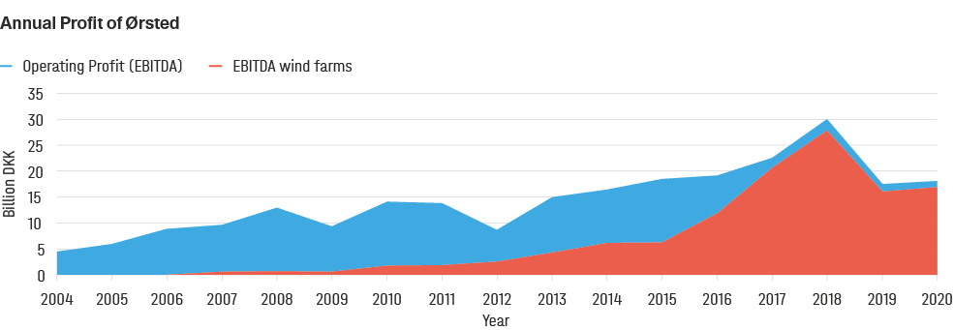
LEARNINGS FROM THE ENERGY COMPANY'S BUSINESS TRANSFORMATION
Creating a sustainable vision
Annual Operating Profit of DONG Energy / Ørsted over the years, and the share of profits from wind as a share of the total. The drop in 2019 was due to divestment.
Notes:
Ørsted put their money where their mouth was, in terms of operating profit, from the annual reports of Ørsted it can be seen that wind plays a dominating role in operating profit.

Slide 17
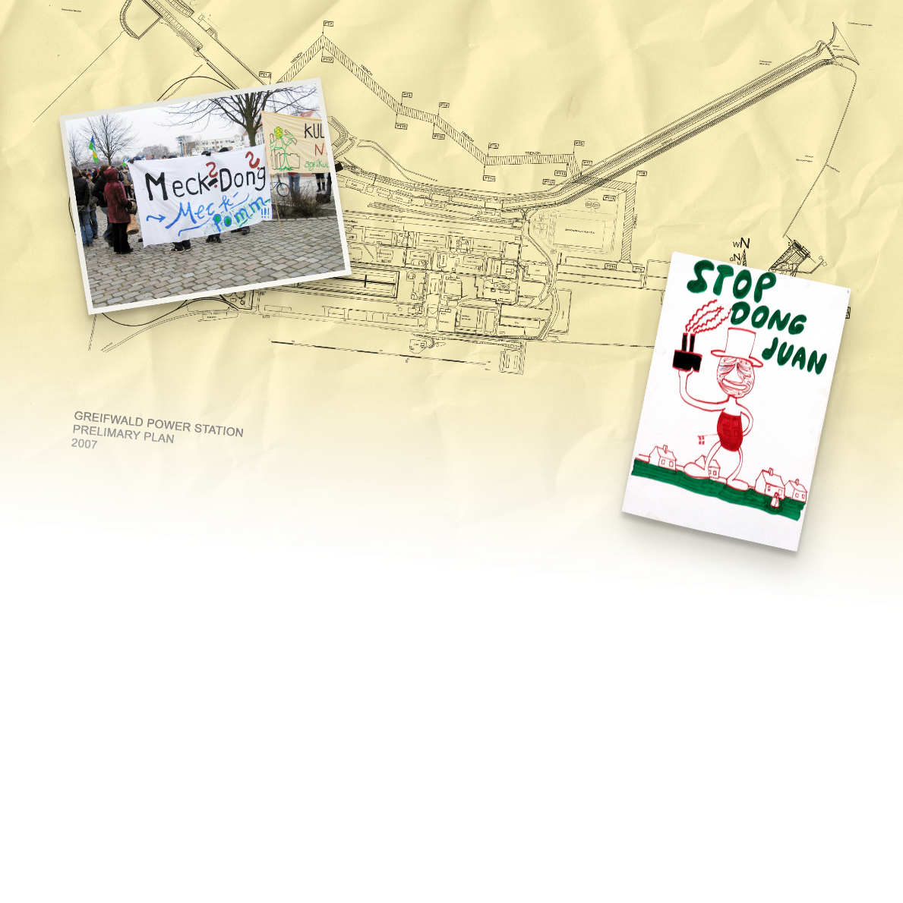
LEARNINGS FROM THE ENERGY COMPANY'S BUSINESS TRANSFORMATION
Exit strategy for fossil fuels
The exit strategy for fossil fuels at Ørsted has taken place through a number of different steps:
Closure of around 40 per cent of the company’s CHPs
A conversion to biomass with a favourable regulatory framework
Divestment of assets and businesses that do not align with the green vision, or
If all else fails, abandoned investments.
Greifswald coal-fired power station
Notes:
DONG Energy had to make a strategy to exit fossil fuels
For the existing coal-fired CHP plants in Denmark, around 40% were closed and some economic incentives made the conversion to biomass attractive, such as biomass subsidies and tax incentives for the use of biomass as a fuel for heating.
Engineers who were skilled in designing and constructing efficient coal-fired power plants were either transferred internally to focus on offshore wind (re-training), or transferred externally to consulting companies e.g. Ramboll Engineering (re-allocation). Similarly, when it became clear that it was not going to be a part of the company’s future vision, the oil & gas division was sold off to INEOS.
If all else fails hwoever, investments must be abandoned at a large cost to the company.
After the merger in 2006, Orsted acquired one project in Germany – a major coal-fired power plant development project
called Greifswald. From a technical perspective, the plant was not technologically risky, as the company had many experienced
and competent engineers.
From a financial perspective, the business case was perhaps viable for the next 3-5 years,
but was suboptimal for the future 20-30 years. The plant also faced significant local opposition due to environmental concerns.
The project investment cost about 20 billion Danish kroner in total (approximately EUR 2.7 billion) but was abandoned
after already 1 billion Danish kroner (approximately EUR 134 million) had been spent in project development costs.
This was a learning for the company and contributed to the strategic target of completely phasing out coal by 2023.

Slide 18
LEARNINGS FROM THE ENERGY COMPANY'S BUSINESS TRANSFORMATION
Entry strategy for renewable energy
Learnings in entering a new renewable energy market
Cultural shifts within the company, use of internal talent and competencies
Supply chain as a key factor to reduce costs
Joint ventures and investor engagement

Slide 19
Recommendations
NATIONAL ENERGY PLANS
CONCRETE LEGISLATIVE REFORMS
A NEW GREEN COMPANY VISION
EXIT STRATEGY FOR FOSSIL FUELS
ENTRY STRATEGY FOR RENEWABLE ENERGY
Notes:
Finally if we look at recommendations, from the Danish green transition which could be relevant for other countries, we group them into 5 main categories.
The first two are from the government or policy side, whereas the last 3 are for the energy company.

Slide 20
RECOMMENDATIONS
Transitioning from black to green energy
A NEW GREEN COMPANY VISION
NATIONAL ENERGY PLANS
Make good use of the long-term planning policies in place
Contextualise the strategy
Develop a holistic vision within the dynamic landscape
Long term
Transparent
Stable
Inclusive
CONCRETE LEGISLATIVE REFORMS
EXIT STRATEGY FOR FOSSIL FUELS
Economic incentives
Reforms to ensure an electricity sector based on competition
Demonstration projects
Permitting and de-risking
Engage actors and government agencies in the divestment plans
Re-evaluate the asset to fit the future of the sector
Abandon investments when regulations and public opposition hinder future opportunities
ENTRY STRATEGY FOR RENEWABLE ENERGY
Attract finance to new renewable energy projects validating the proof of concept
Engage, align and educate stakeholders
Be a first mover: enjoy the benefits and be ready for the challenges
Value joint ventures: share the skills
Build up human resources: harvest internally, retrain personnel, create synergies with existing base and attract new talents

Slide 21
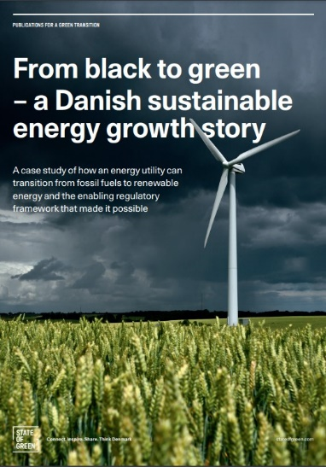
Thank you!
Dr. Mattia Baldini
E-mail: mbal@ens.dk
Danish Energy Agency
Connect. Inspire. Share. Think Denmark
Report:
From Black to Green: A Danish sustainable energy growth story – a case study of how an energy utility can transition from fossil fuels to renewable energy, and the enabling regulatory framework that made it possible
https://ens.dk/sites/ens.dk/files/Globalcooperation/sog_fromblacktogreenreport_210x297_v08_web_spreads.pdf
Supplementary material:
Long term planning for a greener future
https://ens.dk/sites/ens.dk/files/Globalcooperation/Publications_reports_papers/long_term_planning_for_greener_future.pdf
Danish offshore wind tender model
https://ens.dk/sites/ens.dk/files/Globalcooperation/the_danish_offshore_wind_tender_model_final.pdf
Liberalisation of the Danish power sector: an international perspective on lessons learned 1995-2020
https://ens.dk/sites/ens.dk/files/Globalcooperation/liberalisation_of_the_danish_power_sector_-_report_final.pdf
The Danish Energy Agency as a One-stop-shop authority
https://ens.dk/sites/ens.dk/files/Globalcooperation/one-stop_shop_oct2020.pdf
Development and role of flexibility in the Danish power system https://ens.dk/sites/ens.dk/files/Globalcooperation/dea_development_and_role_of_flexibility_in_the_danish_power_system_2021_1905.pdf

Slide 22
TIMELINE
1990 to 1995
Sowing the seeds of sustainable growth
Notes:
”Energy 2000”, was an energy action plan in 1990 which was a gamechanger in Danish climate and energy history. Climate and energy policies were integrated and it was the first governmental plan in the world to reduce CO2 emissions. This included targets of 20% reduction CO2 by 2005 from 1990 levels, and proposed taxes on CO2, SO2 and NOx which were subsequently realised in 1992, (first country to do so), 1995 and 2008 respectively.
Vindeby the world’s first offshore wind farm was installed by Elkraft (state owned energy company in the east of Denmark) in 1991. In 1995, a mapping of regulatory aspects for Danish waters, points to five major areas as suitable locations for future offshore wind farms, considering interests such as military, environemtnal, navigation and so on.
While onshore, Feed in tariff put in place for onshore wind in 1993, and the technology saw rapid development across the country.

Slide 23
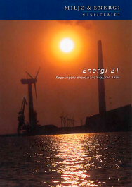
TIMELINE
1996 to 2000
Denmark at the forefront of change and the first
EU provisions for a liberal internal market
Notes:
The latter half of the decade was characterised by the gradual liberalisation and opening up of the European electricity market across national borders throughout Europe. This was motivated by two parallel movements – liberalisation from EU internal market, that electricity should flow freely as a commodity across borders, and the development of the electricity market Nord Pool in Norway and Sweden.
The liberalisation meant that it was necessary to pay out the state-owned electricity companies in Denmark a support package of 8 billion DKK (1,1 billion Euro) to secure their economic survival in the transition, and to ensure that they could transition from long term contracts to selling power on the Nord Pool power exchange to ensure the lowest possible prices for consumers.
At around the same time, the ministery of environment and energy mandated electricity companies to expand offshore wind by 200 MW by 1999 and 900 MW by 2006 in a government order. This was followed by the minister at the time Svend Auken making a political agreement with the energy companies to establish the two first-ever large-scale offshore wind farms (200MW each) – one in the east and one in the west

Slide 24
The integration of day-ahead markets started with the liberalisation in 1999 and by 2021, 25 countries have fully integrated day-ahead markets, and an electricity demand of around 3,000 TWh/year (ENTSO-E). More information can be found at (ENTSO-E, 2021)
TIMELINE
2001 to 2006
A new era for the supply of electricity
Notes:
New millenium, new era
After the liberalisation at the turn of the milenium, transition to market happened, and market coupling. A map of market coupling in the day-ahead market as of 2021 is presented, however this has been a gradual progression, which started back in 2000.
Offshore wind on the other hand saw the build out of the first two major demonstration projects, followed by the first tenders in the world for offshore wind. These first two tenders gave signficant learnings especially on aspects relating to environmental impact assessment, penalties, timelines and so on.
On the energy company side, most notably a merger of 6 power companies in 2006 meant the creation of Dong Energy A/S – an energy behemoth in Denmark, including oil&gas, more than half of the national capacity of power and heat production of aroudn 5.7 GW mostly coal, gas wholesale business, retail, and a small RE business which included the first offshore wind farms. The reason for the merger was to take control of the energy production in Denmark, as it was very close to falling into Vattenfalls hands, the swedish owned energy company FINISH
-------
to the point where Vattenfall was on their way to a press conference to announce it, before they were told that no, it would actually still be Danish. Vattenfall does still however own assets in Denmark and competes for tenders for example for offshore wind farms in Denmark.

Slide 25
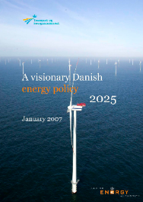
TIMELINE
2007 to 2010
DONG Energy pioneers the green transition
in response to new, long-term political targets
Notes:
Moving to 2007, leaders across EU established targets in energy and climate, in what is commonly known as the 20-20-20 target in 2007, 20% GHG, 20% RE, and 20% energy efficiency by 2020.
This was an average target across EU and distributed across Europe based on their starting point, meaning Denmark had a higher target than some other countries.
A crucial point however was that the targets were enacted in legislation in 2009, making them legally binding. DEA set a target of 20% RE by 2011 and 30% by 2026.
This EU target, and subsueqnet Danish target, plus the momentum from COP climate conference in Copenhagen, all inspired DONG Energy to annouce a radical change in strategy in 2009. Actually a few months after the Energy Agreement was published by DEA, DONG Energy announced its 85/15 strategy, where it would change from being 85% fossil to 85% renewable by 2040.
Two other factors played a big part here – the merger meant the demonstration projects in offshore wind were in DONG Energy’s hands, and another side effect of the merger was that DONG Energy inherited a development project Greifswald in Germany, a 1600MW coal-fired project, which was met with large public resistance. DONG Energy eventually abandoned the project after spending roughly 1 billion DKK on it.
(DONG followed up on their ambition by investing largely into the new technology, 500x3.6 MW wind turbines, as it was necessary to do it at scale to get the new industry going. )
They were also able to attract insitutionaly investors, as offshore wind projects are highly capital intensive, Pension fund would invest in Nysted, giving a huge capital injection. This eventualy became known as the ”farm-down model”, where 50% of the wind farm would be divested to institutional investors, but that DONG Eneryg would take 100% of the construction risk. This mdoel is widely applied in the industry today.

Slide 26
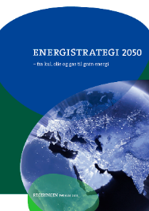
TIMELINE
2011 to 2016
Denmark waves goodbye to coal
and DONG Energy expands overseas
Notes:
The Marine Spatial Planning exercise was repeated again by DEA, identifying 6 areas for future offshore wind farm auctions
On the company side of thinigs, the Credit rating of DONG Energy was downgraded, mainly due to gas prices taking a fall and gas contracts finishing (the company was reliant on gas sale sto a large exctent at the time). The Ministry of Finance found a solution for financial restructuring of the company, and the financial outlook of DONG Energy had returned to stable by 2014.
DONG Energy carried through their strategic focus on offshore wind, as they took over a US offshore wind development project and made investment decision on a 1.2 GW offshore wind farm Hornsea 1, the largest in the world.

Slide 27
POLICY-SIDE LEARNINGS
Planning – setting ambitious and reliable targets
In order to achieve a clear, stable and transparent policy framework,
energy planning should meet the following conditions:
1. Be long-term. By being designed with a long-term mindset, such plans provide a stable framework and the long-term horizon that industry requires to join the transition.
2. Reflect transparency and stability. If political decisions that significantly affect the business case for large investments are reversed, it will severely damage the government’s credibility with developers and investors, leading to higher prices and slower market uptake of RE.
3. Include dialogue with the future players at the early stages: a transparent dialogue between government and industry can give the necessary inputs for designing the rules from parties involved. Denmark has used industry dialogue as a methodology for collecting input e.g., for designing auctions or for collecting technology data to use in long-term analyses (technology catalogue).
4. Be supported by the legislation through concrete reforms. The first step requires the development of a reliable plan with calculations of when and how to achieve the targets in accordance with socio-economic priorities. This will then be implemented by government institutions. An example is the EU 20/20/20 targets, set in 2007 and followed by targets that were enacted in legislation in 2009.
More info here
Notes:
The first learning is the importance of energy planning – it is essential but it should have several characteristics to be effective. These are mainly again to reduce that policy risk or regulatory risk and to achieve cliamte and energy targets
Energy planning needs to be long term in order for industry to make long term commitments
It needs to reflect transparency and stability. If political decisions are reversed or retroactively changed, it can severely damage the government’s credibility with developers and investors, leading to greater perceived risk, higher prices and slower uptake of renewable energy.
Include dialogue with future players at the early stages – this can help design the rules to avoid delays at a later stage. A concrete example of this in Denmark is the market dialogues in offshore wind tenders where industry is invited in to discuss tender rules, or technology catalogues, where industry is invited to give feedback to technology data used for energy planning. All of this information is published online in a transparent manner
Be supported by the legislation through concrete reforms. This ensures the energy plans are achieved.

Slide 28
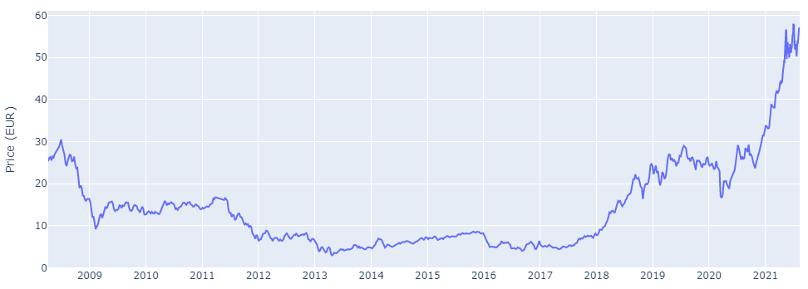
POLICY-SIDE LEARNINGS
Economic incentives
The EU Emmissions Trading Scheme has been a driver since it was introduced in 2005, based on “cap and trade” principle.
Carbon prices are high again now. Even when they were low, such as from 2008-2018, Energy Companies such as DONG/Ørsted were forced to plan and make business decisions for scenarios with high carbon prices
CO2 taxes were introduced in 1992 in Denmark
Source: Sandbag.be
Notes:
An interesting note about the EU ETS. The prices have been relatively low until around a year ago.
However even in the 2000s when the CO2 price was low, DONG Energy and other energy companies was planning business decisions based on sensitivity analyses and scenarios with a higher carbon price. So, even at a low price, the risk that pollutiing companies are exposed to, forces these carbon prices to have an impact on invstments anyway.

Slide 29
POLICY-SIDE LEARNINGS
Competition
Generators can focus on competing on generation cost
After this focus on reductions in cost, they could compete in neighbouring countries’ markets
This has created a vibrant competitive offshore wind industry in Denmark (3 out of 6 bidders in Thor are at least partly Danish)
State ownership at arm’s length in terms of decision-making was essential to not unfairly influence energy policy
Power plant package was necessary and included incentives for RE
Electricity market opens up new opportunities – balancing flexibility, heat pumps, EVs, etc
Liberalisation process told in more detail here
Notes:
Competition creates incentives to innovate and lower prices. Lower prices are passed down to consumers.
As the generators compete on costs, new markets overseas can open up as has been seen with Ørsted.
This has created a vibrant offshore wind industry in Denmark.
Power plant package: While not all countries may have the financial
capacity for such a buyout, capital can be raised in addition
to any available funds, and cost benefit analyses can reveal
where buyouts can make the most impact.

Slide 30
POLICY-SIDE LEARNINGS
Permitting and de-risking
De-risking offshore wind
TYPE OF RISK | OWNER | EXAMPLES
Policy commitment | Government (policy makers, government agencies) | • Credible and realistic political agreements • Certainty of targets • Sanctity of contracts
Adequate project planning and permitting risk | Developer Government agencies | • Capability of developer to plan and time the project adequately • One stop shop licensing • Environmental studies carried out at the requisite level
Construction challenges | Developer Investors | • Technical and financial capability of project owner • Competitive selection of suppliers and sub-suppliers • HSE regulation
Operational risk | Investors Insurance companies | • Cost/quality balance to be struck in desired lifetime • Adequate insurance
Offtake security and revenue support | Policy makers System operator Off-taker | • Priority access to the grid and transparent rules for curtailment • Security of income by sale of energy (market, PPA) • Revenue support
Financial and currency risk | Investors Insurance companies Government guarantees | • Asset should be tradable and transferable • Cost of the financial loan package depends on the perceived risk of the project • Capital expenditure guarantee e.g., government backed loan
Notes:
Here is a table of associated risks to offshore wind. I won’t go into too much detail here, but essentially, the owner of the risk should be the one responsible for mitigating it.
One example is permitting risk, where the government can de-risk to a great extent by offering one-stop shop licensing of offshore wind farms for example.

Slide 31
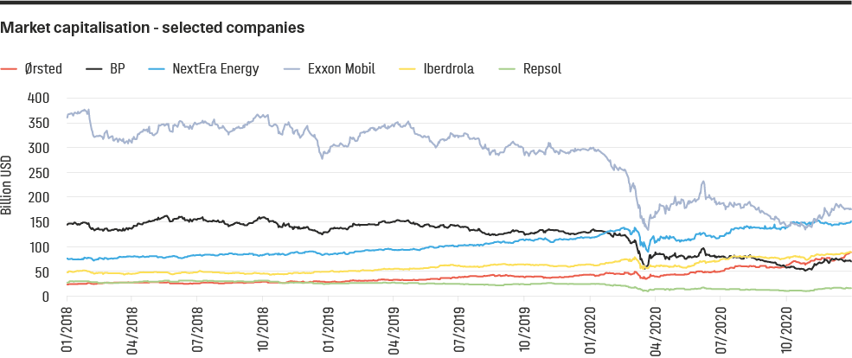
Learnings from the energy company's business transformation
Renewables overtaking their regional oil majors. Inspired by Bloomberg article, "New Energy giants are renewable companies" (Bloomberg, 2020).

Slide 32
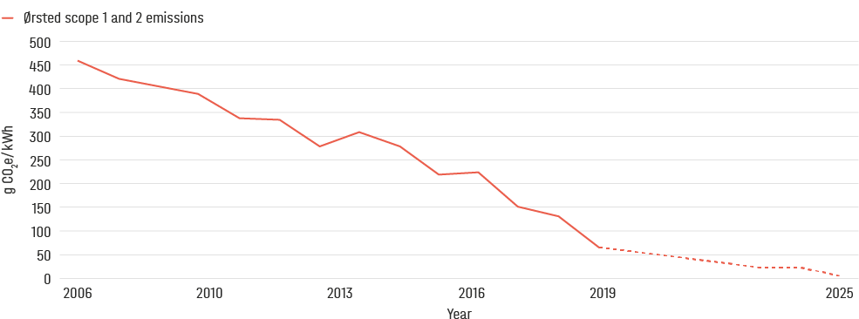
LEARNINGS FROM THE ENERGY COMPANY'S BUSINESS TRANSFORMATION
Creating a sustainable vision
Specific CO₂ emissions. Actual and prognosis. Source: Ørsted.
Notes:
Matching this, the CO2 intensity of the portfolio production of the company has been falling consistently.

Slide 33
LEARNINGS FROM THE ENERGY COMPANY'S BUSINESS TRANSFORMATION
Exit strategy for fossil fuels
The exit strategy for fossil fuels at Ørsted has taken place through a number of different steps:
Closure of around 40 per cent of the company’s CHPs
A conversion to biomass with a favourable regulatory framework
Divestment of assets and businesses that do not align with the green vision, or
If all else fails, abandoned investments.
Greifswald coal-fired power station
Notes:
DONG Energy had to make a strategy to exit fossil fuels
For the existing coal-fired CHP plants in Denmark, around 40% were closed and some economic incentives made the conversion to biomass attractive, such as biomass subsidies and tax incentives for the use of biomass as a fuel for heating.
Engineers who were skilled in designing and constructing efficient coal-fired power plants were either transferred internally to focus on offshore wind (re-training), or transferred externally to consulting companies e.g. Ramboll Engineering (re-allocation). Similarly, when it became clear that it was not going to be a part of the company’s future vision, the oil & gas division was sold off to INEOS.
If all else fails hwoever, investments must be abandoned at a large cost to the company.
After the merger in 2006, Orsted acquired one project in Germany – a major coal-fired power plant development project
called Greifswald. From a technical perspective, the plant was not technologically risky, as the company had many experienced
and competent engineers.
From a financial perspective, the business case was perhaps viable for the next 3-5 years,
but was suboptimal for the future 20-30 years. The plant also faced significant local opposition due to environmental concerns.
The project investment cost about 20 billion Danish kroner in total (approximately EUR 2.7 billion) but was abandoned
after already 1 billion Danish kroner (approximately EUR 134 million) had been spent in project development costs.
This was a learning for the company and contributed to the strategic target of completely phasing out coal by 2023.

Slide 34
LEARNINGS FROM THE ENERGY COMPANY'S BUSINESS TRANSFORMATION
What is a
decommissioning
auction?
A decommissioning auction is a financial tool employed by some EU member countries to phase out coal from the national electricity mix.
The local government organises an auction to compensate
for the decommissioning of the black asset for companies
owning and operating coal power plants. This type of
auction has been introduced both for tackling the impact
of coal on climate change targets, but also to meet halfway
with existing large coal plant operators, which are currently
struggling in the increasingly difficult market situation.
The auction is structured to award bids based on the ratio
between the asked compensation price and the resulting
reduction in CO2 emissions. In special cases, the transmission
grid operators can ask to spare some of the plants to
be used as backup capacity reserve in “critical situations”.
Nonetheless, the plants will not be allowed to participate in
the electricity market remuneration mechanisms.
Exit strategy for fossil fuels
Vattenfall abandoned a recently constructed coal-fired power plant in Germany. A decommissioning auction was facilitated by the German government
Notes:
A decommissioning auction is another innovative mechanism. Germany and Netherlands have both made decommissioning auctions but it has not been done in Denmark yet.

Slide 35
LEARNINGS FROM THE ENERGY COMPANY'S BUSINESS TRANSFORMATION
Entry strategy for renewable energy
Learnings in entering a new renewable energy market
Cultural shifts within the company, use of internal talent and competencies:
Supply chain as a key factor to reduce costs
Joint ventures and investor engagement

Slide 36
LEARNINGS FROM THE ENERGY COMPANY'S BUSINESS TRANSFORMATION
Follow the growth
Examples of entry and exit strategies for Ørsted, as experienced in Denmark over the last 10-15 years in particular
 | Entry strategy for renewable energy | Exit strategy for fossil fuels
Human resources | Cultural shift within the company. Build up human resources: harvest internal resources, retrain personnel, create synergies with existing base and attract new talents, increasing sustainable job opportunities. | Divest businesses that do not align with the new green vision
Technology strategy | Develop and test proof of concept projects, devise long term strategies with ambitious targets and scale up large-scale renewable projects. Then choose technologies based on their return and risk profile in a given regulatory framework, investigating the impact on players in the supply chain. Bring the technology to cost-competitive levels with the existing products, assessing the role of the new product in existing and new markets. | Convert directly, e.g., coal to biomass The same could be done with existing coal power plants, by using the land for hybrid solar and wind projects and re-using the existing transmission infrastructure.
Market forces & project choices | Invest in new projects. Joint ventures can be a good way to gain technical experience and knowledge, filling the gap with the missing technical competences to reach the objective. Institutional, national and international investors can be attracted to green projects with long-term returns and low risk. Investors and technical advisors which have been educated about the new technology and the mission are more likely to feel confident in approving co-investments. | Abandon projects Several coal-fired power plants have been abandoned in northern Europe as they are no longer profitable and attract public opposition.
Notes:
As with the exit strategy for the fossil technology, so there needs to be a strategy to enter into growth industries such as renewable energy.
There needs to be a human resources strategy, technology strategy and a market entry strategy. Development projects and supply chain investment can be a way to accelerate the technology strategy. Joint ventures can also be an effective mechanism to gain technical experience and knowledge with more mature players.

Slide 37
RECOMMENDATIONS
National Energy Plans
Long term
Transparent
Stable
Inclusive
Notes:
The first is the need for national energy plans which are long-term, stable, transparent, and inclusive.

Slide 38
RECOMMENDATIONS
Concrete legislative reforms
Economic incentives
Reforms to ensure an electricity sector based on competition
Demonstration projects
Permitting and de-risking
Notes:
The second is to follow these energy plans with concrete legislative reforms

Slide 39
RECOMMENDATIONS
A new green company vision
Make good use of the long-term planning policies in place
Contextualise the strategy
Develop a holistic vision within the dynamic landscape
Notes:
For the energy company, a new sustainable vision needs to be made, with the context of climate change, falling cost of RE, fuel price risk, carbon price risk and other uncertainties

Slide 40
RECOMMENDATIONS
Exit strategy for fossil fuels
Engage actors and government agencies in the divestment plans
Re-evaluate the asset to fit the future of the sector
Abandon investments when regulations and public opposition hinder future opportunities
Notes:
The exit strategy for exxistings assets and businesses must be made, in dialogue with government when necessary

Slide 41
RECOMMENDATIONS
Entry strategy for renewable energy
Attract finance to new renewable energy projects validating the proof of concept
Engage, align and educate stakeholders
Be a first mover: enjoy the benefits and be ready for the challenges
Value joint ventures: share the skills
Build up human resources: harvest internally, retrain personnel, create synergies with existing base and attract new talents
Notes:
And finally, a strategy for HR, technology and market entry need to be made, to make the green vision a reality. The green growth can only be achieved when it is done at a large scale with a large change to businesses, and Denmark and Ørsted have shown that it is indeed possible.

