Slide 1
The Green Agenda of Denmark and the European Union
The Danish Energy Transition Initiative: Denmark-Colombia
13th October 2021
Beatriz Martinez Romera
Associate Professor, Faculty of Law

Slide 2
Outline
Introduction
EU’s green agenda
Denmark’s green agenda

Slide 3


Introduction
UNFCCC
Kyoto Protocol (Doha Amendment)
Paris Agreement

Slide 4
EU’s green Agenda

Slide 5
EU as a global actor
Art 1 TEU – ‘The High Contracting Parties establish among themselves a European Union’
Art 47 TEU - ‘The Union shall have legal personality’
Declaration 24 concerning the legal personality of the EU – ‘the Conference confirms the fact that the European Union has a legal personality will not in any way authorize the Union to legislate or act beyond the competences conferred upon it by the Member States in the Treaties’
Art 3(5) TFEU – Obligation to observe and develop international law and respect the principles of the UN Charter
Art 216(2) TFEU - International Agreements are binding for Member States and EU Institutions
  “Mixed Agreements” – concluded by both: EU and MSs
Notes:
5

Slide 6
EU Institutions and Bodies
European Council (Summit)
European Parliament
Council of Ministers
(Council of the EU)
European Commission
Court of Justice
Court of Auditors
Economic and Social Committee
Committee of the Regions
European Investment Bank
Agencies
European Central Bank
Source EU website

Slide 7
Sources of European Environmental/Climate Law
Det Juridiske Fakultet
Primary law: The Treaties,
  Art 11 TFEU - Sustainability and integration requirements
  Title XX on environment, art 191-193 TFEU - Source of objectives, criteria, bases and environmental principles
  Title XXI on energy
Secondary legislation: Regulations, Directives and Decisions.
  Based on the Treaties, for example 192 or others if policy areas that also impact upon environment.
International Treaties
Judgments and principles set by the Court of Justice
Notes:
7

Slide 8
Stages in EU Environmental Law
Det Juridiske Fakultet
1957-1973. Original Treaty of Rome has no provisions on the environment
1973 -1986 - Environmental action without Treaty base and the Environmental Action Programs (declaration / resolution)
1986 - 1993– Single European Act creates a formal legal basis for environmental legislation – Title VII on Environment.
Notes:
8

Slide 9
Stages in EU Environmental Law
Det Juridiske Fakultet
1993- Maastricht Treaty enacted environmental policy and protection to one of the fundamental objectives of EU, introduces the precautionary principle and the integration requirement.
1997 – Amsterdam Treaty simplified decision making procedures for environmental area, QMV. Unanimity remains for rules on a fiscal nature.
2009 – Lisbon Treaty enhances environmental protection and climate change is first mentioned
Notes:
9

Slide 10
EU Environmental Law
Det Juridiske Fakultet
Lisbon Treaty
  Sustainable Development as one of the fundamental objectives for EU and in its relations with the world.
  Environmental Integration – art 11
  Shared competence
  First time that climate change is explicitly referred to in the Treaties: the need to combat climate change at international level.
  Energy – new article 194, ‘development of new and renewable sources of energy’
Notes:
10

Slide 11
Objectives
      Article 191 TFEU
      Establish the objectives for the Union environmental policy:
        preserving, protecting and improving the quality of the environment,
        protecting human health,
        prudent and rational utilization of natural resources,
        promoting measures at international level to deal with regional or worldwide environmental problems, and in particular combating climate change.

Slide 12
Criteria and principles
      Article 191 TFEU
        2. State the criteria and the principles for environmental policy measures:
          Aim at a high level of protection
          Take into account the diversity of situations in the various regions
          Principles (the precautionary principle and on the principles that preventive action should be taken, that environmental damage should as a priority be rectified at source and that the polluter should pay)

Slide 13
7th Environment Action Programme
Det Juridiske Fakultet
Vision for the 2050s
‘In 2050, we live well, within the planet’s ecological limits. Our prosperity and healthy environment stem from an innovative, circular economy where nothing is wasted and where natural resources are managed sustainably, and biodiversity is protected, valued and restored in ways that enhance our society’s resilience. Our low-carbon growth has long been decoupled from resource use, setting the pace for a safe and sustainable global society.’
Notes:
13

Slide 14
From 2020 Package to 2030 Framework
-20 % Greenhouse Gas Emissions
20% Renewable Energy
20 % Energy Efficiency
2020
- 40 % Greenhouse Gas Emissions
32%* Renewable Energy
32,5%* Energy Efficiency
2030
* To be reviewed in 2023 (only upwards)
* To be reviewed in 2023 (only upwards)

Slide 15
The 2030 Climate and Energy Framework
Proposed by EU Commission and endorsed by European Council in 2014
  Upgrade of GHG, RE and EE targets
  More flexibility for MS
Update of existing legislation ...
  ETS reform → Directive (EU) 2018/410, amending Directive 2003/87/EC
  Effort Sharing Regulation → Regulation (EU) 2018/842
  RED → Directive (EU) 2018/2001
  EED → Directive (EU) 2018/2002

Slide 16
The 2030 Climate and Energy Framework
... introduction of a ‘Energy Union’...
  Long-term strategy for the integration of MS’ energy and climate policies
    Energy security, solidarity and trust
    Integration of the EU energy market
    Energy efficiency
    Decarbonisation
    Research, innovation and competitiveness
and introduction of a new system of governance
  Governance Regulation → Regulation (EU) 2018/1999
  National Energy and Climate Plans (NECPs) → bridge between 2030 Framework and Energy Union
  Unified planning and reporting mechanism

Slide 17
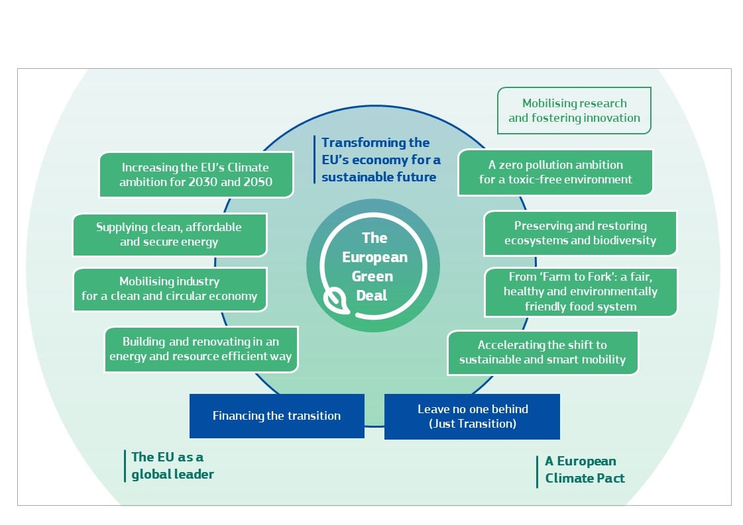
EU Green Deal
COM(2019) 640 final

Slide 18
Increase climate ambition: Key Issues
50-55% GHG emission reduction target by 2030
Climate neutrality 2050
      Review of EU ETS (new sectors)
      Non-ETS sectors
      Taxation –consumer behaviour
      Carbon Border Adjustment Mechanism
      Carbon Pricing – ‘different pricing instruments must complement each other and jointly provide a coherent policy framework’

Slide 19
EU Climate Law (Adopted June 2021)
      legally binding target of net zero greenhouse gas emissions by 2050
      new EU target for 2030 (55% compared to levels in 1990)
      2030-2050 EU-wide trajectory
      By June 2021, the Commission shall review legislation towards the target
      measures to keep track of progress and adjust actions
      Assessment of Union progress and measures (2023, and every 5 years thereafter)
      Assessment of National Energy and Climate Plans or Biennial Progress Reports (Governance Regulation)

Slide 20
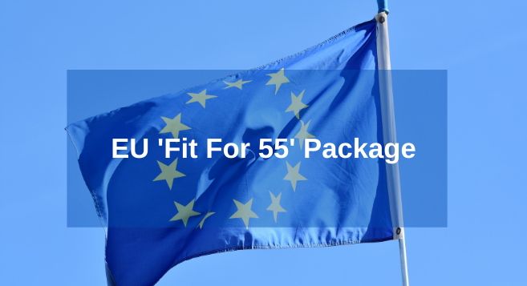
Fit for 55 Package
The package contains legislative proposals to revise the entire EU 2030 climate and energy framework, including:
Revision of the EU Emissions Trading System (ETS), including maritime, aviation and CORSIA, Carbon Border Adjustment Mechanism (CBAM), Effort Sharing Regulation (ESR), Amendment to the Renewable Energy Directive to implement the ambition and Energy Efficiency Directive…

Slide 21
Denmark’s green Agenda

Slide 22
Climate change law and policy in Denmark
Derives from:
1. International climate commitments
2. EU obligations
3. Nationally driven (energy sector and climate law)

Slide 23
1 International Climate-related Commitments
1992 UNFCCC
1997 Kyoto Protocol - Quantified emission limitation or reduction commitment: -8% (-21 under the EU Burden Sharing Agreement) & Doha
2015 Paris Agreement – NDC
Also:
1985 Vienna Convention and 1987 Montreal Protocol on SDO
Notes:
23

Slide 24
Det Juridiske Fakultet
2020 Climate and Energy Package
Oberthur et al.

Slide 25
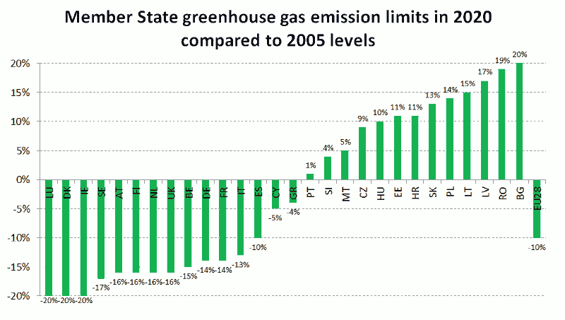

Slide 26
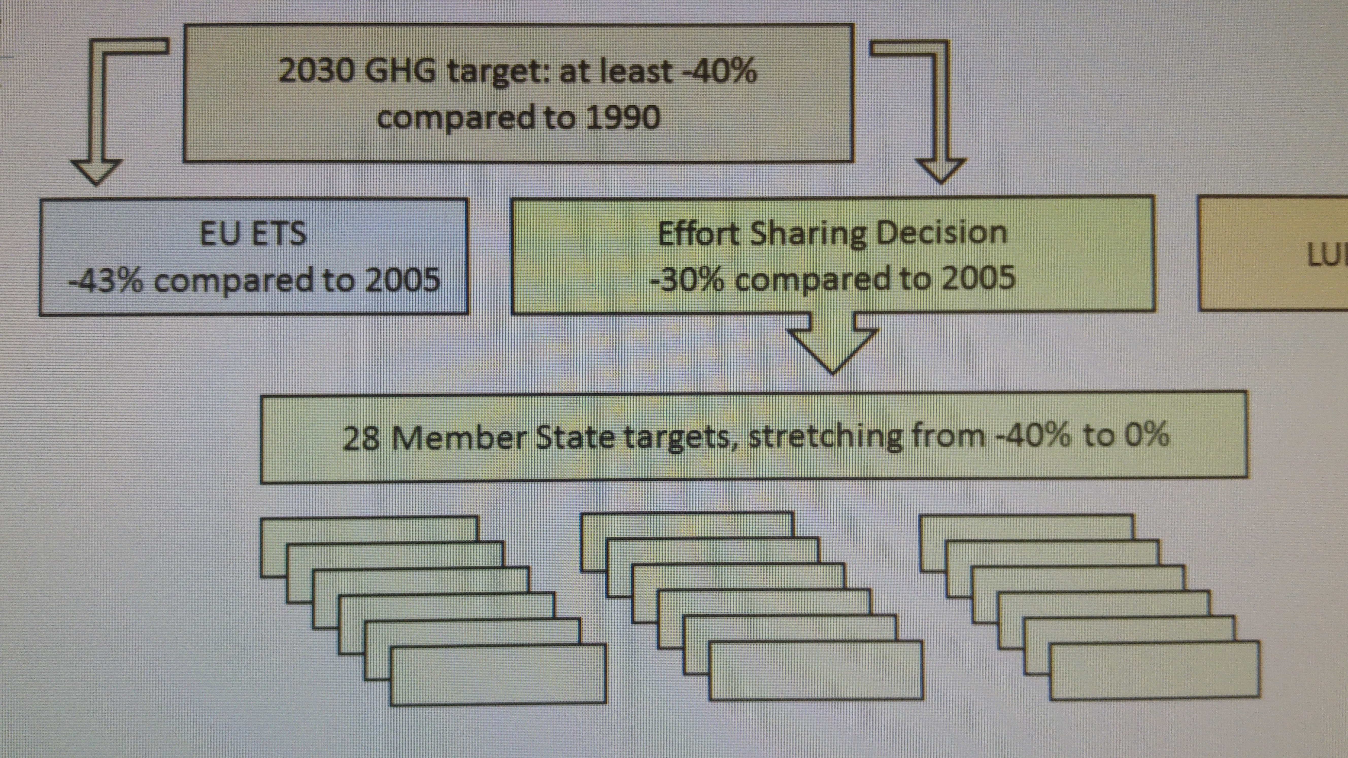
2030 Climate and Energy Framework

Slide 27
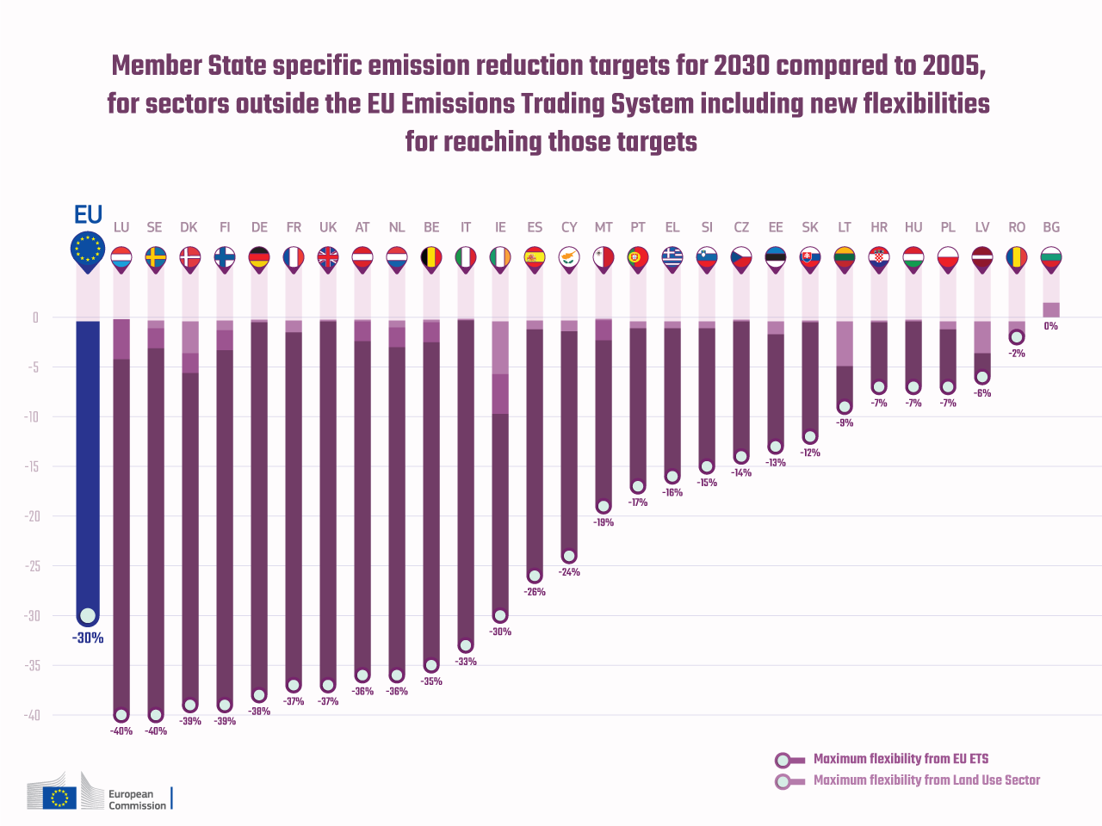

Slide 28
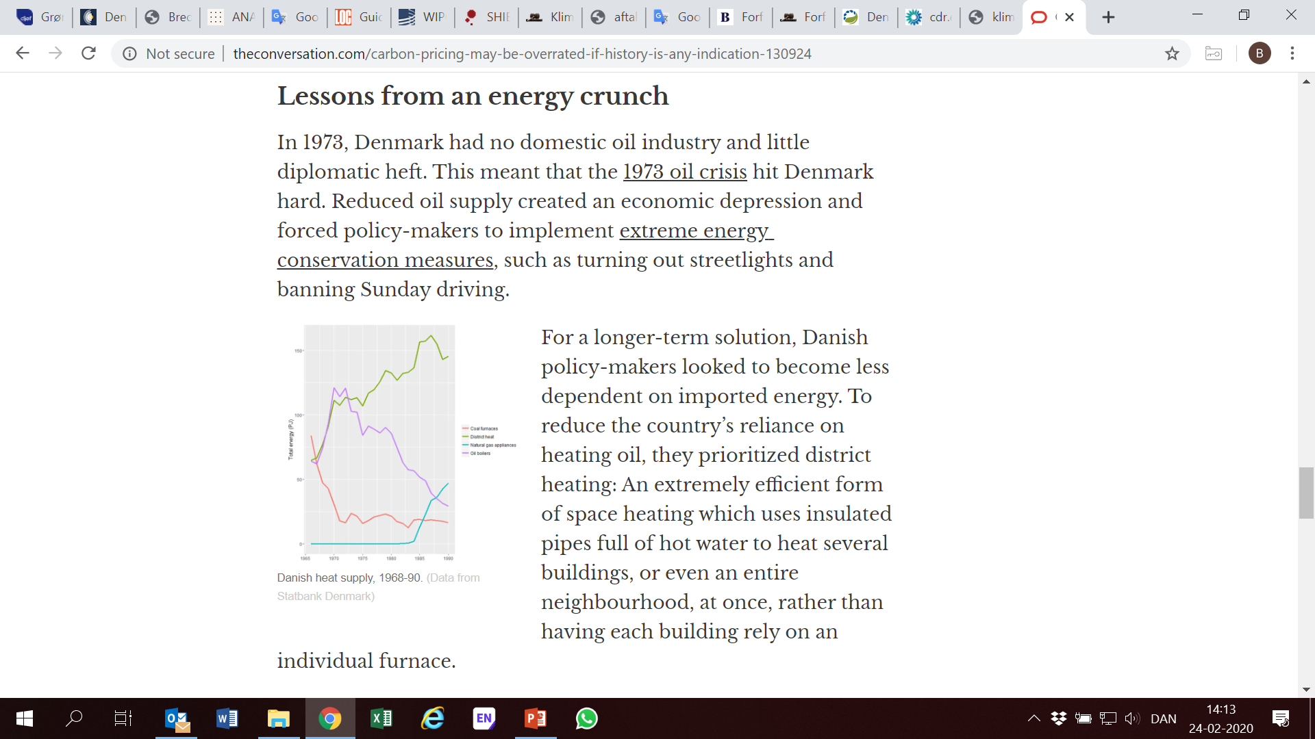
3. Danish Climate Law and Policy: targets and obligations
Carbon pricing may be overrated, if history is any indication. The Conversation. Cameron Roberts

Slide 29
Denmark Energy Law and Policy
Since the energy crisis of the 1970s, Denmark has pioneered the promotion of renewables particularly wind power and generation from biomass and waste.
In the 1970’s - the oil crisis changed the scene from a largely market-driven model to a policy-driven system, where planning and regulation were at the heart of the strategy to secure electrical energy supply, and to reduce dependency on fossil fuels.
In the 1980s, efforts grew to explore renewable energy sources of generating electrical energy.
Wind turbines was already well established in Denmark, and was popular amongst policymakers.
In 1990, the government introduced “Energy 2000”, designed to reduce energy consumption and CO2 emissions. The main contributor identified to achieve energy saving, enhanced efficiency and a greener energy output were a combination of wind, biomass and natural gas.
Arcas-Leal 2018

Slide 30
3. Danish Climate Law and Policy: targets and obligations
As an EU member State, Denmark has adopted legislation in line with EU directives and beyond:
aimed at mitigation of emissions of GHGs from sources and increasing uptake by sinks:
    2009 - The Forest Act
    2012 - Energy Agreement
    2013 - Danish Climate Policy Plan: Towards a Low Carbon Society
    2014 - Danish Climate Change Act as the legal framework for climate action devoted to mitigation.
    2018 – Renewable Energy Act
    2019 – Climate Act

Slide 31
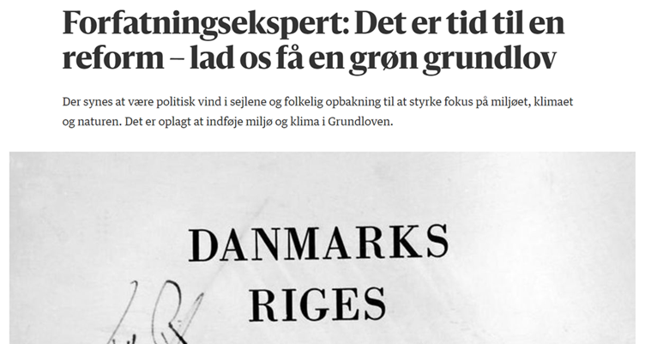
Denmark Energy Law and Policy
2019 – Aftale om Klimalov 6 December 2019
2020 – Lov om Klima - LOV nr 965 af 26/06/2020
Reducing greenhouse gas emissions by 70 per cent in 2030 compared to 1990 level.
In 2025 target will be set for 2035
Climate neutrality by 2050
1.5 C Paris Agreement goal (DK skal arbejde aktivt)
Obliges present and future governments to work towards this goal.

Slide 32
3. Danish Climate Law and Policy: targets and obligations
2019 – Aftale om Klimalov 6 December 2019
2020 – Lov om Klima - LOV nr 965 af 26/06/2020
Reducing greenhouse gas emissions by 70 per cent in 2030 compared to 1990 level.
In 2025 target will be set for 2035
Climate neutrality by 2050
1.5 C Paris Agreement goal (DK skal arbejde aktivt)
Obliges present and future governments to work towards this goal.
”Det står jo altid Folketinget frit for at ophæve loven igen. Det er kun EU-lovgivning, der kan forpligte Danmark i videre udstrækning, fordi EU-regler er ude af Folketingets hænder.” Prof. Peter Pagh

Slide 33
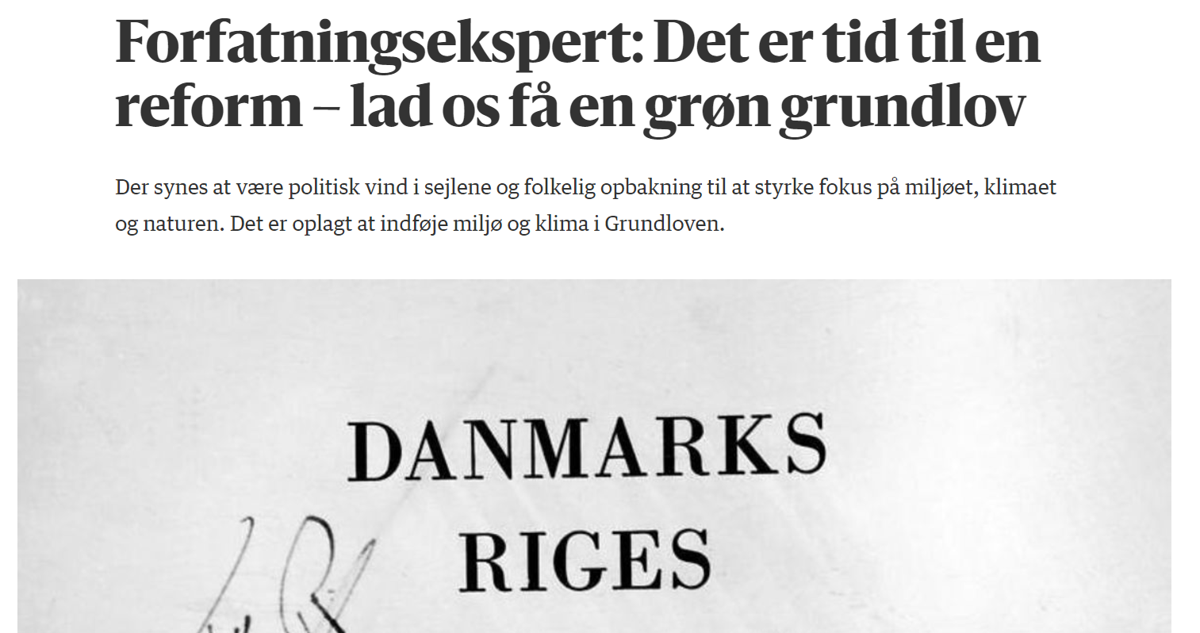
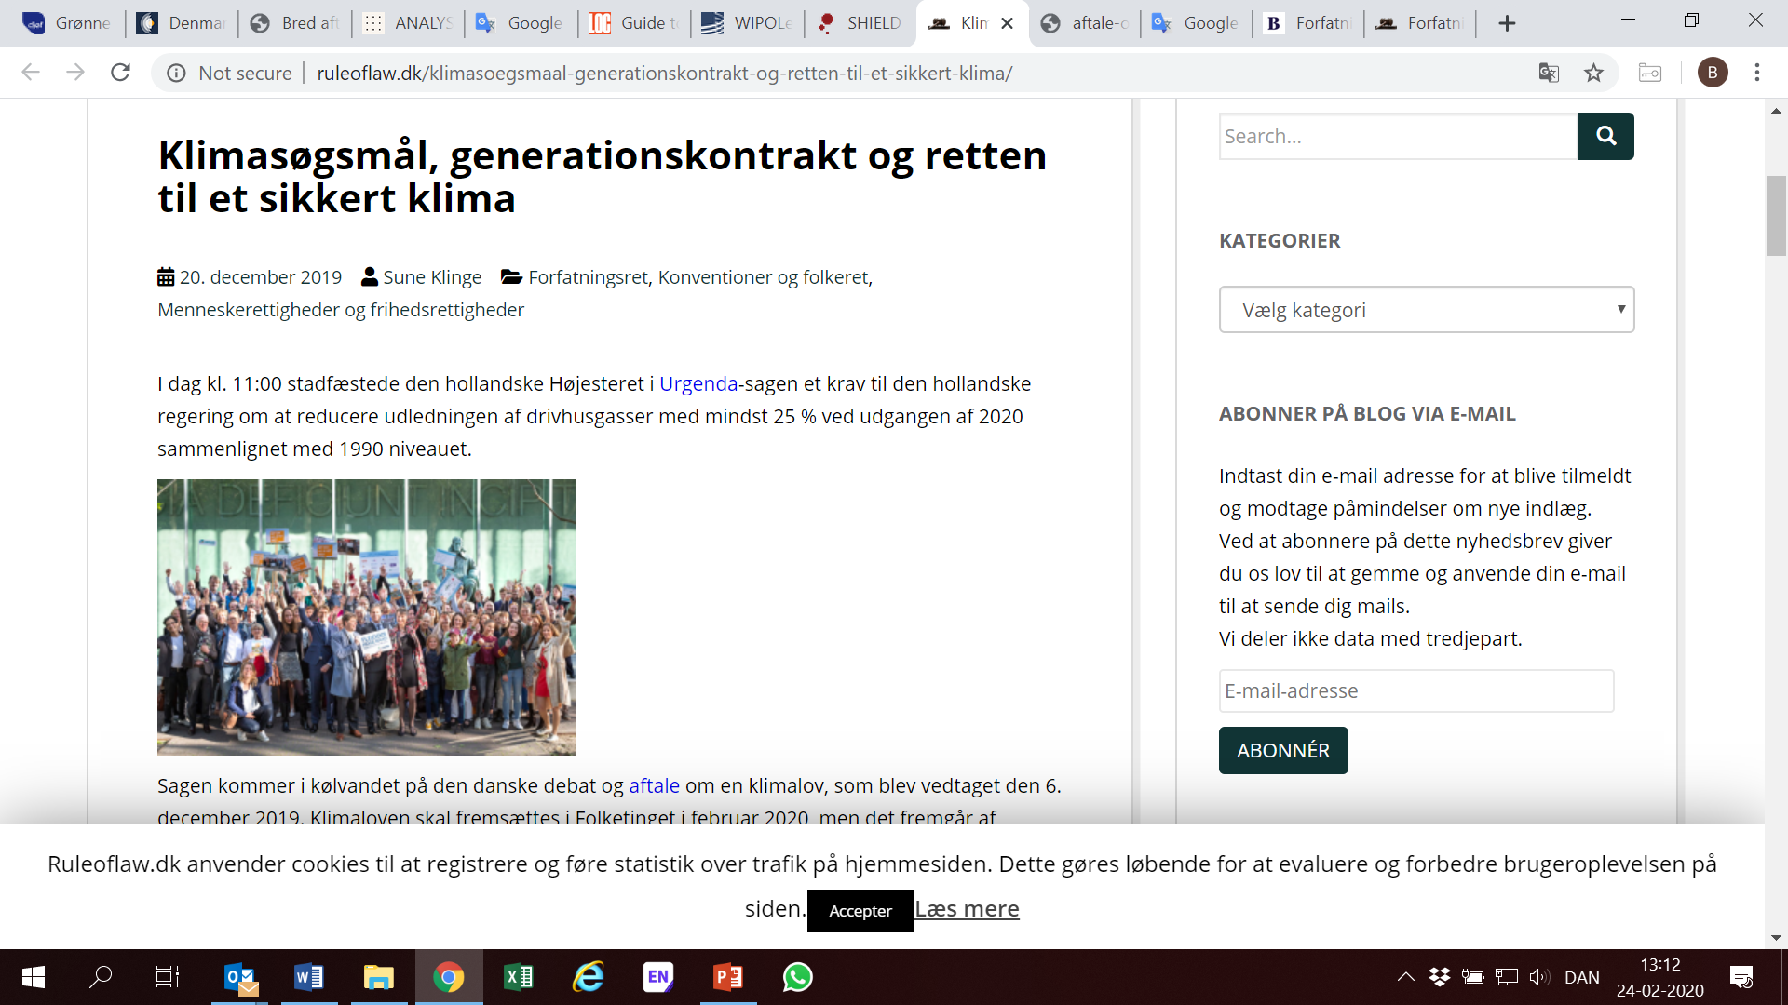
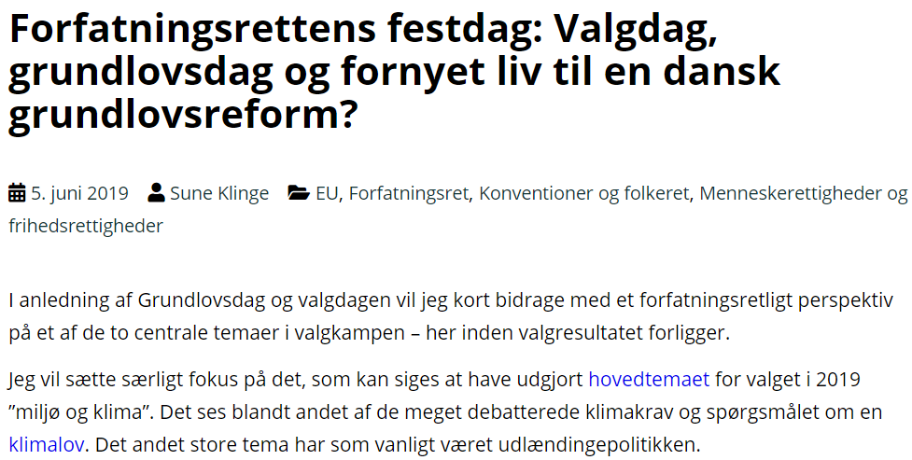
Green Constitutional Reform in Denmark?

Slide 34
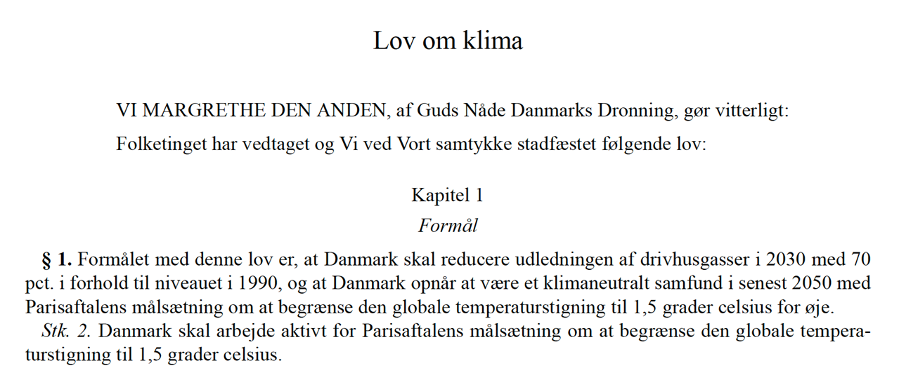
3. Danish Climate Law and Policy: targets and obligations
Principles:
Denmark must be a global leader and has a ”historical and moral responsibility”
Cost-effectiveness with view to green transition
Green transition must coexist with a strong welfare-society
Actual domestic reductions must be achieved (not just international ”transfer” of emissions)

Slide 35
3. Danish Climate Law and Policy: targets and obligations
5 years - the Minister on Climate, Energy and Utilities determines a Goal on Climate with a perspective of 10 years (not be less ambitious than the previous)
Action Plan on Climate with a 10 year perspective

Slide 36
3. Danish Climate Law and Policy: targets and obligations
The Climate Council (independent organ, advisor for the Ministry on Climate, Energy and Utilities)
The Ministry on Climate, Energy and Utilities must make public a yearly Status on Climate
The Ministry on Climate, Energy and Utilities must deliver a yearly Programme on Climate to the parliament containing status and Climate Council’s recommendations
Duty to Act

Slide 37
3. Danish Climate Law and Policy: targets and obligations
Danish Climate Agreement for Energy and Industry 2020:
Focus forthcoming years:
Carbon Capture and Storage
Power to X
Green transport
Energy efficiency
Energy Islands project (5GW production capacity min.)
Public funds for transition of industries
A green tax-reform

Slide 38
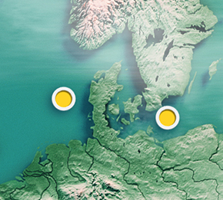
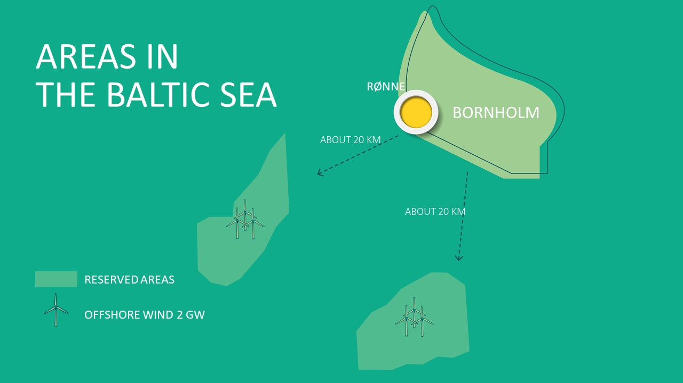
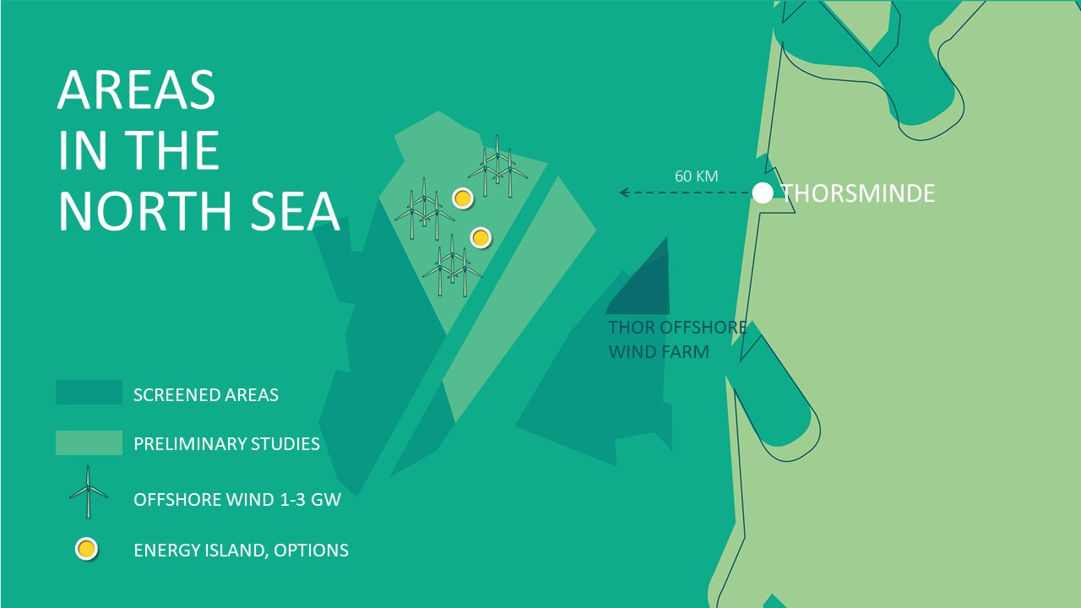
Denmark Energy Law and Policy
Energy Islands
Denmark is establishing the world’s first energy islands to large-scale offshore wind power.
The two energy islands are to be completed in 2030, and will be able to supply 5 GW of power.
Key issues: connectivity, power-to-X
https://en.energinet.dk/Green-Transition/Energy-Islands/Visuals

Slide 39
3. Danish Climate Law and Policy: targets and obligations
Government 2050 target | Phase-out of fossil fuels | Denmark is to be independent of fossil fuels by 2050
Danish climate law | 70% reduction GHG by 2030 Climate neutrality from 2050 | 70% reduction GHG by 2030 Climate neutrality y 2030
EU: 2020 targets | Greenhouse gas emissions from buildings, agriculture and transportation | To be reduced by 20 pct. between 2005 and 2020
 | Fraction of renewable energy in total energy consumption | 30 pct. by 2020
 | Fraction of renewable energy in the transport sector | 10 pct. by 2020
EU: 2030-targets | The total emissions from the EU are to be reduced by 40 pct. between 1990 and 2030. This includes the following targets for the EU as a whole: 43 pct. reductions from large emitters such as power plants and the oil and gas sectors. 30 pct. reductions of emissions from buildings, agriculture and transportation. At least 27 pct. renewable energy in total energy consumption by 2030. At least 27 pct. increase in energy efficiency by 2030. | The emission reduction targets for the EU as a whole are to be implemented as national reduction obligations for buildings, agriculture and transportation. The Danish reduction obligations have not yet been negotiated.
Based on Energistyrelsen website

Slide 40
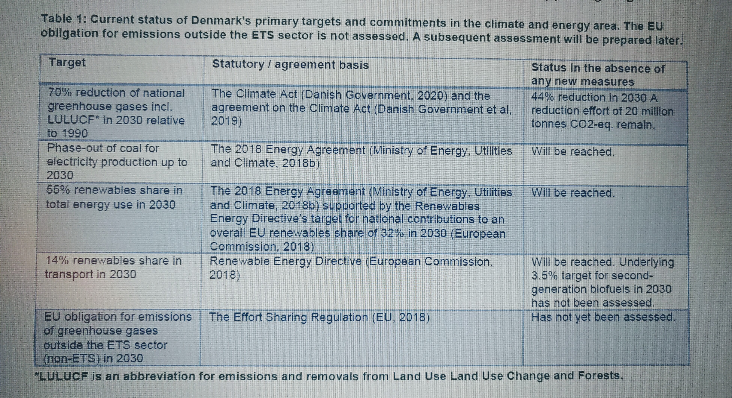
Denmark Energy Law and Policy
Denmark’s Energy and Climate Outlook 2020

Slide 41
The Danish Energy Model: de-coupling economic growth, energy consumption and emissions
Denmark Energy Law and Policy
Index: 1990 = 100
3 reasons:
Energy Efficiency
Renewable Energy
Smart Energy

Slide 42
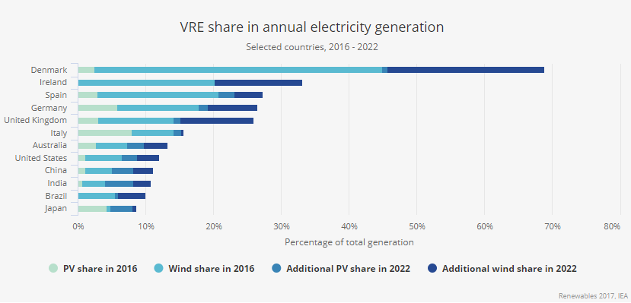
Denmark Energy Law and Policy

Slide 43
Beatriz.Martinez.Romera@jur.ku.dk
Thank you !

