Slide 1
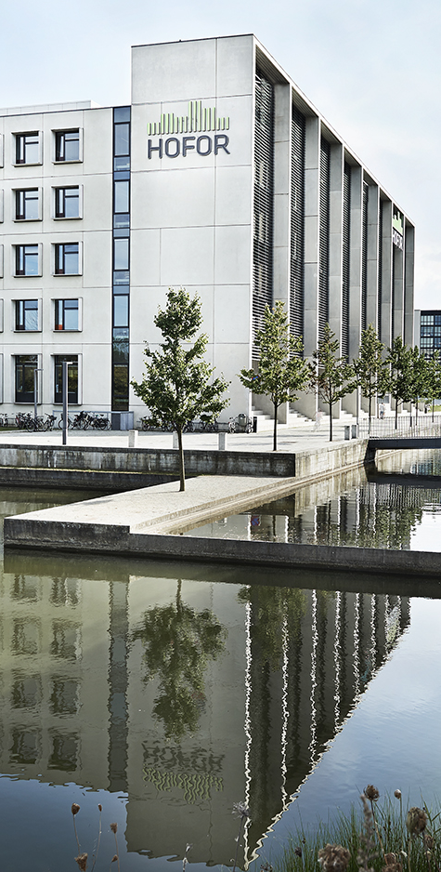
Government delegation from the Ministry of Energy in Colombia
  Site visit at Novozymes on 11 October 2021 – Danish experiences with Offshore Wind and Energy Efficiency
  Example of Energy Efficiency project:
  “Electric driven heat pump to produce cooling and district heating at the same time.”
Thomas Engberg Pedersen (thep@hofor.dk)
Head of heat production and demand
Planning department

Slide 2



The company today
    Denmark's largest utility company within our core areas
    More than 1,300 employees
    Approximately one million customers in Greater Copenhagen
    Approximately EUR 712 million in net turnover
    Approximately EUR 389 million invested annually in pipelines, cables and wind turbines
    Total fixed assets: More than EUR 4 billion

Slide 3

About us in brief
  We are municipally owned
  Our utilities are regulated by law
  Our revenue and expenditure must balance out over time
  We focus on a sustainable supply and renewable energy
  We support community development
Notes:
NOTE: Remember, though, that under the point "Our revenue and expenditure must balance out over time", district cooling as a business area is subject to market conditions!

Slide 4
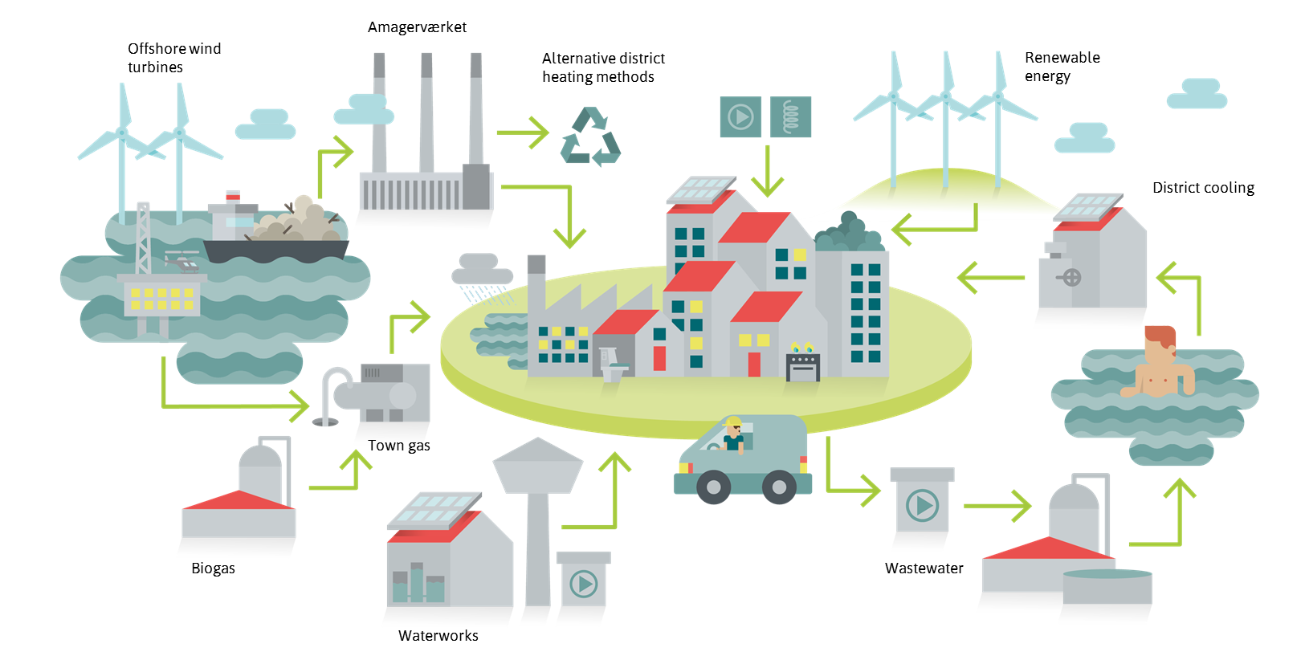
Our utilities

Slide 5
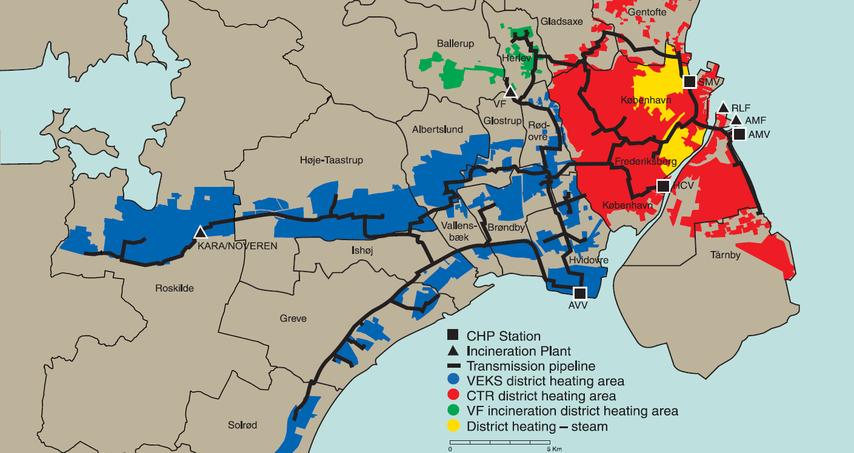
Main characteristics of the Greater Copenhagen DH system
    Large interconnected district heating network:
    One out of six large central DH areas in in Denmark
      Transmission grid with relatively high pressure and temperatures (100-120 °C)
      A number of distribution grids with lower pressure and temperatures
      Heat used for both space heating and hot tap water (annual heat demand: 38,000 TJ – peak load: 3,500 MW

Slide 6
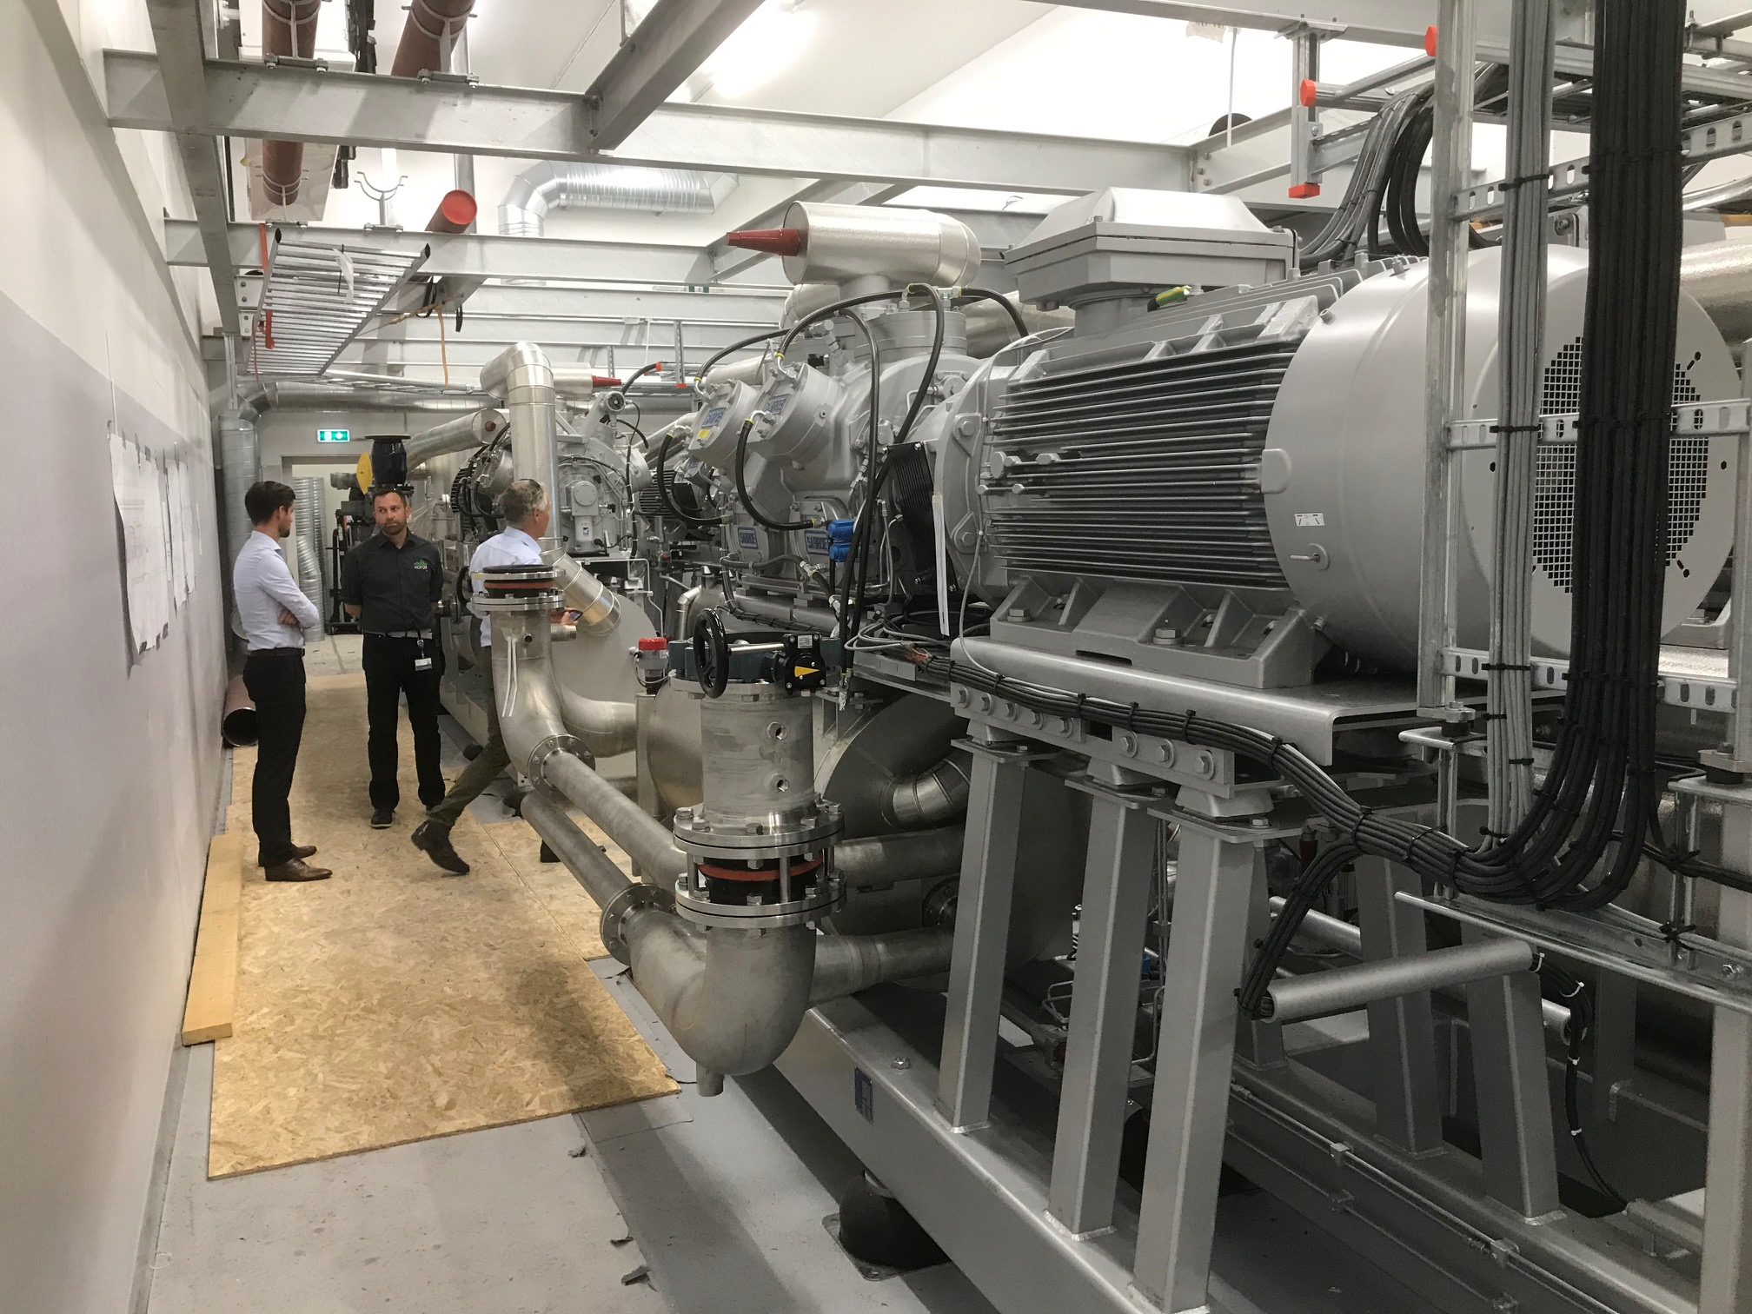
Electric driven heat pump to produce cooling and district heating at the same time
    The heat pump produces 3 MW cooling and 4 MW district heating
    Thereby, excess heat from Novozymes’ cooling process is utilized in the district heating network instead of just being diverted to the surroundings
    The project saves cost – both for HOFOR (the DH system) and for Novozymes
    The project saves CO2
    Thereby, the project also helps HOFOR to achieve its goal of having a competitive and CO2-neutral supply of district heating (supporting also the city of Copenhagen’s goal of being the first CO2-neutral capital in 2025)

