Slide 1
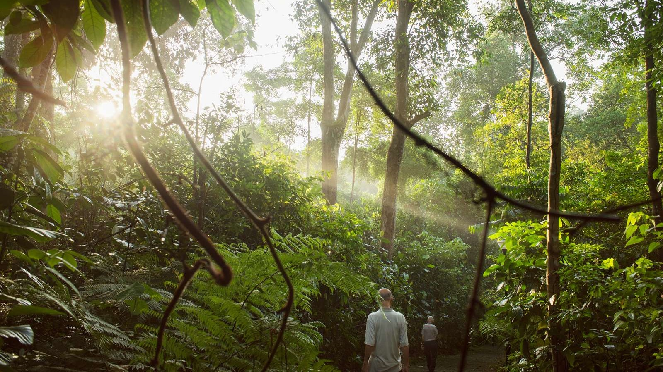


Slide 2
When science goes big scale
Biological solutions for both companies and consumers
Notes:
The building blocks in the Novozymes’ technology come from a natural process - for example, the enzymes that catalyze processes in every living organism. But it takes insight, innovation, experience and capacity to be able to apply the enzymes in an industrial setting.
Novozymes has years of experience in finding and further developing enzymes and microorganisms.
When the basic product is developed, one string of enzymes needs to become trillions in order to create an efficient solution for our customers. Like one single grain of sand that needs to become a truckload. This demands extensive capacity for fermenting the enzymes and this is something that Novozymes excels at – we can create large, stable, high-quality solutions for industrial purposes.
And we deliver on specification, on time, all over the world.
The foundation for this is a global organization with production facilities spread over four continents.

Slide 3
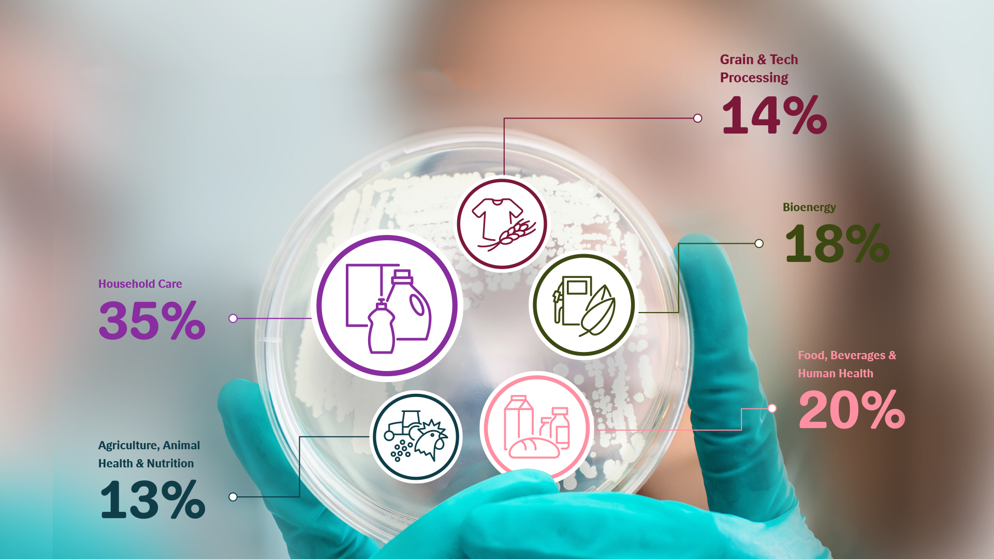
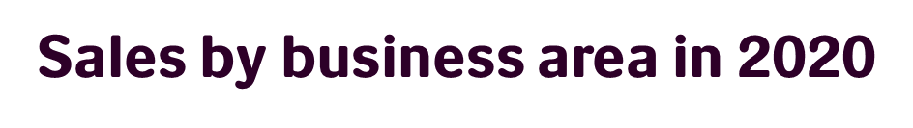

Notes:
Sales by business area in 2020

Slide 4
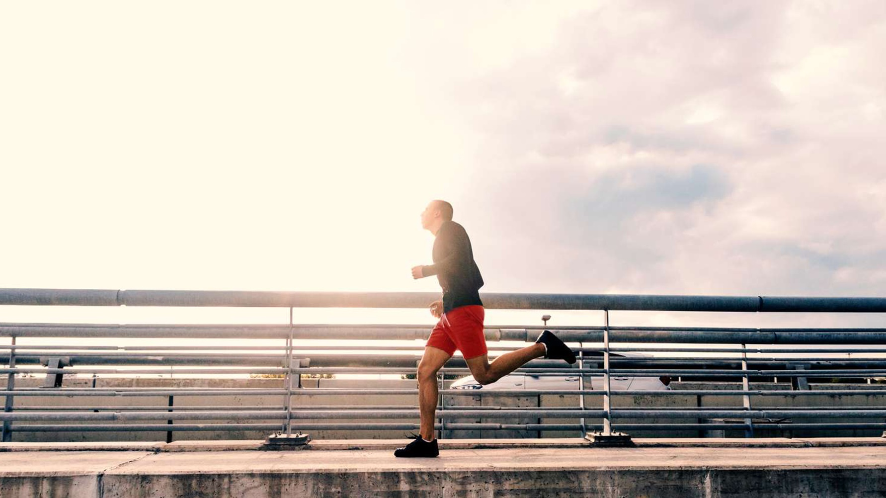

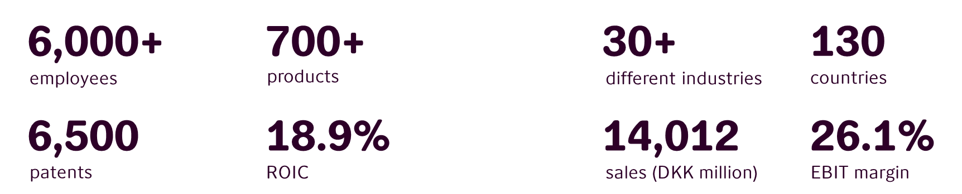

6,000+
700+
30+
130
employees
products
different industries
countries
6,500
18.9%
14,012
26.1%
patents
ROIC
sales (DKK million)
EBIT margin
,
Notes:
Novozymes in numbers

Slide 5
Novozymes production sites
Our biological answers, near you
Bagsværd, Denmark
Headquarters
R&D
Pilot plant
Kalundborg, Denmark
Enzyme production
Pilot plant
Fuglebakken, Denmark
Enzyme Production
Lyngby, Denmark
R&D
Milwaukee, Wisconsin
BioAg production
Cork, Ireland
R&D office
Saskatoon, Canada
BioAg production
R&D
Berlin, Germany
R&D
Moscow, Russia
Seoul, Korea
R&D office
Ottawa, Canada
Enzyme production
Dittingen, Switzerland
Blair, Nebraska
Enzyme production
Istanbul, Turkey
R&D office
Tokyo, Japan
R&D
Fayetteville, Arkansas
R&D
Raleigh, North Carolina
Enzyme production
R&D
Salem, Virginia
Microorganisms production
MicroAg R&D
Le Peq, France
- R&D office
Beijing, China
R&D
Karachi, Pakistan
Tianjin, China
Enzyme production
Davis, California
R&D
Houston, Texas
BioAg production
Patalganga, India
Enzyme production
Bangkok, Thailand
R&D office
Hongda, China
Enzyme production
Shenyang, China
Microorganisms
production
Bangalore, India
Enzyme production
R&D office
Mexico City, Mexico
Curitiba, Brazil
BioAg production
Enzyme production
R&D office
Kuala Lumpur, Malaysia
R&D office
Pilar, Argentina
BioAG production
R&D office
Sydney, Australia
20 R&D sites (10 labs, 10 offices)
16 Production sites
Johannesburg, South Africa
Notes:
This map is illustrative and does not contain every location. You are free to add a location on the map that isn’t shown.

Slide 6
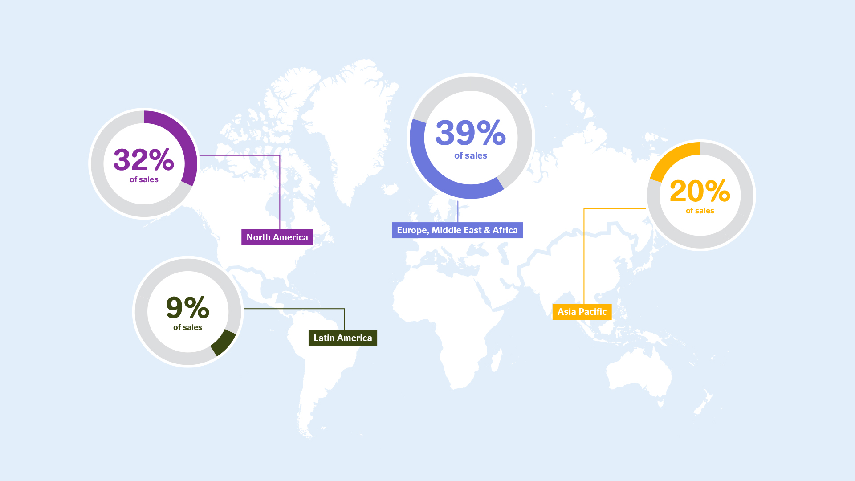
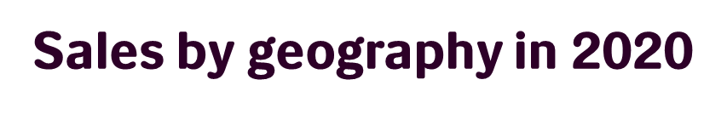
Notes:
Sales by geography in 2020

Slide 7
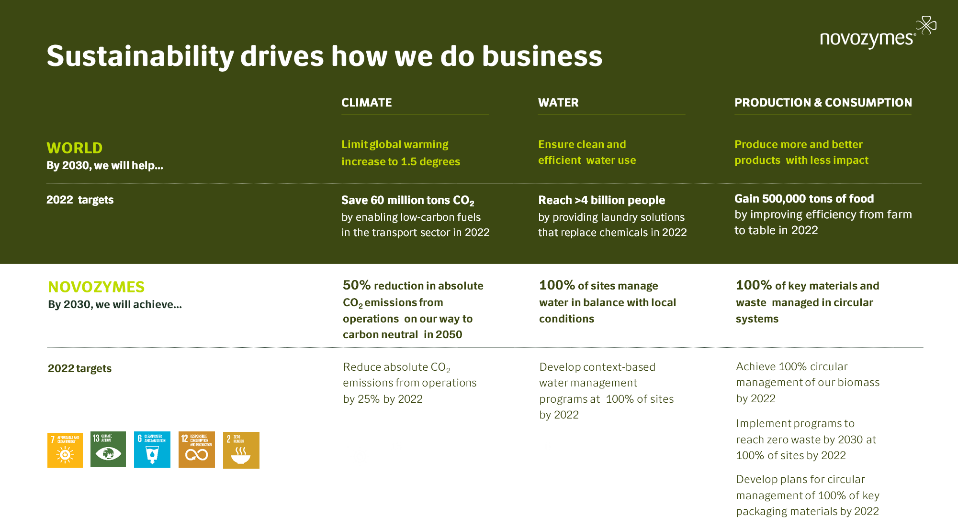
Sustainability drives how we do business
Notes:
The UN Sustainable Development goals are also Novozymes goals
Novozymes 2030 commitments, and our 2022 targets, are guided by the UN’s Sustainable Development Goals – this helps us stay on course for a better world and helps us live our purpose
We hold ourselves accountable inside Novozymes for the impact that we are trying to create in the world on climate, water and production & consumption
Novozymes
Climate: In 2018, the IPCC released a report that the world needs to limit global warming to 1.5°C above pre-industrial levels to avoid catastrophic, irreversible effects of climate change. To meet this, the world must reduce emissions at a pace called the 1.5° pathway or science-based pathway. Novozymes is committed to playing its part in implementing the Paris Agreement and following a 1.5° reduction pathway. By 2030, we will achieve a 50% reduction in absolute CO2 emissions from our own operations on our way to becoming carbon neutral by 2050. By 2022, we will reduce absolute CO2 emissions from our own operations by 25%
Water: Novozymes operates in several regions worldwide where the water supply and demand conditions are very different. We are committed to pioneering a context-based approach to water management, which includes building a thorough understanding of the local water conditions. By 2030, we will ensure that we fully understand local conditions and manage our water use in balance with that, at all our sites. This includes understanding the needs of other users in our watershed as well as the future availability of water in the water basin based on science. By 2022, we will have context-based water management programs at all of our sites
Production & Consumption: Novozymes aims to drive our business towards more circularity. This means that we choose material and design processes to minimize waste and maximize reuse and recycling. By 2030, all of our key materials and waste will be managed in circular systems. By 2022, all of our biomass will be managed in circular systems. We will also be engaging with key customers to develop plans for circular management of key packaging materials
If not covered earlier in the presentation:
Novozymes is committed to helping solve three global challenges: Climate, Water and sustainable Production & Consumption, and to helping people, inside and outside the company, learn and thrive.
For each of the global challenge areas, we have defined 2020-22 targets where we can make the greatest difference with our biological solutions and reliably measure our progress. We commit to grow the positive impacts from our commercial solutions and to reduce the negative impact from our operations
These replace current non-financial targets
Climate: To avoid severe consequences from climate change, the world needs to limit global warming increase to 1.5°C. Novozymes is committed to playing its part by 2030 and thereby help realize the Paris Agreement. Our solutions have a big impact, especially within transportation. Transportation accounts for about 25% of total energy-related global CO2 emissions. To realize the Paris Agreement, the transport sector will need a range of solutions, including low-carbon fuels. In 2022, we will help the transport sector save 60 million tons of CO2 emissions by enabling the production of bio-based, low-carbon fuels
Water: Over 2 billion people live in countries experiencing high water stress (UN, 2018), caused by water scarcity or pollution, affecting the quality of existing water resources. There is a growing need for solutions to ensure clean and efficient water use. Novozymes provides solutions which can prevent pollution by replacing chemicals, and enable better treatment of water. In 2022, we aim to reach more than 4 billion people with our laundry solutions that replace chemicals and thereby help protect water resources
Production & Consumption: Roughly one-third of the food produced in the world for human consumption every year (~1.3 billion tons) gets lost or wasted. (FAO 2018). Our solutions enable more efficient food processing and reduce losses across the food value chain. In 2022, we will enable the production of 500,000 tons of additional food

Slide 8
Novozymes Fuglebakken
Energy
LAJH/LTBC
11.10.2021

Slide 9
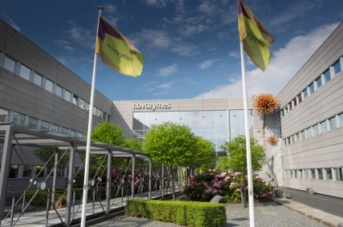
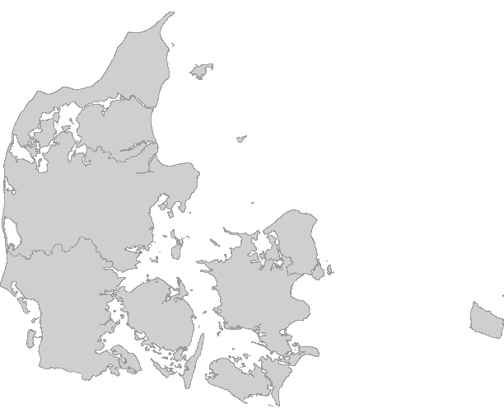
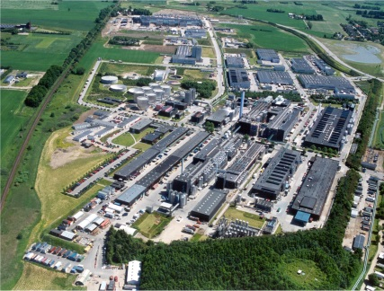

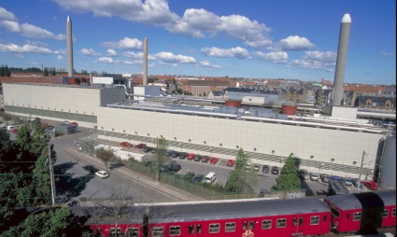
Novozymes Denmark
3 sites in Denmark
2.500+ employees
Bagsværd
Novozymes headquarter
Established in 1965
Kalundborg
The world's largest and most high-tech enzyme plant
Established in 1969
600+ employés
Fuglebakken
Novozymes first enzyme site
Established in the 1930’s

Slide 10
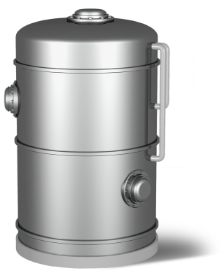
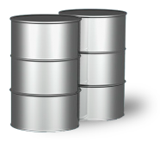
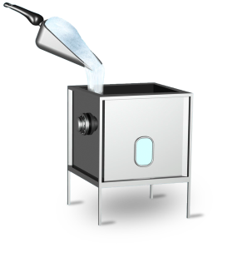
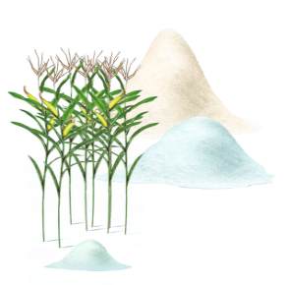
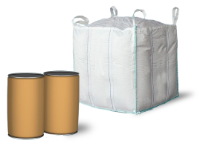
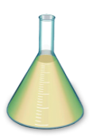
Enzymes- Production overview
FERMENTATION
READY TO SELL PRODUCTS
FORMULATION
RAW MATERIALS
LIQUID PRODUCT
PURIFICATION
GRANULATED PRODUCT
MICRO-ORGANISMS
Treatment of Biomass
Fertilizer

